Slide 1
Alabama Department of Revenue
Wholesale Retail Accountability Program
(WRAP)

Slide 2
What is WRAP?
The purpose of the Wholesale Retail Accountability Program is to ensure sales tax collected by retailers is submitted to the state of Alabama to finance the services provided to Alabamians.
To ensure a level playing field for all businesses, the Department of Revenue is constantly monitoring and auditing sales tax collected and remitted.

Slide 3
Why Wholesale Retail Accountability Program?
Act 2017-294 established the Wholesale Retail Accountability Program, requires new information be provided to the Alabama Department of Revenue in five areas:
April 30, 2018 - 1099K information
July 1, 2018 - distributors of beer and wine – report sales
July 1, 2018 – sellers of tobacco products – report sales
October 1, 2019 – municipal business privilege license applications
Make reports available to local governments
An Industry advisory group was created to implement the legislative action and provide guidance to the Department of Revenue.
The group was made up of representatives from industry and local government who all worked together to ensure all concerns were discussed and considered.

Slide 4
1099K information
Requires payment settlement entities, third-party settlement organizations, electronic payment facilitators, and third parties acting on behalf of payment settlement entities to file duplicate federal form 1099-K information returns with the Alabama Department of Revenue.
1099-K information returns are due within 30 days of the filing due date required by the IRS. The 2017 1099-K information returns will be due on or before April 30, 2018.

Slide 5
Distributors of Beer and Wine
Requires each licensed beer or wine distributor (seller) to file an informational monthly report of any beer or wine sales made to retail licensees for which an exemption from sales or use tax collection was claimed at the time of the sale.
A “seller” is a manufacturer, wholesaler, or distributor of beer, or wine who sells to a retailer (licensee) in this state.
The term also includes a wholesale club or warehouse club that under a membership.
The first informational monthly report will cover sales occurring on or after July 1, 2018 through July 31, 2018 and is due on or before August 20, 2018.
For each month after, the informational report will be due on or before the 20th day of the month next succeeding the month in which sales occur.

Slide 6
WRAP Reporting Format requirements (beer and wine):
The WRAP reporting format requirements for the sales of any beer or wine are shown below :
(1) Invoice date
(2) Invoice number
(3) Retailer’s (licensee’s) ABC Board beverage license number
(4) Retailer’s (licensee’s) sales tax account number (optional)
(5) Retailer’s (licensee’s) name
(6) Retailer’s (licensee’s) street address
(7) Retailer’s (licensee’s) city
(8) Retailer’s (licensee’s) state
(9) Retailer’s (licensee’s) zip code
(10) Total invoice dollar amount.

Slide 7
WRAP Reporting Due dates (beer and wine):
The monthly informational report is in addition to the sales tax return and is not in place of the sales tax return.
The sales tax return continues to be required to be filed each month.
If you are a quarterly or annual filer, or have been issued an Exemption Certificate, your sales tax return filing status will change to monthly beginning with the July 1, 2018 tax period due on or before August 20, 2018.
You will report all sales each month and deduct your wholesale and exempt sales to arrive at taxable sales.
You must file even if you have zero taxable sales.

Slide 8
Sellers of tobacco products
Since October 1, 2014 an informational report of tobacco sales for resale report has been required.
Act 2017-294 now requires additional information, such as:
Customer sales tax account number
Quantity sold
Product Type
Total sales price
Itemized county tobacco tax paid
Itemized city tobacco tax paid

Slide 9
Sellers of tobacco products
Requires sellers of tobacco products to report their sales for resale monthly.
A “Seller” includes all wholesalers, jobbers, semi-jobbers, retailers, importers and any other person selling, receiving, or distributing tobacco products for resale.
The new informational monthly report will cover sales occurring on or after July 1, 2018 through July 31, 2018 and is due on or before August 20, 2018.
For each month after, the informational report will be due on or before the 20th day of the month next succeeding the month in which sales occur.

Slide 10
WRAP Reporting Format requirements (tobacco Products):
The WRAP reporting format requirements for the sales of any tobacco products are shown below :
invoice date
invoice number
customer’s full name
customer’s address
customer’s city
customer’s state
customer’s zip
customer’s sales tax number
description of tobacco products
Product type
Cigarettes, cigars, little cigars, filtered cigars, smoking tobacco, cigar wrappers, chewing tobacco, or snuff
quantity sold
Total sales price
The itemized Alabama state tobacco tax paid
The itemized County tobacco tax paid
The itemized City tobacco tax paid.
* Items in bold are additional requirements

Slide 11
Municipal Business Privilege Licenses
Beginning October 1, 2019, information on municipal business privilege license applications is to be submitted to the Department of Revenue electronically.
Currently the counties are transmitting this information electronically.

Slide 12
how has the department prepared for this information?
The MyAlabamaTaxes filing system has been upgraded to include a separate return for the monthly informational report
WRAP training will be conducted for all Revenue Examiner’s (Field Auditors)
ABC Licenses and Alabama Sales Tax Account numbers have been cross referenced

Slide 13
how has the department prepared for this information? (con’t)
Vendor information and Alabama Sales Tax Account numbers have been worked and cross referenced
In addition to training for Field agents, a special WRAP unit has been created
Consisting of a Manager, three Revenue Examiners and two Accounting Technicians

Slide 14
How will the department use this information?
Once received, a comparison of the monthly reported purchases and monthly reported sales will be made.
Those underreporting will be either be sent an inquiry letter or referred to the field.
Those referred to the field will be sent to both Sales Tax for audit and Tobacco Tax for inspection.
The ultimate end goal is to correct taxpayer behavior

Slide 15
How can I get more information on wrap?
Additional information can be found by following the link below: (please note this information will be updated periodically)
https://revenue.alabama.gov/sales-use/wrap/
You can also email questions to:
wrap@revenue.alabama.gov

Slide 16
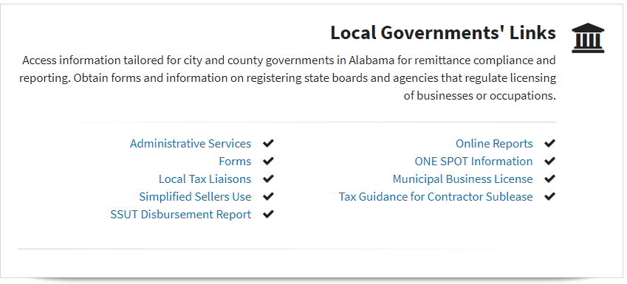
As a local official, how can I access wholesaler data?
Using the Local Governments’ link on the ADOR’s website:
Log in
Click on “online reports”
Click on “WRAP Reports”
WRAP Beer and Wine Sales Resale Report
WRAP Tobacco Sales for Resale Report

Slide 17
How will you, the local governments, use this information?

Slide 18
Contact: Randy Winkler Director Sales & Use Tax division Alabama Department of Revenue 334-242-1575 Randall.winkler@revenue.alabama.gov

