Slide 1
Budget Preparation 101
or “How I Make September 30th a Happy Birthday”
David Smyth, Crenshaw County Administrator

Slide 2
Four Simple Points

Slide 3
Code of Alabama, Section 11-8-3 Letter

Slide 4
Additional budget preparation letter

Slide 5
Departmental Budget Worksheet

Slide 6
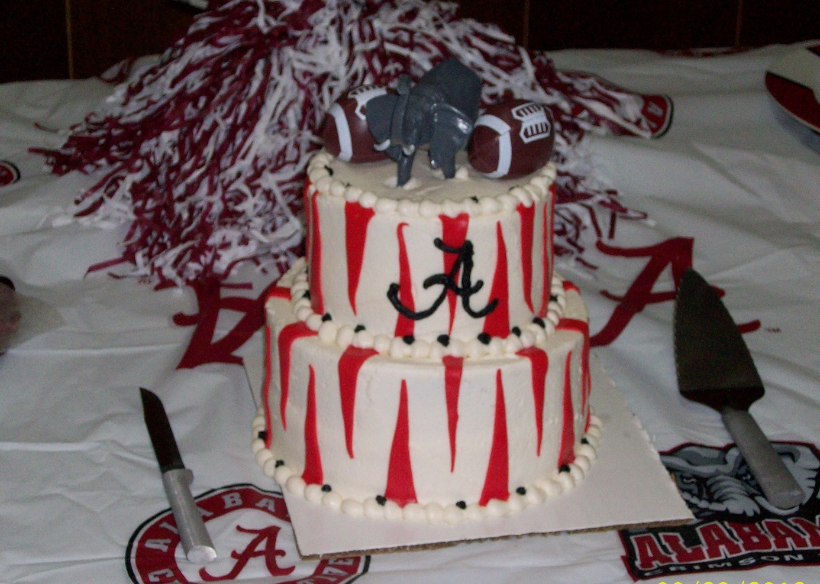
Happy Birthday to Us!

