Slide 1
Cybersecurity:
Why Should I worry?

Slide 2
What is Cybersecurity?
According to the Gartner Group:
"Cybersecurity encompasses a broad range of practices, tools and concepts related closely to those of information and operational technology security. Cybersecurity is distinctive in its inclusion of the offensive use of information technology to attack adversaries."

Slide 3
In a nutshell, this is cyber: security, attacks, threats……
Hitting Your Network looking for Vulnerabilities

Slide 4
The ACCA has developed a form to assist county’s in surmising it’s; IT infrastructure, policies & procedures, and awareness involving cyber security.

Slide 5
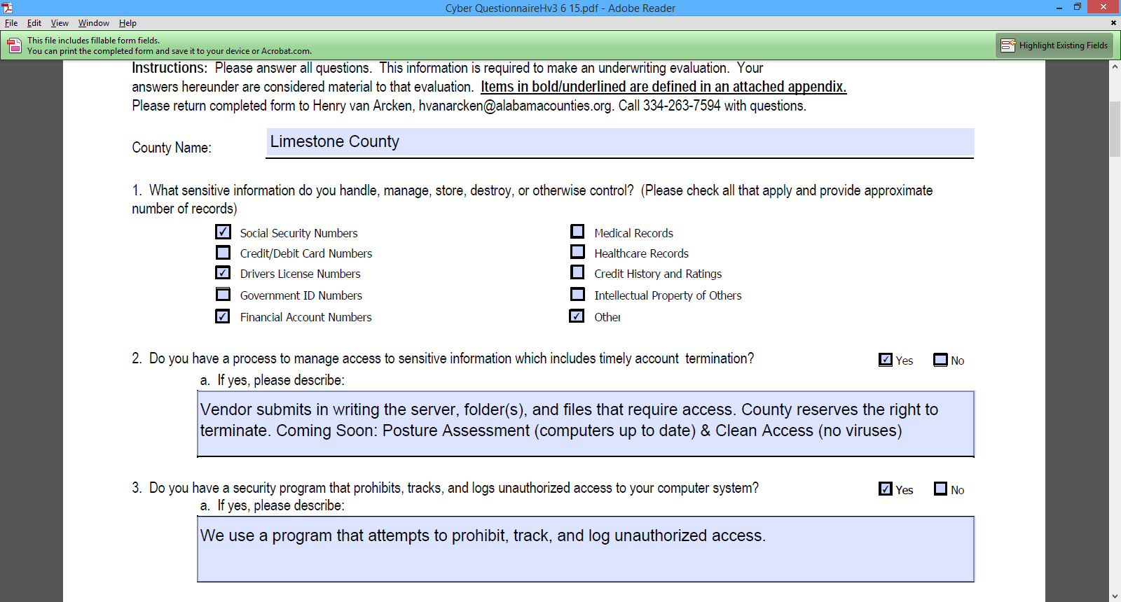

Slide 6
Question 1 – Sensitive/Private Information - Required for use internally, but not to be made public.
Question 2 – Have a Policy whereby any 3rd Party users of network resources must provide in writing who, what, when, where, and how they will use the network resource(s).
TERMINATE the connection if they break the rules.
Question 3 – Something that will watch and track network usage. For example: SolarWinds (we use), ManageEngine, SpiceWorks

Slide 8
What is IPS and IDS?
Attempts to prevent, detect, monitor, and stop intruders on the network.

Slide 9
Prospecting Your Network for Valuables

Slide 10
Question 4
The main function of an IDS (Intrusion Detection System) product is to warn you of suspicious activity taking place − not prevent them. An IDS essentially reviews your network traffic and data and will identify probes, attacks, exploits and other vulnerabilities. An IDS is not a replacement for either a firewall or a good antivirus program.
IPS (Intrusion prevention system) is definitely the next level of security technology with its capability to provide security at all system levels from the operating system kernel to network data packets. Where IDS only informs of a potential attack, an IPS makes attempts to stop it. Another huge leap over IDS, is that IPS has the capability of being able to prevent known intrusion signatures, but also some unknown attacks due to its database of generic attack behaviors.
IDS and IPS vendors: Dell Sonicwall, Cisco, Fortinet, Juniper

Slide 12
Question 7
Patch management is an area of systems management that involves acquiring, testing, and installing multiple patches (code changes) to an administered computer system.

Slide 13
Why is it important to ensure that software patches, both for operating systems as well as software application programs, are deployed?
Patches are released to address one or more of the following issues:
Compromised security – the software vendor has released a patch to counter the threat of a virus or other form of malware that has been created to breach an area of the operating system or application that has been found to be exposed or vulnerable.

Slide 14
Compromised security – the software vendor has released a patch to counter the threat of a virus or other form of malware that has been created to breach an area of the operating system or application that has been found to be exposed or vulnerable.
A fix for a software bug – the patch has been released to repair functionality that is not working as designed (and is either causing frustration, has caused an application or system to cease working properly or results in incorrect output).
A version update which adds enhanced functionality or a better user experience.
One of the top 3 most critical needs for network devices to battle cyber attacks. And most of the time this is FREE…..

Slide 15
Question 8 – Some inexpensive software tools or methods to help prevent an infection or attack from the inside, or to help prevent private information from being removed.
Tools – Symantec Security, Trend Micro Security, to name a few. Purchase at Staples for approximately $89.00 per computer.
Methods – keep database passwords as complex as possible, do not give out passwords to others, and logoff when you leave your computer.

Slide 16
Question 9
The Policies & Procedures need to cover various aspects of subjects including, but not limited to: network usage, computer usage, email usage, internet usage, and 3rd Party usage.
It is not only important to have the policies & procedures written, but to have them in place and enforced.
Example of a website that contains Policies & Procedures available to download.
https://msisac.cisecurity.org/resources/local-cyber-policies.cfm

Slide 17
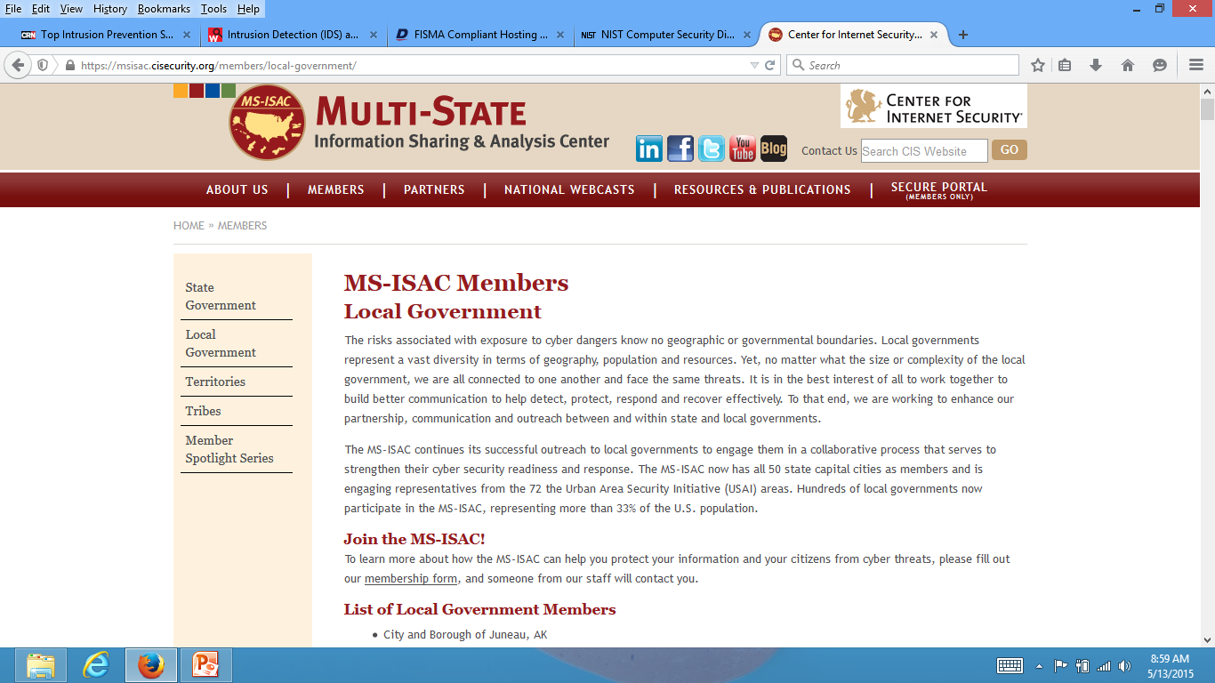

Slide 18
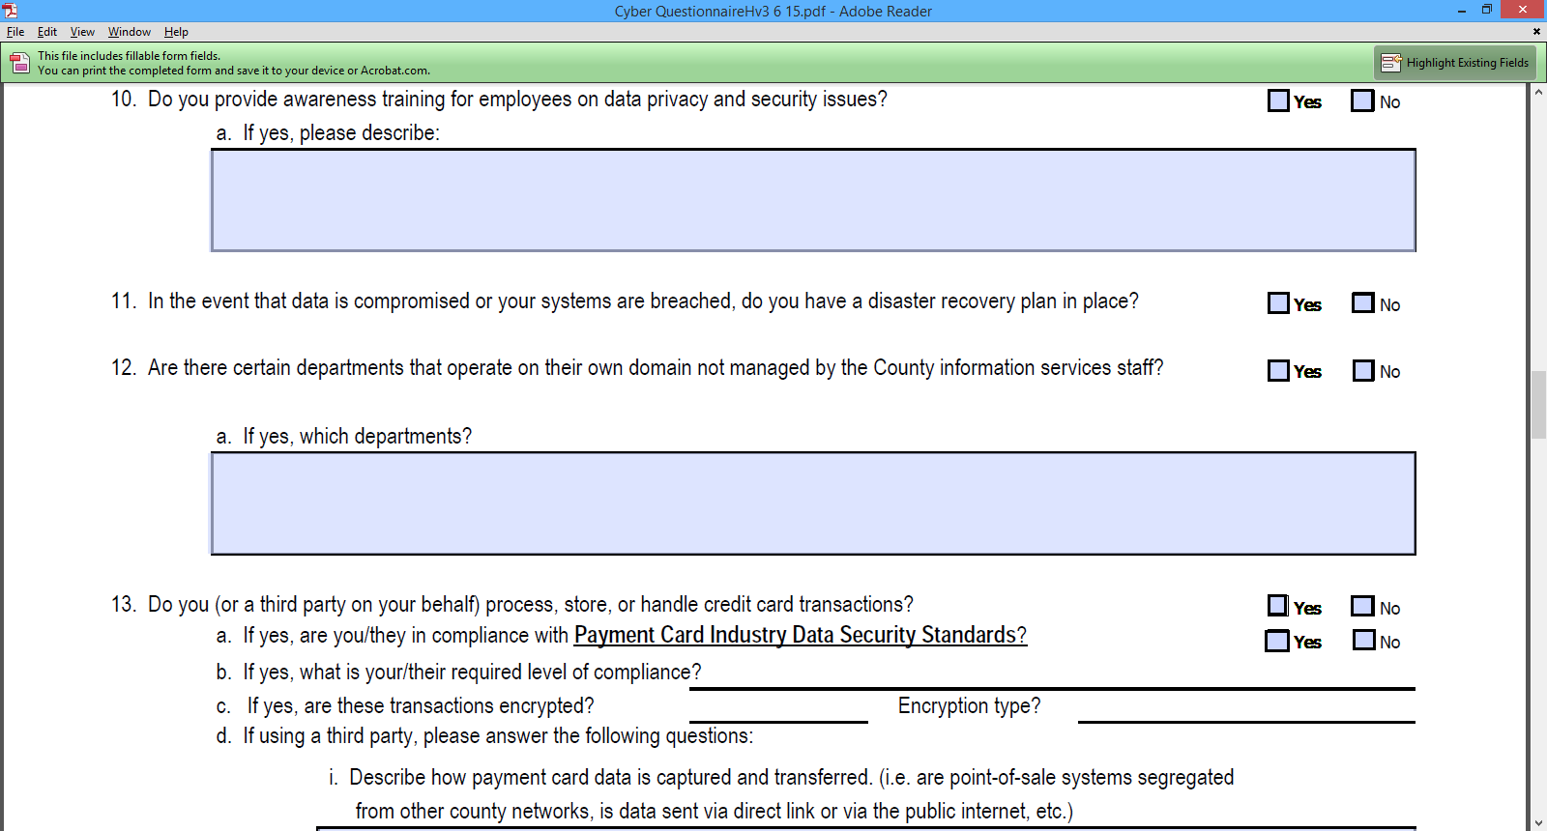

Slide 19
Question 10
Do you provide Awareness training to your employees?
Keeping a clean machine: Your County should have clear rules for what employees can install and keep on their work computers. Make sure they understand and abide by these rules. Unknown outside programs can open security vulnerabilities in your network.
Following good password practices: Making passwords long and strong, with a mix of uppercase and lowercase letters, numbers and symbols, along with changing them routinely and keeping them private are the easiest and most effective steps your employees can take to protect your data.
When in doubt, throw it out: Employees should know not to open suspicious links in email, tweets, posts, online ads, messages or attachments – even if they know the source. Employees should also be instructed about your company's spam filters and how to use them to prevent unwanted, harmful email.
Backing up their work: Whether you set your employees' computers to backup automatically or ask that they do it themselves, employees should be instructed on their role in protecting their work.
Staying watchful and speaking up: Your employees should be encouraged to keep an eye out and say something if they notice strange happenings on their computer.

Slide 21
Question 11
Disaster recovery is the area of security planning that deals with protecting an organization from the effects of significant negative events. Significant negative events, in this context, can include anything that puts an organization’s operations at risk: crippling cyber attacks and equipment failures (busted water pipes), for example, as well as hurricanes, earthquakes, and other natural disasters.
A Disaster Recovery Plan is essential for Continuity of Operations

Slide 23
Question 13
The PCI Security Standards Council is an open global forum, launched in 2006, that is responsible for the development, management, education, and awareness of the PCI Security Standards, including the Data Security Standard (PCI DSS), Payment Application Data Security Standard (PA-DSS), and PIN Transaction Security (PTS) requirements.
https://www.pcisecuritystandards.org/

Slide 24
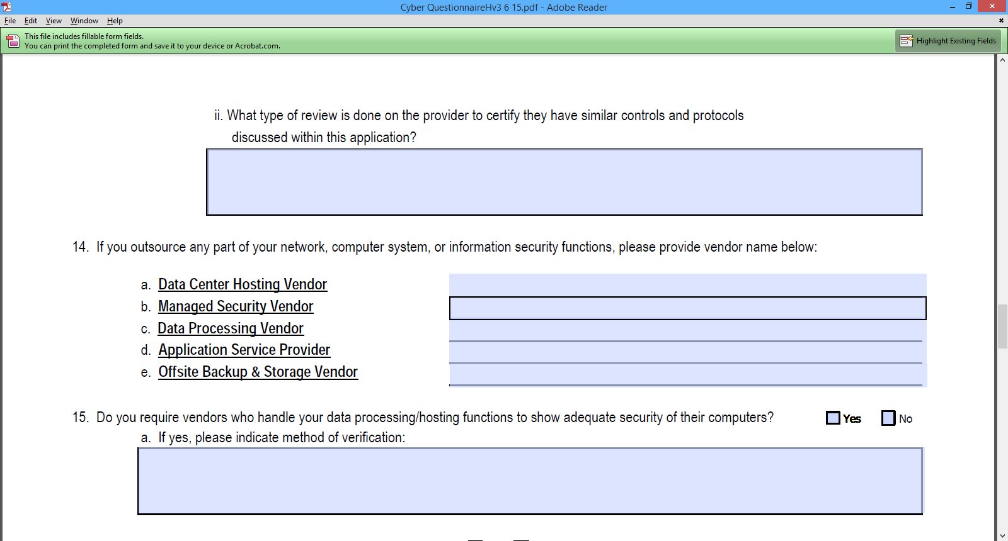

Slide 25
Questions: 14 & 15
Compliance standards for vendors that handle off-site data storage and retrieval.
SAS 70 audits are important to service organizations such as hosted data centers, insurance claims processors and credit processing companies because these organizations provide outsourcing services, and thus must prove that they have the necessary controls in place when they handle customer data.
The FISMA (Federal Information Security Management Act) Implementation Project was established in January 2003 to produce several key security standards and guidelines required by Congressional legislation. These publications include FIPS 199, FIPS 200, and NIST Special Publications 800-53, 800-59, and 800-60. Additional security guidance documents are being developed in support of the project including NIST Special Publications 800-37, 800-39, and 800-53A. It should be noted that the Computer Security Division continues to produce other security standards and guidelines in support of FISMA. These publications can be located by visiting the division's Publications page at: http://csrc.nist.gov/publications/.

Slide 26
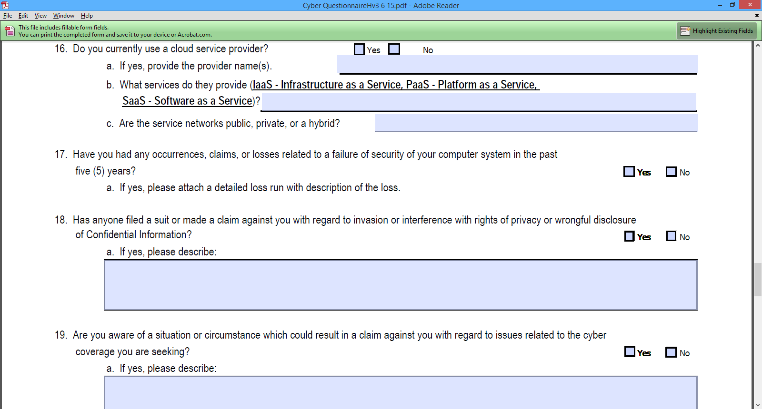

Slide 27
Question 16
What is the “Cloud”?
“Cloud” is a buzzword that vaguely suggests the promise and convenience of being able to access files from anywhere. But the reality is that the cloud is hardly floating like mist above our heads — it's a physical infrastructure, its many computers housed in massive warehouses all over the world.
DEFINITION of 'Cloud Computing'
A model for delivering information technology services in which resources are retrieved from the internet through web-based tools and applications, rather than a direct connection to a server. Data and software packages are stored in servers. However, cloud computing structure allows access to information as long as an electronic device has access to the web. This type of system allows employees to work remotely.

Slide 28
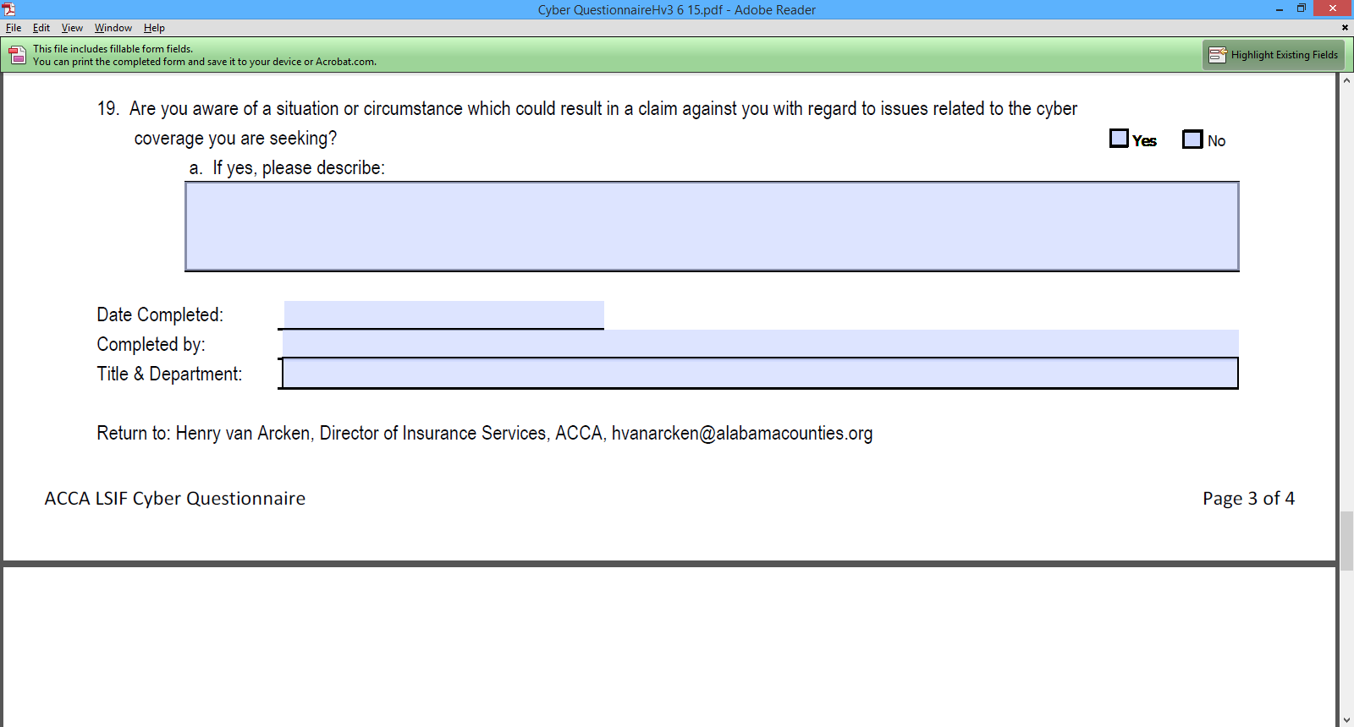

Slide 29
Questions 17, 18, & 19 are addressing the issues of:
Privacy and Disclosure
This is where Cyber & Network security become really tricky!
Why? Because you have to open up the network for access to the public information
But, you have to secure it to keep your private information from being stolen.

Slide 30
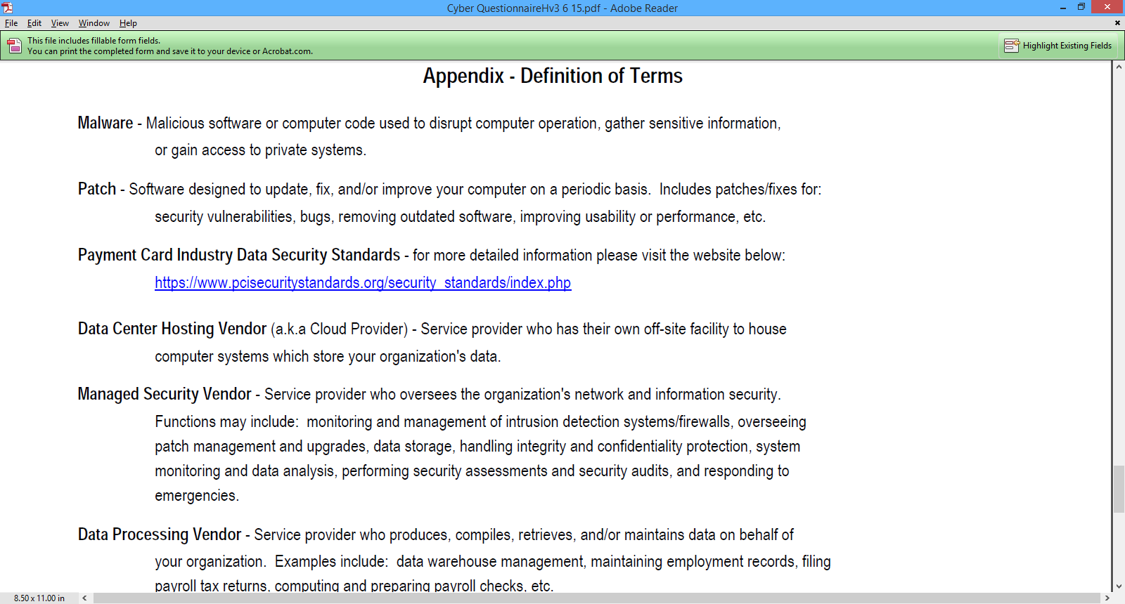

Slide 31
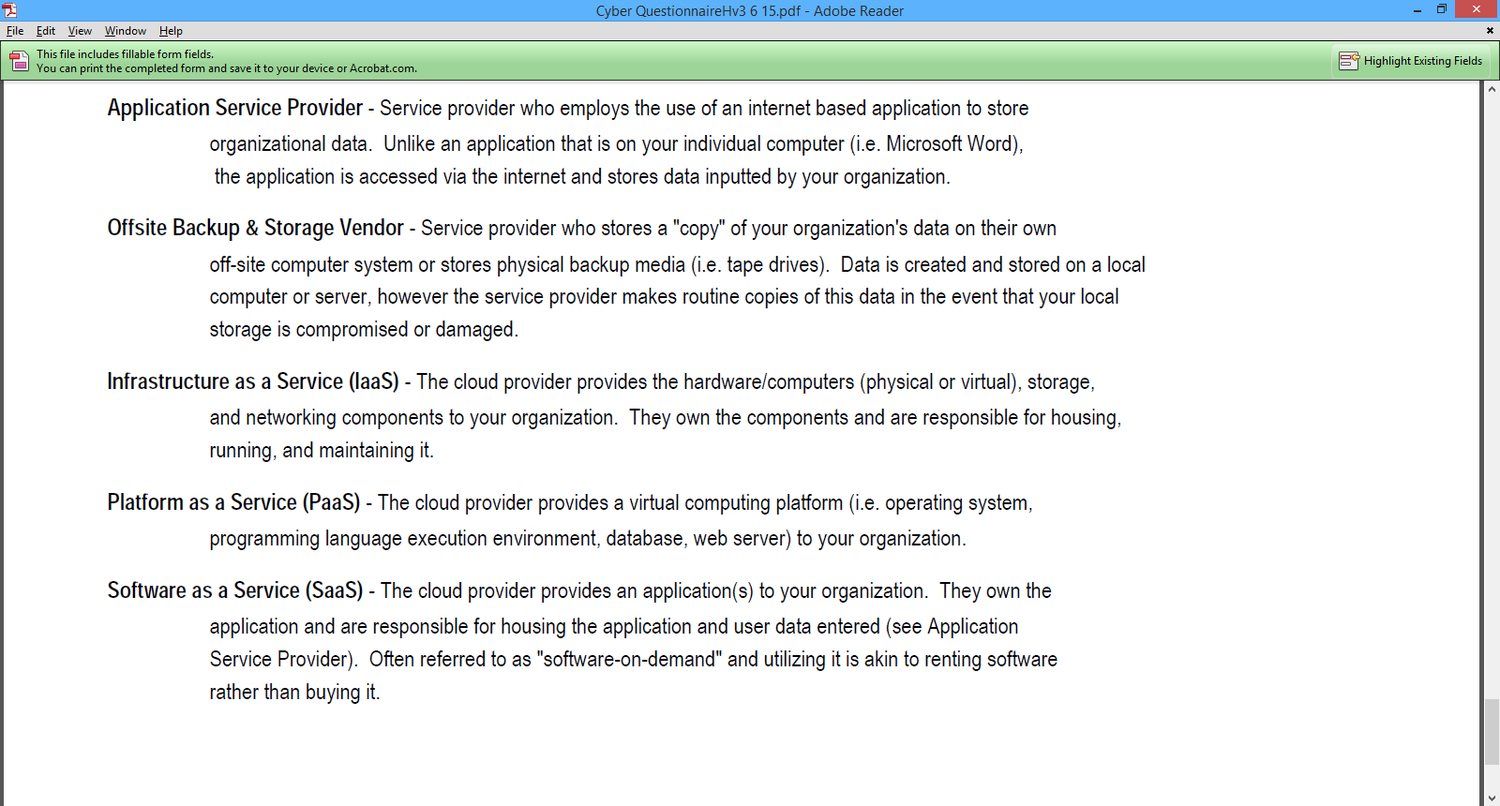

Slide 32
There is help out there!

Slide 33
Even though the title says “County”, we are encouraging sll county’s or city’s to sign-up for a login.
This is a collaboration site that we (NACo IT Executive Committee) created to help bridge the gap between large and small local governments. This is not only for IT related issues, but policies and procedures, RFP/RFQ’s, etc..
Please join COIN today by going to: http://www.countyinnovation.us/

Slide 34
Q/A

Slide 35
Contact Info
David Freeman
IT Director – Limestone County
256-216-3450
David.freeman@limestonecounty-al.gov

