Slide 1
The Importance of the Safety Incentive Discount Program Sonny Brasfield, Executive Director

Slide 2
SIDP Background
The purpose of the Nine point Safety Incentive Discount Program is to encourage Fund Members to improve their safety efforts by establishing basic safety standards in order to control losses.
Additionally, Each Liability Fund Member that meets all nine requirements for the qualifying period of 10/1-10/1 is eligible to receive a cash bonus of 5% of its current premium contribution up to a maximum amount of $6,000

Slide 3
SIDP Background (cont.)
Each WC Fund Member that meets all nine requirements for the qualifying period of 10/1-10/1 is eligible to receive a cash bonus of 5% of its current premium contribution up to a maximum amount of $7,500
Counties that meet all nine requirements must apply for the discount via the Safety Incentive Verification Form (available on ACCA website under SIP)

Slide 4
SIDP Background (cont.)
The Safety Incentive Verification Form must be signed by the county chairperson and include all required documentation

Slide 5
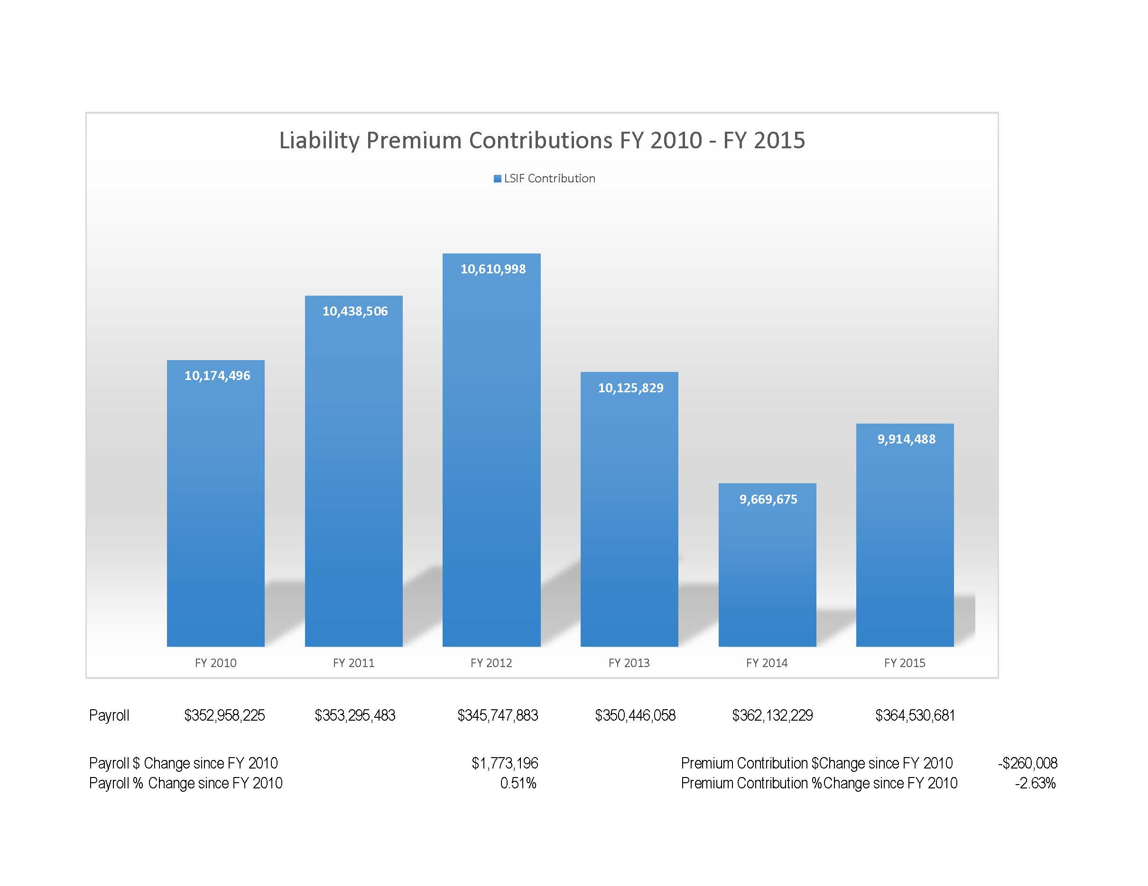

Slide 6
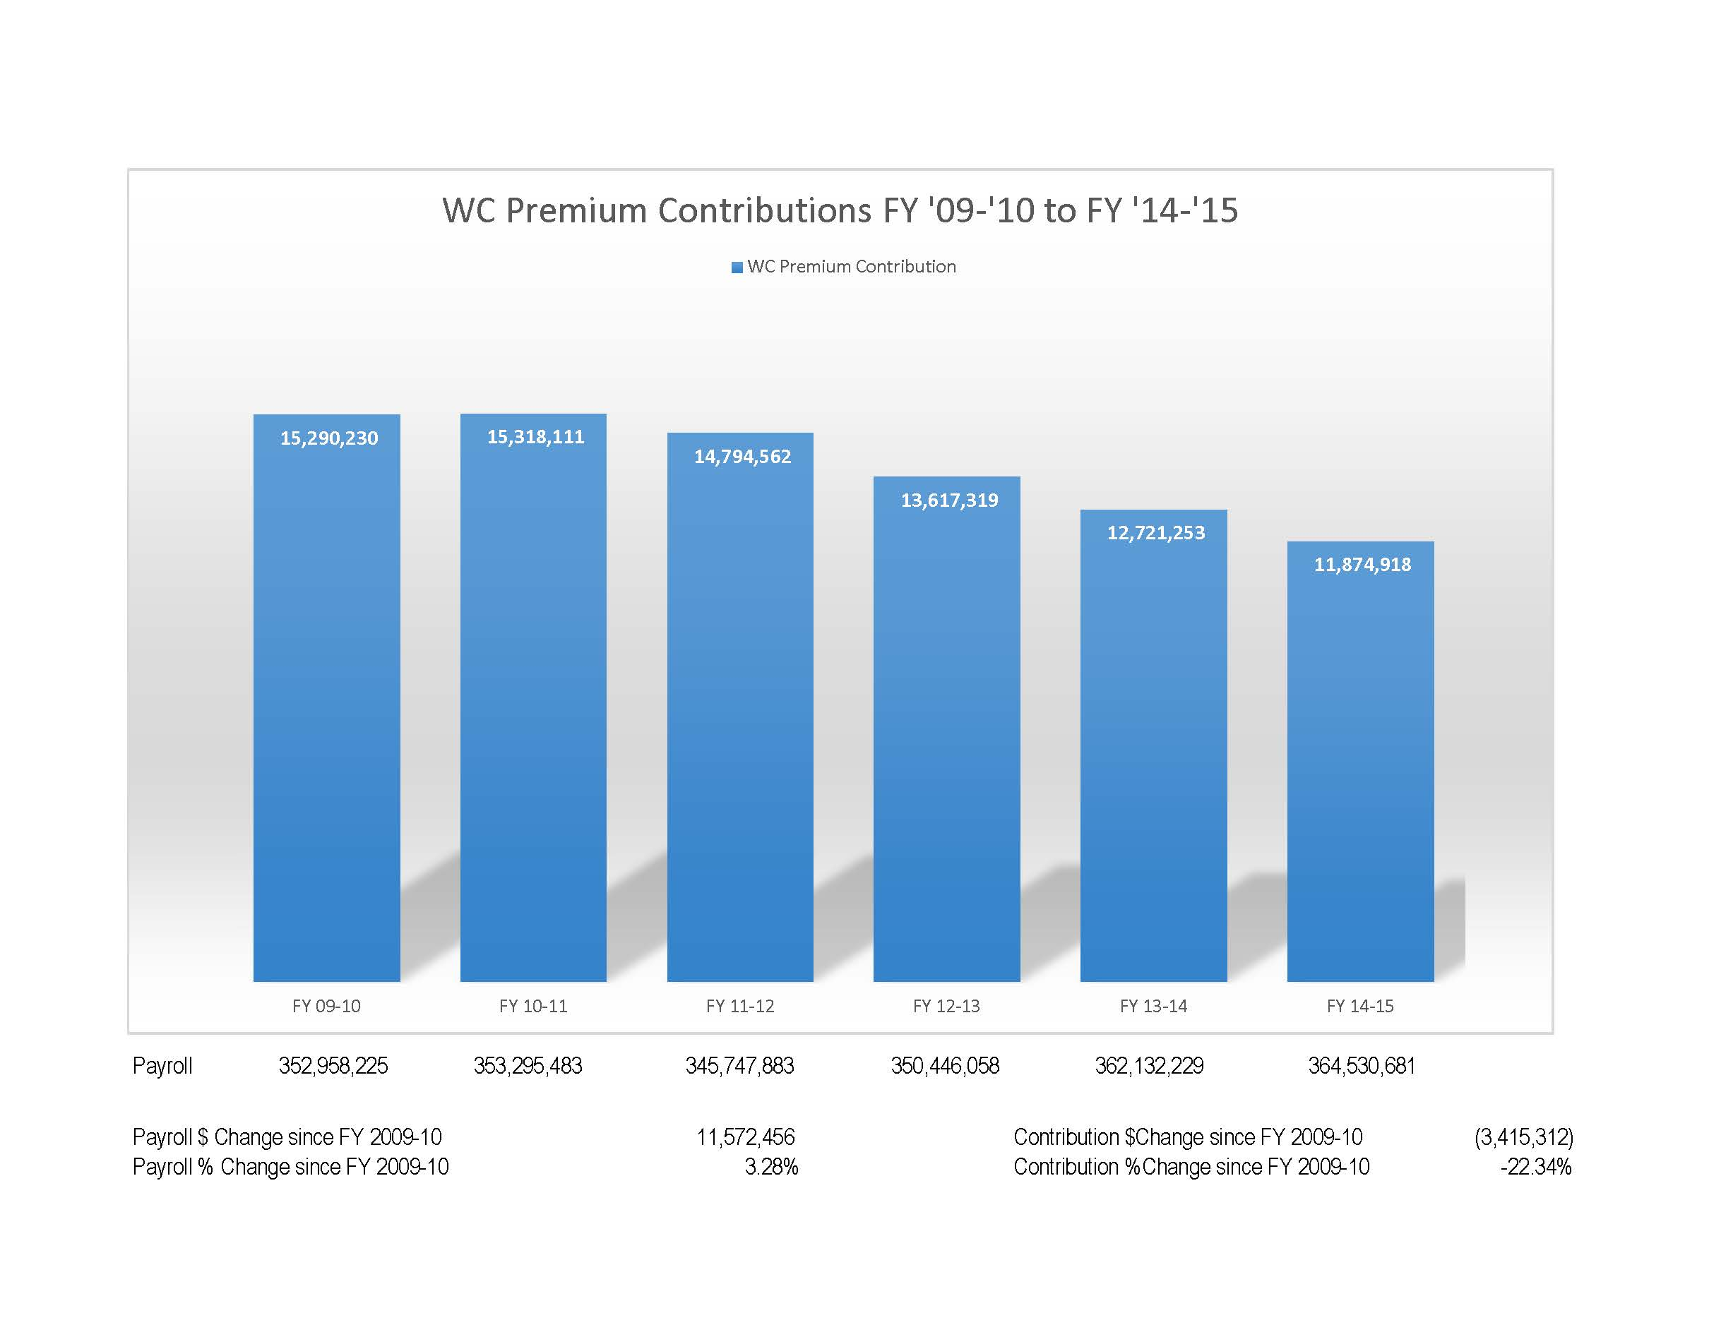

Slide 7
SIDP Benefits
The return on the county’s SIDP investment is high relative to resources expended on the program
Counties that participate and meet the nine requirements receive a cash bonus
If the county wide safety program is implemented and maintained the county should realize lower losses and reduced premium contributions

Slide 8
SIDP Benefits (cont.)
An effective loss control program helps identify, control, or eliminate hazards so injuries and losses are minimized or prevented
Counties that participate in the SIDP can reduce the severity of both workers compensation and liability claims by implementing basic safety controls
Participants in the program are exposed to fewer lost time WC claims through return to work programs-saving the county money

Slide 9
SIDP Benefits (cont.)
Participants experience less severe claims by implementing the proper loss/risk controls
Counties that have a bona fide safety program will have safer work environments than counties that do not have a safety program
The SIDP program helps reduce medical expense by implementing controls that help reduce the severity of an accident (Seat Belt Policy, Cell Phone Policy)

Slide 10
SIDP Benefits (cont.)
SIDP policies save $$ on third party liability claims, e.g., cell phone policy
SIDP policies save $$ on third party liability claims- Law enforcement training, Employment training
The SIDP program promotes a safety culture from the top (management) down (employees)

Slide 11
SIDP Benefits (cont.)
The SIDP requirement of a Safety Coordinator is the cornerstone of the program by having a person in charge to implement the safety program, hold and preside over safety meetings, report safety issue to the commission, identify hazards, perform accident investigations

Slide 12
SIDP Benefits (cont.)
Most Counties do not need a full time Safety Coordinator. However, counties that have at least a part-time SC realize fewer losses than counties that do not have a SC
Safety Coordinators, through proper training, have improved accident investigation skills to help determine the root cause of an accident

Slide 13
SIDP Benefits (cont.)
Once the root cause of an accident or near miss is discovered, the proper controls can correct safety hazards, e.g., a missing saw blade cover can be replaced reducing the exposure of lost appendages and severe lacerations
Required Safety Coordinator (SC) training is aimed at providing the SC with the tools to be successful at that position.

Slide 14
SIDP Benefits (cont.)
The SIDP Requirement of a county wide safety committee promotes discussion with all county departments as to the unique safety exposures in each department so that each department can implement safety measures particular to its exposure
Another important factor of the SIDP is that it requires employees to sign off on the county’s safety policies, so they know what is expected of them

Slide 15
SIDP Benefits (cont.)
The program holds supervisors and employees accountable for unwanted behavior
Policies are applied to everyone in every county department whether or not the department is under the commission’s direct control. This includes the sheriff’s department, which is covered under the county’s insurance programs through ACCA

Slide 16
SIDP Benefits (cont.)
ACCA’s insurance related training is aimed at reducing loss in the areas with the highest severity of loss
Most importantly the SIDP is a tool that will help counties change unwanted (unsafe) behavior through effective leadership that will in turn lead to a safer work environment and protect counties financial and human resources

