Slide 1
Alabama Energy & Residential Codes Board

Slide 2
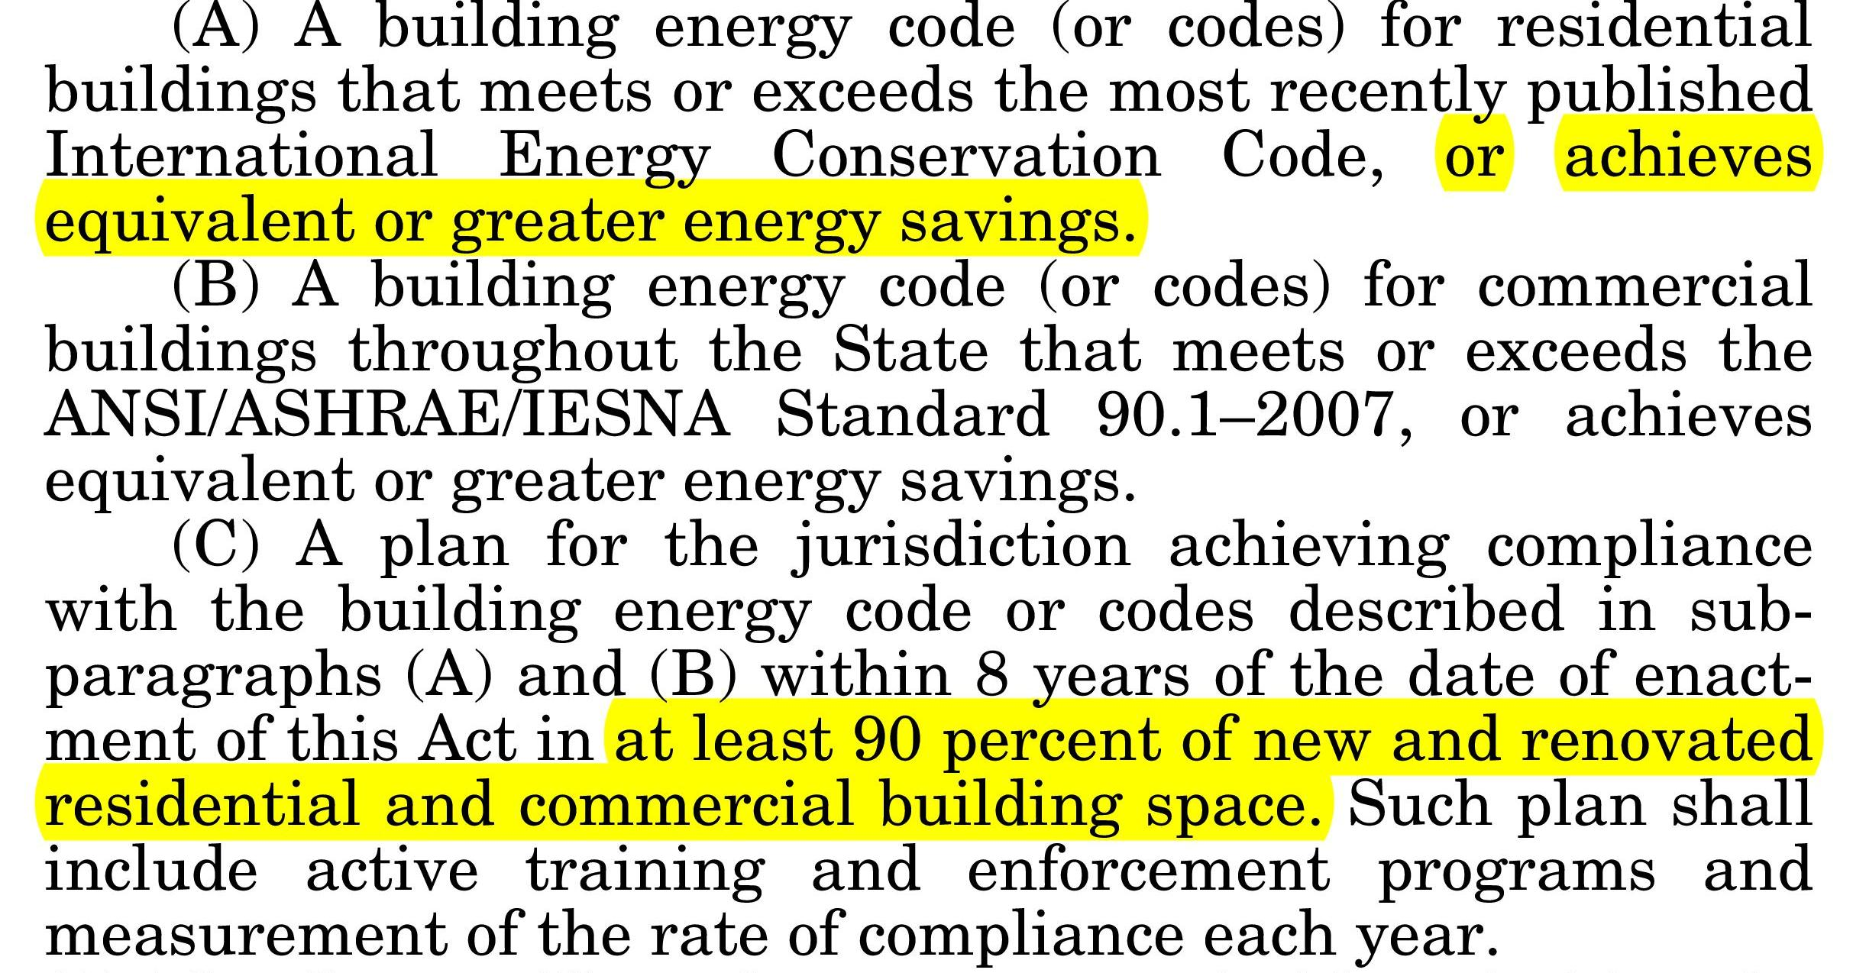
Why the Alabama Energy & Residential Code?
Title IV, Section 401(a)(2), American Recovery and Reinvestment Act of 2009
(§41-23-82, Code of Alabama 1975)

Slide 3
Why the Alabama Energy & Residential Code?
March 9, 2010 - Governor Bob Riley signs SB 315 into law as Act 2010-185, giving the Alabama Energy and Residential Codes Board sole authority over adoption and implementation of the state’s energy and residential building codes.

Slide 4
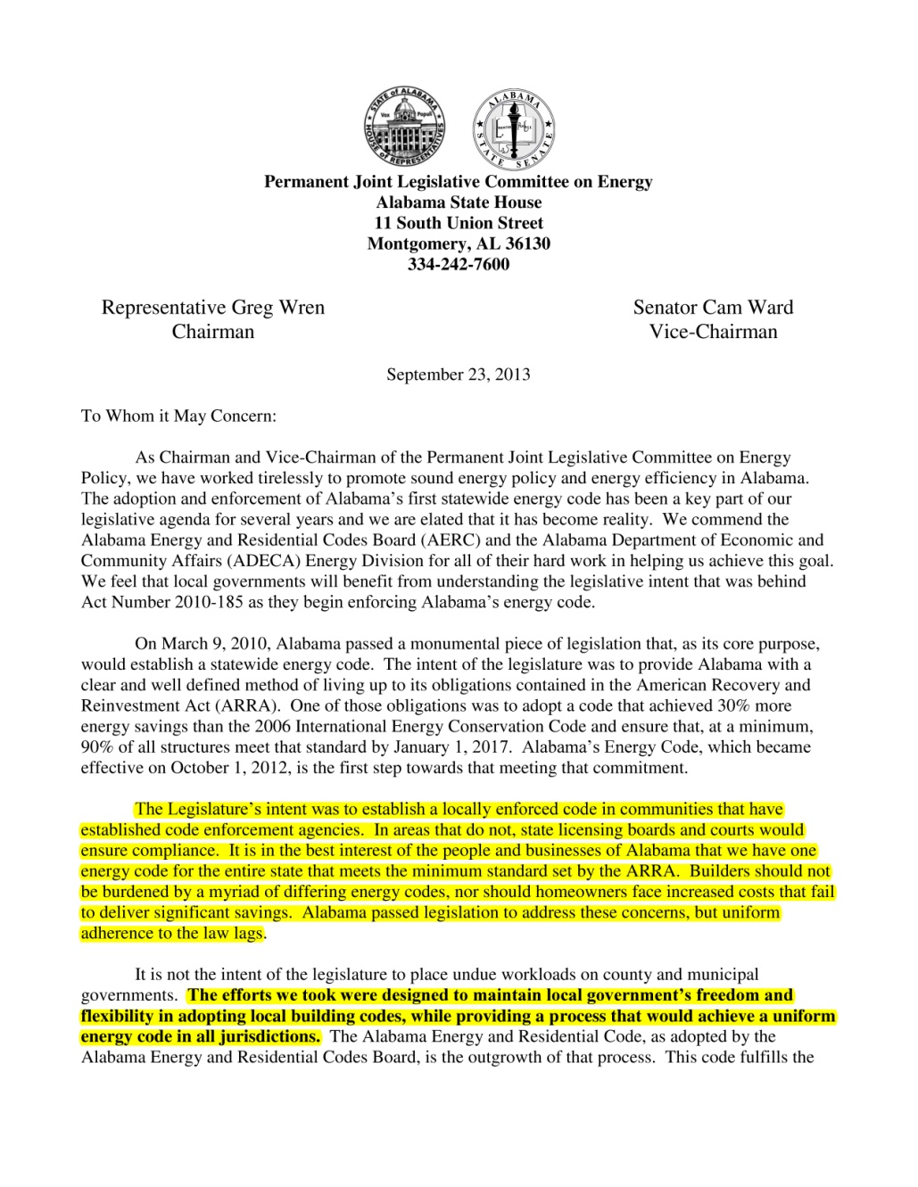
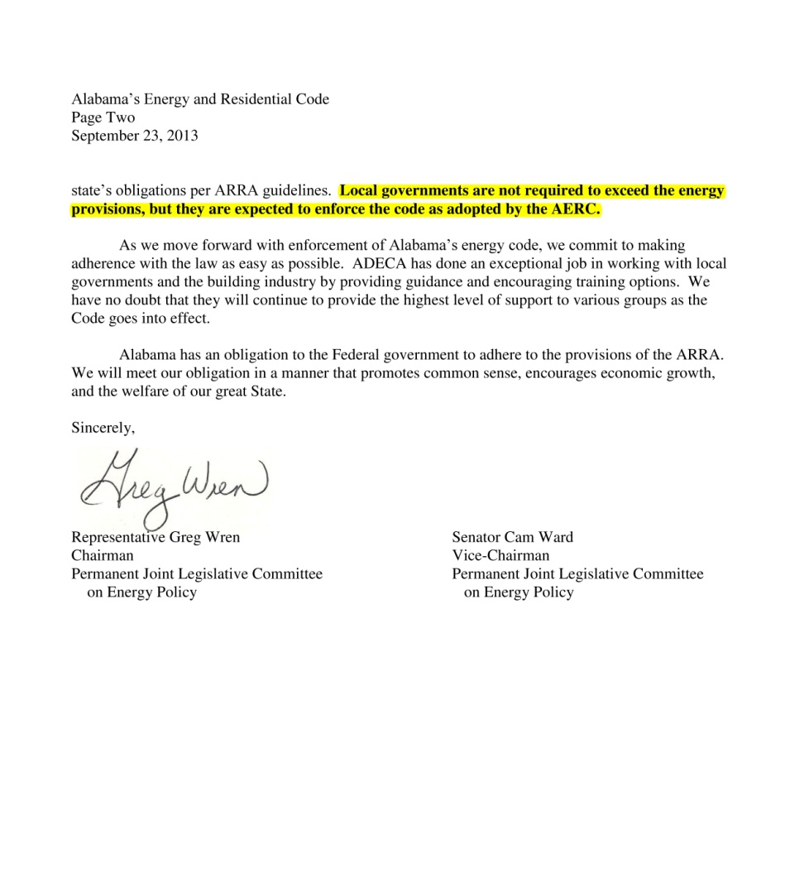
Legislative Intent
The Legislature’s intent was to establish a locally enforced code in communities that have established code enforcement agencies. In areas that do not, state licensing boards and courts would ensure compliance.
It is not the intent of the legislature to place undue workloads on county and municipal governments. The efforts we took were designed to maintain local government’s freedom and flexibility in adopting local building codes, while providing a process that would achieve a uniform energy code in all jurisdictions.
Local governments are not required to exceed the energy provisions, but they are expected to enforce the code as adopted by the AERC.

Slide 5
What is the Alabama Energy & Residential Codes Board?
Maintains authority over all matters pertaining to the acceptance, adoption, and implementation of the Alabama Energy and Residential Codes (AERC)
Review, amend, and adopt the AERC
Evaluate, assess, and advise relevant entities on residential energy codes
Conduct a program of public information regarding the AERC
No enforcement authority
(§41-23-80, Code of Alabama 1975)

Slide 6
Who is the Alabama Energy & Residential Codes Board?
17 members – 15 appointed by the Governor, 2 by the Chairman of the Permanent Joint Legislative Committee on Energy Policy
Alabama Board of Heating, Air Conditioning, and Refrigeration
Alabama General Contractors Board
Alabama Joint Fire Council
Alabama Liquefied Petroleum Gas Board
Alabama Council, American Institute of Architects
County Governments
Electric Cooperatives
Licensed Professional Engineers
(§41-23-82, Code of Alabama 1975)

Slide 7
Who is the Alabama Energy & Residential Codes Board?
17 members – 15 appointed by the Governor, 2 by the Chairman of the Permanent Joint Legislative Committee on Energy Policy
Home Builders Association
Home Builders Licensure Board
International Code Council, Alabama Chapter
Municipalities
Natural Gas Industry
Property and Casualty Insurance Industry
Private Electric Utility
PJLCOE, House Member
PJLCOE, Senate Member
(§41-23-82, Code of Alabama 1975)

Slide 8
How is the AERC Adopted?
State Requirement: must consider updates to the AERC no more than two years after the date of publication of the most recent version of the codes by the International Code Council (International Energy Conservation Code and International Residential Code)
Federal Requirement: must consider (federal definition) new energy code within 1 year of DOE Determination of Increased Efficiency
(§41-23-82, Code of Alabama 1975)

Slide 9
How is the AERC Adopted?
Subcommittees review proposed codes and make recommendation to the AERC Board
Follows rulemaking process per the Alabama Administrative Procedure Act
Public comments are an important part of the Board’s process and decision making
The AERC is codified in the Alabama Administrative Code, §305-2-4

Slide 10
2015 Alabama Energy and Residential Codes
Residential Building Code: 2015 International Residential Code, as amended
(effective October 1, 2016)
Residential Energy Code: 2015 International Energy Conservation Code, as amended
(effective October 1, 2016)
Commercial Energy Code: 2015 International Energy Conservation Code or ASHRAE 90.1-2013 (effective January 1, 2016)

Slide 11
Significant Changes: Residential Energy
Mandatory blower door testing (mechanical ventilation)
Added equipment efficiency trade-off option (mandatory minimums are still mandatory)
ERI-based compliance: 70

Slide 12
Why These Codes?
2015 IECC as written: 4% cost increase, or approximately $120 million annual consumer cost impact
2015 Alabama Residential Energy Code: less than 1% cost increase, or approximately $15 million annual consumer cost impact

Slide 13
DOE Residential Energy Codes Field Study
Alabama is 1 of 8 participating states
Three main stages:
Baseline study
Education, training, and outreach
Post-study assessment
Baseline study based on 2009 IECC as adopted: more than 90% compliance
DOE has approved going forward with training based on the new 2015 Alabama Residential Energy Code

Slide 14
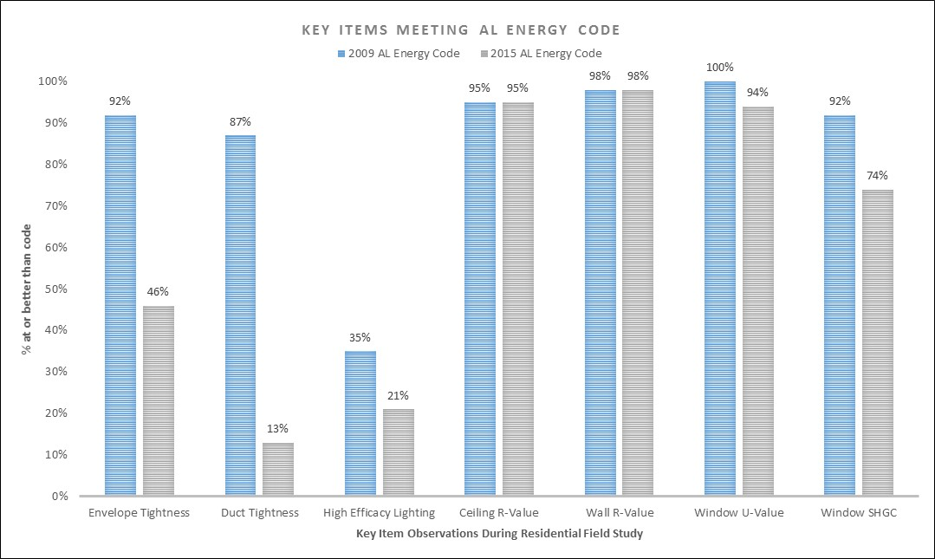
DOE Energy Codes
Field Study
Notes:
ACH50 – The majority of homes in both climate zones are better (lower) than prescriptive 2009 IECC levels. With respect to the 2015 Alabama state code levels however, roughly half of the homes are worse than code in both climate zones.

Slide 15
How Can We Help?
Adoption package for adopting the Alabama Energy and Residential Codes by reference:
Sample ordinances:
Alabama Residential Energy Code
Alabama Commercial Energy Code
Alabama Residential Building Code
Full Alabama Energy and Residential Code
Press Release Package
Resources
Training Opportunities
Needs?

Slide 16
Heather Goggin ADECA Energy Division 334-242-5330 heather.goggin@adeca.alabama.gov

Slide 17
BUILDING OPERATOR CERTIFICATION®
Alabama League of Municipalities
May 22, 2017
BOCAlabama.com

Slide 18
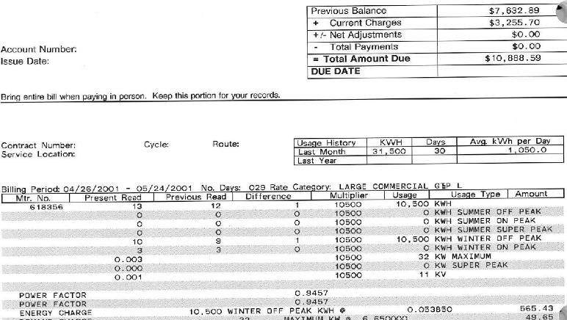
Do you understand your utility bill?
Notes:
How many of you review or pay your organization’s utility bills?
How many of you actually understand the usage, multipliers, rates, and so on?
Did you know that electricity rates can change during the day, sometimes by as much as 40%? Depending on your utility rate structure, you may be charged separate rates for different times of the day. Rates are higher during peak hours, when most people are using electricity. Rates are lowest during off-peak periods.
For example, you may have programmable thermostats in your buildings that are set to make the temperature cooler at 7:00am because people begin to arrive at 7:15. Lowering the temperature on your HVAC unit to cool your building from 74 to 68 uses a lot of power. Your unit is working overtime to be prepared for the day when its July and 100 degrees outside. If your electricity rates are structured where peak hours begin at 7:00am, you’re paying a much higher rate for that unit to cool down your building. If you were to set your thermostats or HVAC controls to lower the temperature just an hour before that peak rate kicks in you could save a significant amount of money.

Slide 19
You can’t manage what you don’t measure.

Slide 20
How satisfied are you with the temperature in your workspace?
42% of workers are dissatisfied with the thermal environment
10,000
8,000
19%
6,000
15%
16%
16%
Number of responses
14%
13%
4,000
6%
2,000
-
-3
-2
-1
0
1
2
3
very dissatisfied
very satisfied
Notes:
On an average day, are you comfortable in your office setting? How many of you have a heater, fan or sweater at your desk, or know someone who does?
When asked how satisfied with building comfort, 42% of building occupants gave thermal comfort the lowest scores in a survey conducted by Center for the Built Environment. BOC certified operators Identify ways to improve thermal comfort, reduce system energy use, and maintain an effective and high-performing HVAC system.

Slide 21
What is BOC?
Building Operator Certification (BOC®) is a competency-based training and certification program for building operators.
Nationally recognized credential
Established in 1996
Currently operating in 36 states and Canada
Notes:
That’s where Building Operator Certification comes in.
You can’t manage what you don’t measure.

Slide 22
What is BOC?
Building Operator Certification (BOC®) is a competency-based training and certification program for building operators.
Participants learn how to make their buildings more comfortable and efficient by making their systems work better together.

Slide 23
What is BOC?
Building Operator Certification (BOC®) is a competency-based training and certification program for building operators.
Participants learn how to make their buildings more comfortable and efficient by making their systems work better together.
Notes:
That’s where Building Operator Certification comes in.
You can’t manage what you don’t measure.

Slide 24
Who attends BOC?
Operating Engineers
Maintenance Mechanics
HVAC Technicians
Electricians
Control Technicians
Building/Facility Managers
Engineering Project Managers
Energy Managers
Notes:
The people who make your work environment livable.

Slide 25
Who attends BOC?

Slide 26
Benefits of BOC
Make your buildings comfortable
Reduce energy costs
Reduce equipment costs through preventative maintenance
Work effectively with vendors
Bring ideas for improving operations
Become a skilled building operator
Help increase job safety
Help improve operator productivity and building performance
Notes:
When you have solid data on the energy usage of your buildings with charts to support it and know the operations of your equipment, it is much easier to go to the city council to approve the purchase of improvements or maintenance. Public administrators are often concerned with the bottom line, and BOC helps equip the building operators who work with the equipment everyday with the knowledge to present that bottom line.
For Building Owners
Thanks to practical training and a fresh perspective on building management, the average BOC graduate saves his or her employer as much as $20,000 a year. We help managers and operators find opportunities for change, so they can cut costs and serve building occupants well.
BOC is the industry’s longest-running energy efficiency training program, and we offer the best value of any training provider.

Slide 27
Benefits of BOC
BOC national average is $20,000 annual savings per organization
Georgia’s K-12 schools saw $4,250 - $8,322 actual savings per school in first year of its BOC program
Over 80% of employers found the BOC useful to their employees.

Slide 28
Benefits of BOC
“Vancouver Public Schools (VPS) has been actively engaged in the BOC program since 2001. On completion of the class of 2010, we will have sent a total of 59 active and retired Building Operators, Custodial Supervisors and HVAC technicians through BOC training. As a direct result of participation in the BOC training, graduates have contributed to over $300,000 per year in energy savings to our school district. Additionally, our school communities benefit from having certified operators in each facility that have a significant understanding of the building components and systems necessary to the maintenance of high performing environments for the students, staff and patrons of Vancouver Public Schools.”
John Weber, Interim Custodial Maintenance Crew Leader, Vancouver Public Schools, Washington
“BOC makes me think more about the overall building performance rather than looking at one area of the building.”
Jim Funderburk, Clover School District 2, South Carolina
“BOC is the type of program that produces real benefits for our communities. City staff who go through this training and certification are well prepared to improve operational efficiencies in municipal facilities.”
Jane Cummins, Senior Staff Associate, League of Oregon Cities

Slide 29
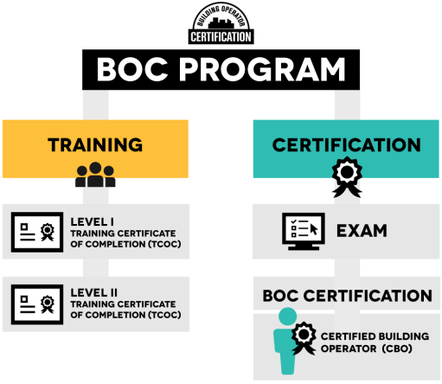
Course Structure

Slide 30
Course Structure
Level I: Building Systems Maintenance
Job Performance Outcomes:
Foundational understanding of electrical, HVAC and lighting systems and controls.
Benchmark building energy consumption
Identify low-cost or no-cost operations improvements
With supervision, establish or review preventative maintenance program
Level II: Equipment Troubleshooting
Job Performance Outcomes:
Advanced ability to troubleshoot
Independently develop preventative maintenance programs
Advanced skills in equipment operations
Reduce water use
Enhanced automation and demand reduction

Slide 31
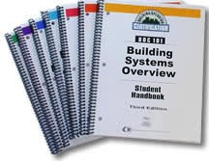
Level I Knowledge & Skills
BOC 1001 - Energy Efficient Operation of HVAC Systems
BOC 1002 - Measuring Energy Performance
BOC 1003 - Efficient Lighting Fundamentals
BOC 1004 - HVAC Controls Fundamentals
BOC 1005 - Indoor Environmental Quality
BOC 1006 - Common Opportunities for Operational Improvement
Supplemental Classes: Electrical Systems, O&M for Sustainable Buildings, High Performance HVAC, Building Scoping & Energy Recovery
74 hours of training
5 application projects
700 pages of reference books
Notes:
Right now, Alabama is only offering the Level 1 track. In a few years, after there are a pool of trainees that have gone through Level 1, we will begin offering Level 2 classes.

Slide 32
Course Description
BOC 1002 Measuring and Benchmarking Energy Performance
Utility bill components and rate structure
Collecting and organizing utility and building data
Building data analysis
Benchmarking
Trend analysis
Energy conservation and facility management
Notes:
Remember – you can’t manage what you can’t measure!

Slide 33
Level II Knowledge & Skills
BOC 201 - Preventive Maintenance & Troubleshooting
BOC 202 - Advanced Electrical Diagnostics
BOC 203 - HVAC Troubleshooting & Maintenance
BOC 204 - HVAC Controls & Optimization
Supplemental Classes: Water Efficiency, Motors, Demand Reduction, Building Commissioning
61 hours of training
3 application projects
600 pages of reference books

Slide 34
Class Structure
First month – 2 days
1 day per month next 6 months
Test at the end of each day
Cover content covered in class
Are open-book
Take 1 hour to complete

Slide 35
Class Structure
The difference between school and life?
In school you, you’re taught a lesson and then given a test. In life, you’re given a test that teaches you a lesson.
Tom Bodett, American author, actor, and radio personality

Slide 36
BACK-ON-THE-JOB PROJECT ASSIGNMENTS
Demonstrate ability to apply skills covered in BOC classes
Required to earn the BOC Training Certificate of Completion
HVAC Equipment Floor Plan
Energy Benchmark
HVAC Operations Map
Lighting Surveys
Occupancy Schedule
Notes:
Back on the job (in between classes), BOC participants, conceptually map the integration of a building’s systems and how components interact with each other, the building, its occupants, and the environment. As a BOC project, participants create an HVAC Equipment Floor Plan to identify primary heating and cooling plants, distribution lines and control points.

Slide 37
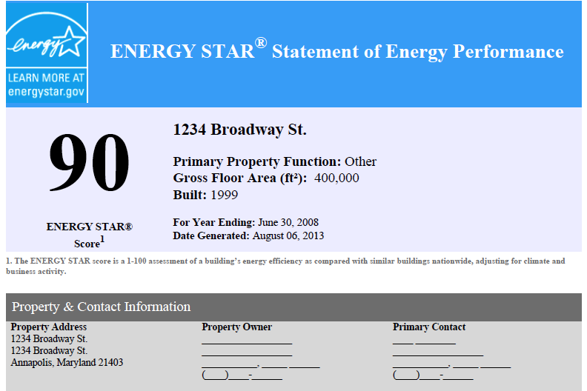
BACK-ON-THE-JOB PROJECT ASSIGNMENTS
Energy Benchmarking
With ENERGY STAR® Portfolio Manager
Normalized Benchmark Data | ENERGY STAR | Your Bldg.
Energy Performance Rating: | 75 | 60
Energy Consumption: (kBtu/ft2-yr): | 95 | 123
Energy Costs/SF/YR: | $1.75 | $2.50
Notes:
Create an energy benchmark for her/his building using Energy Star® Portfolio Manager to calculate the Energy Utilization Intensity (EUI) for a building.
Perform a simplified lighting survey including lighting power density and lighting levels. Research utility contacts, incentives and calculate
lighting retrofit incentive.
Review facility HVAC operations and maintenance measures and
review the control system to identify strategies by system and running time
comparisons.
Develop an Occupancy Schedule. Profile the occupancy of the
facility by week, month, and year.

Slide 38
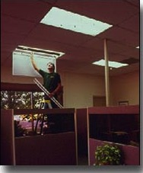
BACK-ON-THE-JOB PROJECT ASSIGNMENTS
Lighting Surveys
Inspect lighting fixtures and lamps to assess type and wattage
Identify cleaning and repair
Measure light levels and compare to IES illumination recommendations
Recommend improvements for energy performance
Identify utility incentives
Notes:
Create an energy benchmark for her/his building using Energy Star® Portfolio Manager to calculate the Energy Utilization Intensity (EUI) for a building.
Perform a simplified lighting survey including lighting power density and lighting levels. Research utility contacts, incentives and calculate
lighting retrofit incentive.
Review facility HVAC operations and maintenance measures and
review the control system to identify strategies by system and running time
comparisons.
Develop an Occupancy Schedule. Profile the occupancy of the
facility by week, month, and year.

Slide 39
Earn BOC Level I Training Certificate of Completion (TCOC)
Attend seven of eight BOC classes
Earn a passing score of 70% on all eight in-class tests
Complete five in-facility project assignments
Submit a Training Certificate of Completion Application

Slide 40
Tuition and Fees
Training Tuition - $1,595 per registrant
74 hours of technical training
700 page Student Handbook
5-part Project Workbook
Tests
Credential
Partial scholarships available
Certification Exam - $285
Credential Maintenance - $65 per year
Notes:
BOC national average is $20,000 annual savings per organization
Georgia’s K-12 schools saw $4,250 - $8,322 actual savings per school in first year of its BOC program
Tuition below the national average
Credential Maintenance - $65/year
Subscription to BOC Bulletin
Free continuing education opportunities
Listing in BOC Registry

Slide 41
BOC Level I Schedule
CLANTON, AL – STARTING OCTOBER 2017
All classes are held from 8:00am to 4:00pm.
Energy Efficient Operation of Building HVAC Systems 10/03/17
Energy Efficient Operation of Building HVAC Systems 10/04/17
Measuring and Benchmarking Energy Performance 11/07/17
Efficient Lighting Fundamentals 12/05/17
HVAC Controls Fundamentals 01/09/18
Indoor Environmental Quality 02/06/18
Opportunities for Low-Cost Operational Improvements 03/06/18
Supplemental Class (TBD) 03/27/18
Notes:
The course is structured so that participants miss a minimal amount of work at one time and are able to complete on-the-job assignments in between classes. One two-day class session on HVAC systems then one day a month over a 7 month period.

Slide 42
To Learn More
Visit BOCAlabama.com
Email info@BOCAlabama.com

Slide 43
Questions?

Slide 44
Thank You!
Heather Goggin
Energy Program Manager
ADECA Energy Division
heather.goggin@adeca.alabama.gov
(334) 242-5330

