Slide 1
Update from Montgomery
Sonny Brasfield Executive Director, Association of County Commissions of Alabama

Slide 2
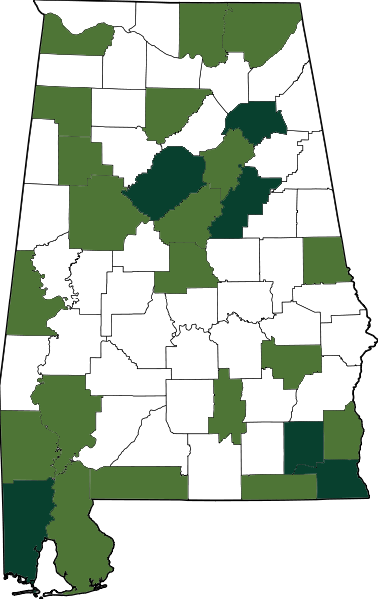
CGEI-Certified
26 counties with CGEI-certified 9-1-1 staff
1 staff member certified
2 or more staff members certified

Slide 3
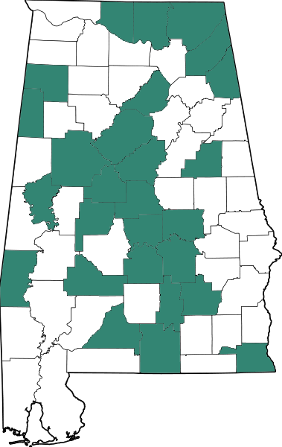
CGEI-Enrolled
27 counties with 9-1-1 staff working toward CGEI certificate

Slide 4
Certificate in Emergency Communication District Administration
Earning Requirements:
Complete 4 basic-level courses (48 hours)
Complete 2 elective courses (24 hours)
Complete 1 profession-specific course (12 hours)
Maintaining Requirements:
Complete 12 continuing education units during every 2-year period

Slide 5
Basic-Level Courses – All Required
Overview of County Government
Ethics of County Officials and Employees
Personnel Administration
Finance and Revenue

Slide 6
Elective Courses – 2 Required
Conflict Management
General Management and Supervision
Disaster Preparedness and Response
General Accounting
Communication and Media Relations
Legislative and Governmental Relations
Grants

Slide 7
Profession-Specific Course – Required
Fundamentals of Emergency Communication District Administration

Slide 8
2019 CGEI Basic-Level Courses
Personnel Administration
February 20-21
Finance and Revenue
September 25-26
Overview of County Government
October 9-10
Ethics of County Officials and Employees
October 30-31

Slide 9
2019 CGEI Elective Courses
Legislative and Governmental Relations
January 30-31 *Tentative
General Management and Supervision
April 3-4
Grants
June 12-13

Slide 10
2019 CGEI Profession-Specific Course
Fundamentals of Emergency Communication District Administration
October 30-31

Slide 11
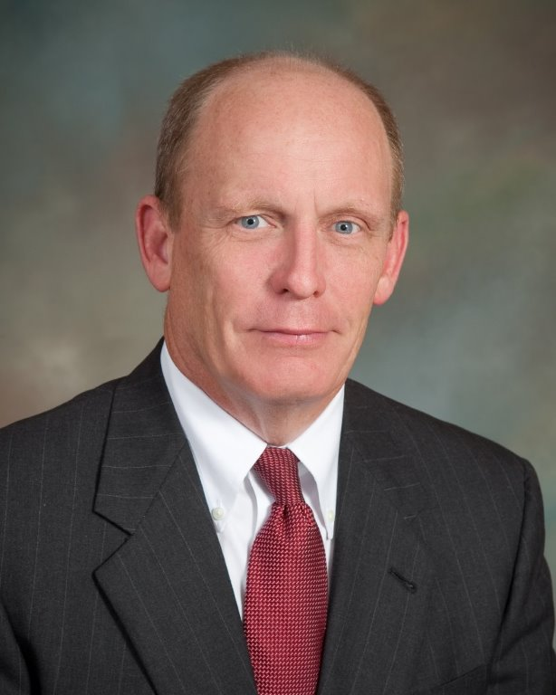
Contact Information
Sonny Brasfield,
ACCA Executive Director
(334) 263-7594
sbrasfield@alabamacounties.org
@sonnybrasfield

