Slide 1
THE IMPACT OF ATRIP ON COUNTY GOVERNMENT
ACCA Annual Conference 2015

Slide 2

Purpose of the Project
Tool to highlight the positive impacts ATRIP is making on county government;
Vehicle to illuminate the needs of counties not reached by ATRIP- local roads and minor collector;

Slide 3
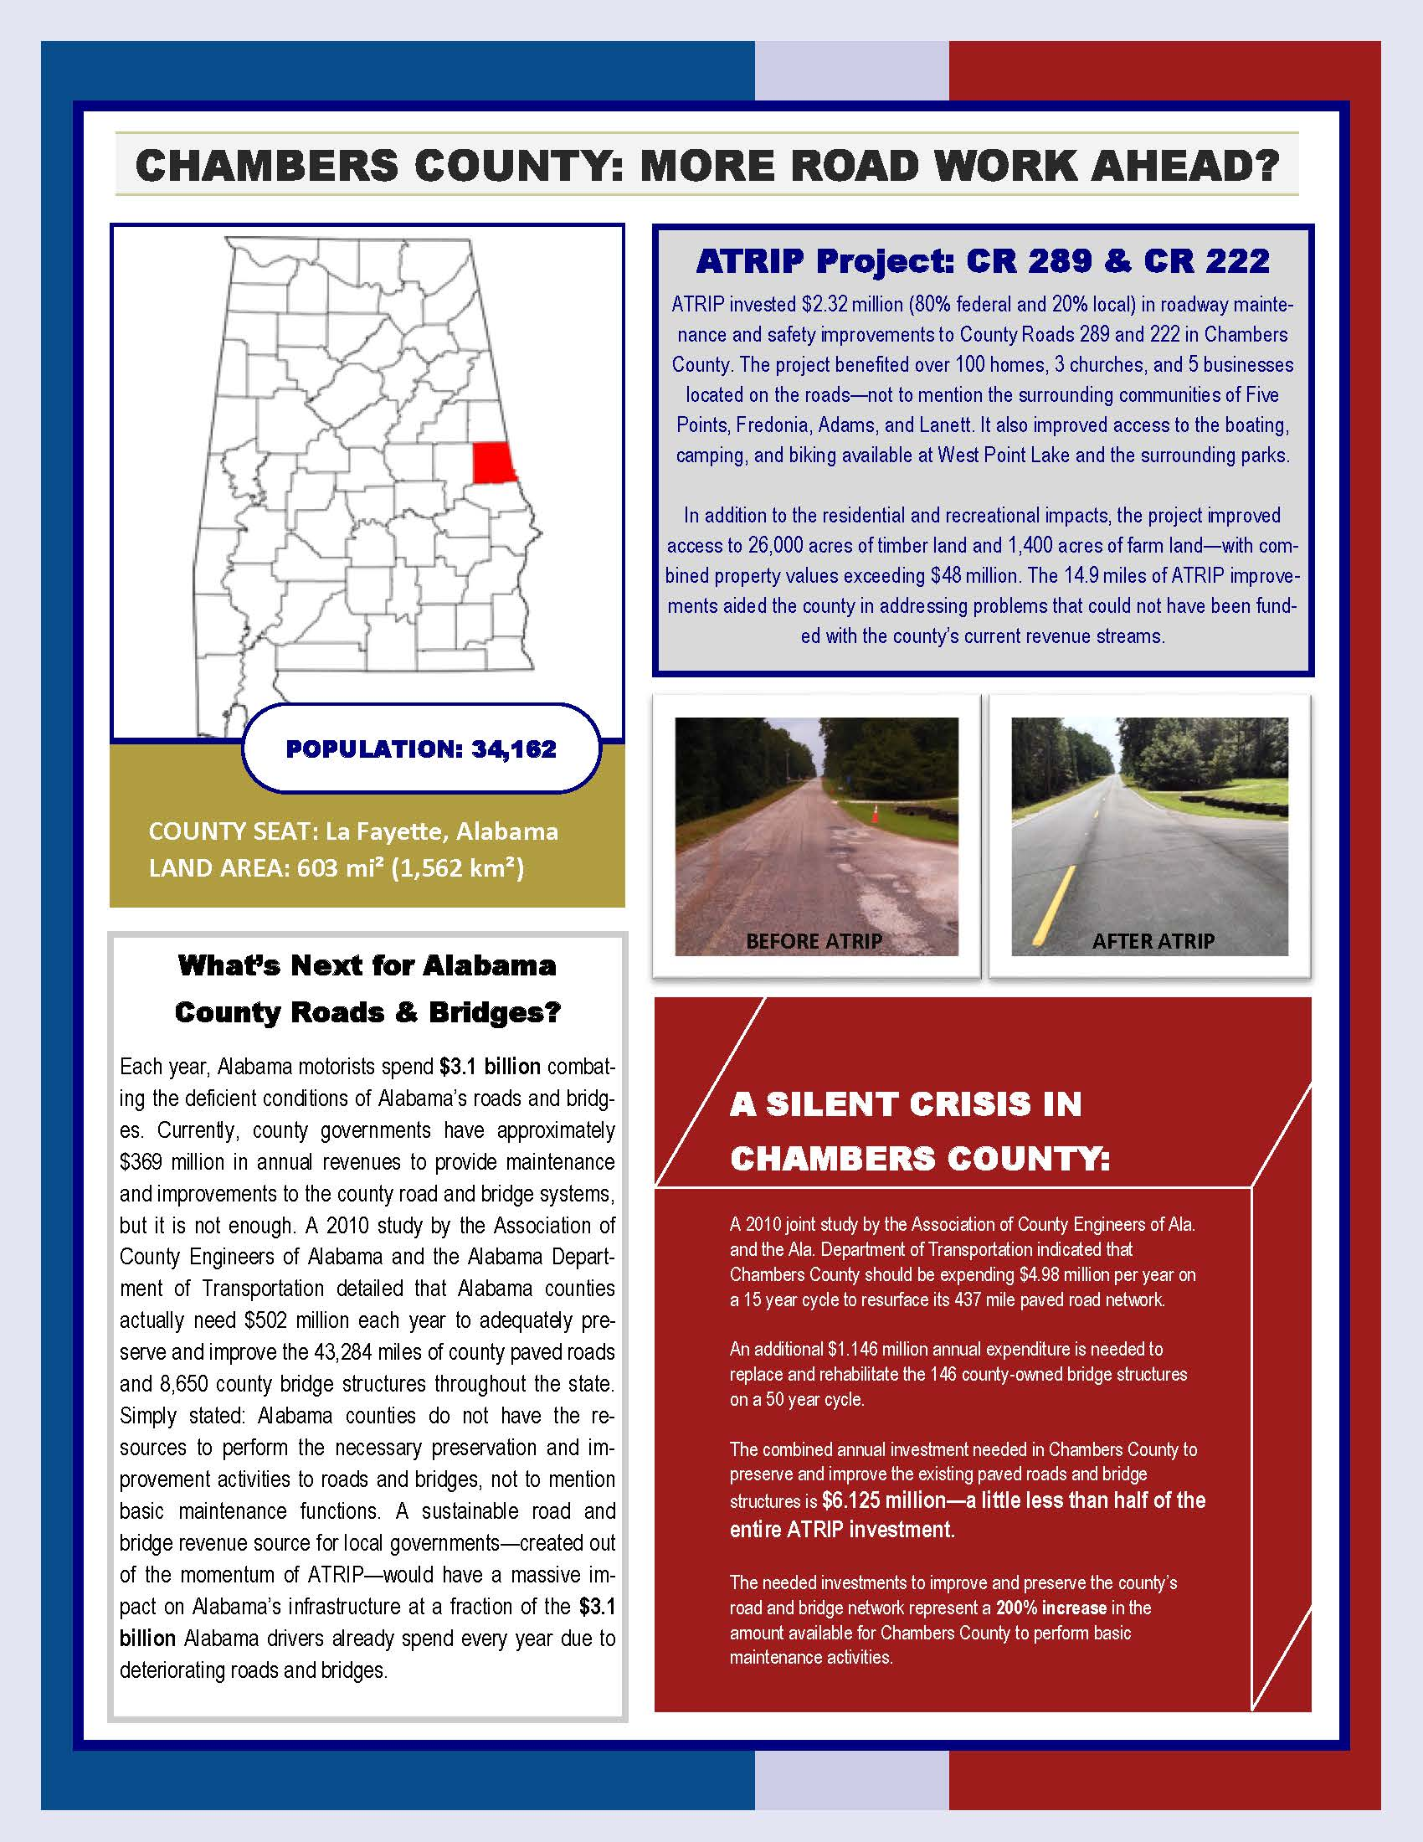
Bringing ATRIP Home…
Customizable for all counties;
Format to be used to educate public, legislators and media;
County can produce one for entire county or one for each ATRIP project.

Slide 4
ATRIP IMPACT TEMPLATE
TEMPLATE COUNTIES
Chambers County- Josh Harvill
Coosa County- Tad Eason
Washington County- Matt Rouse
Franklin County- David Palmer

Slide 5
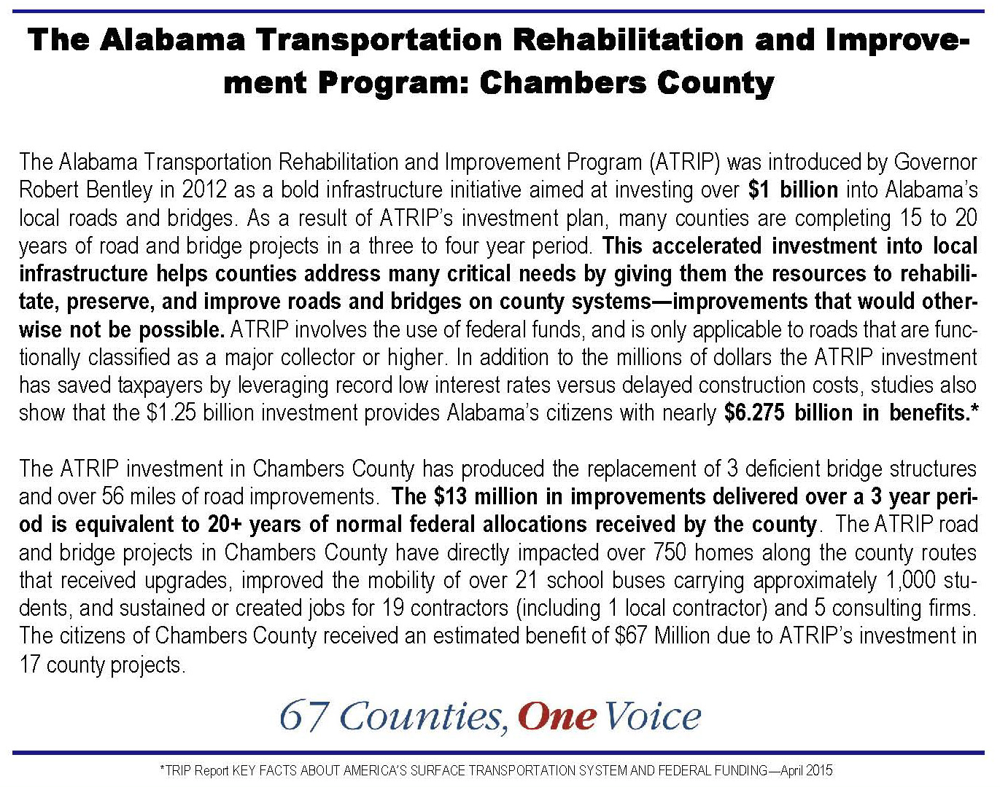
Anatomy of the TEMPLATE
Statewide Facts
County Specific Facts

Slide 6
Anatomy of the TEMPLATE- COUNTY SPECIFIC FACTS

Slide 7
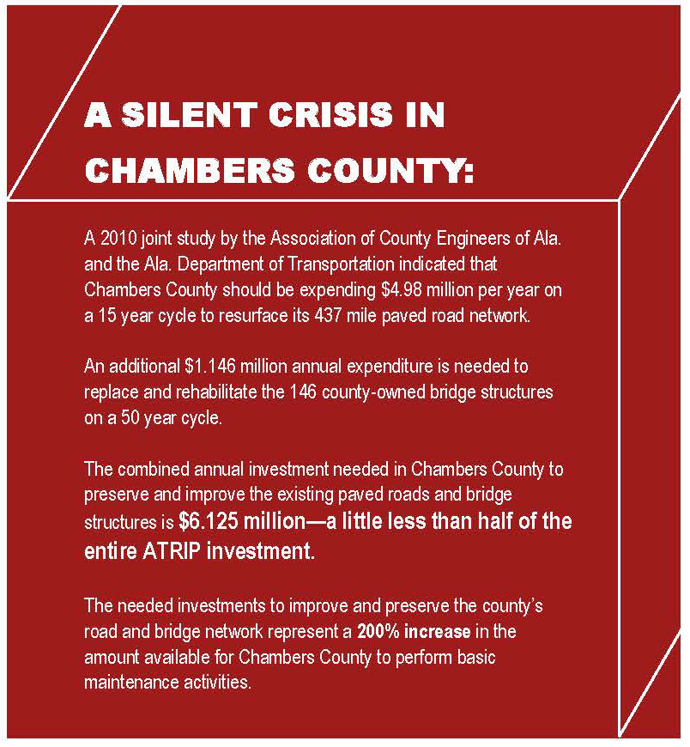
Anatomy of the TEMPLATE- SILENT CRISIS DATA REVISISTED

Slide 8
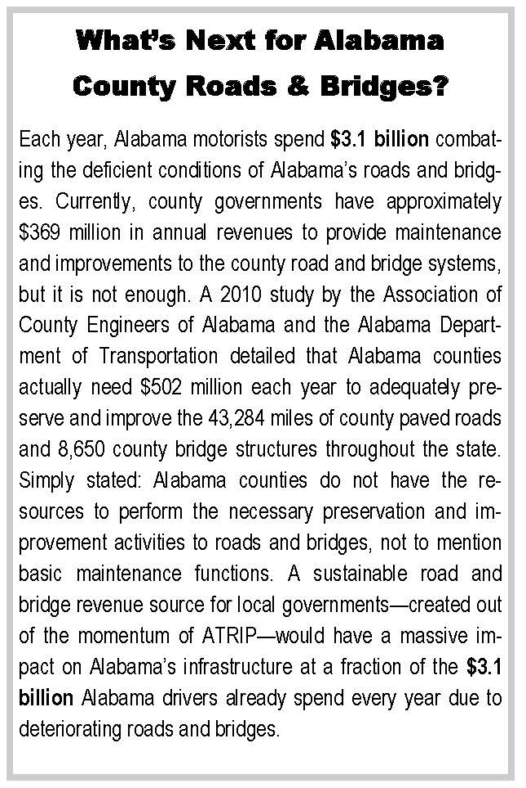
Anatomy of the TEMPLATE- LIFE AFTER ATRIP?

Slide 9
Anatomy of the TEMPLATE- PROJECT SPECIFIC IMPACTS

Slide 10
Anatomy of the TEMPLATE- PROJECT SPECIFIC IMPACTS

Slide 11
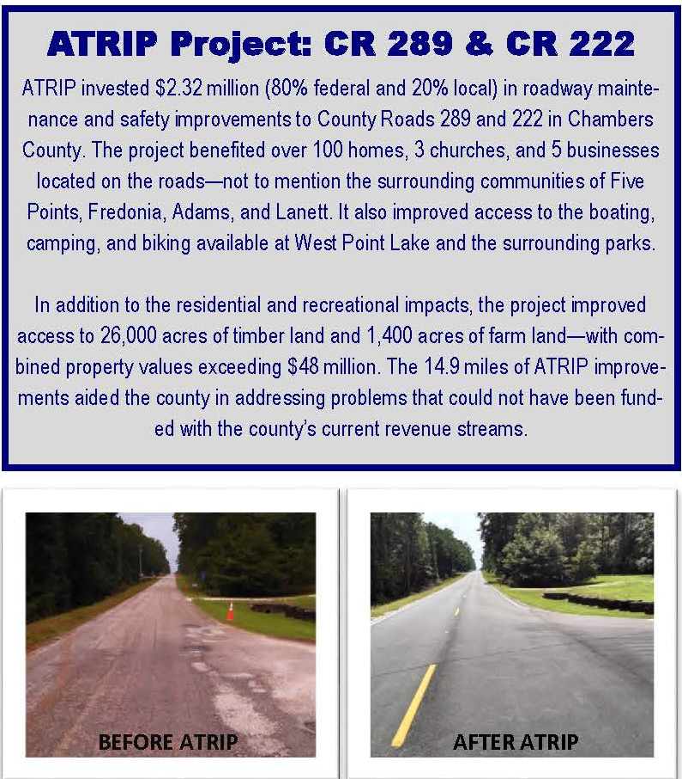
Anatomy of the TEMPLATE- PICTURES ARE PRICELESS

Slide 12
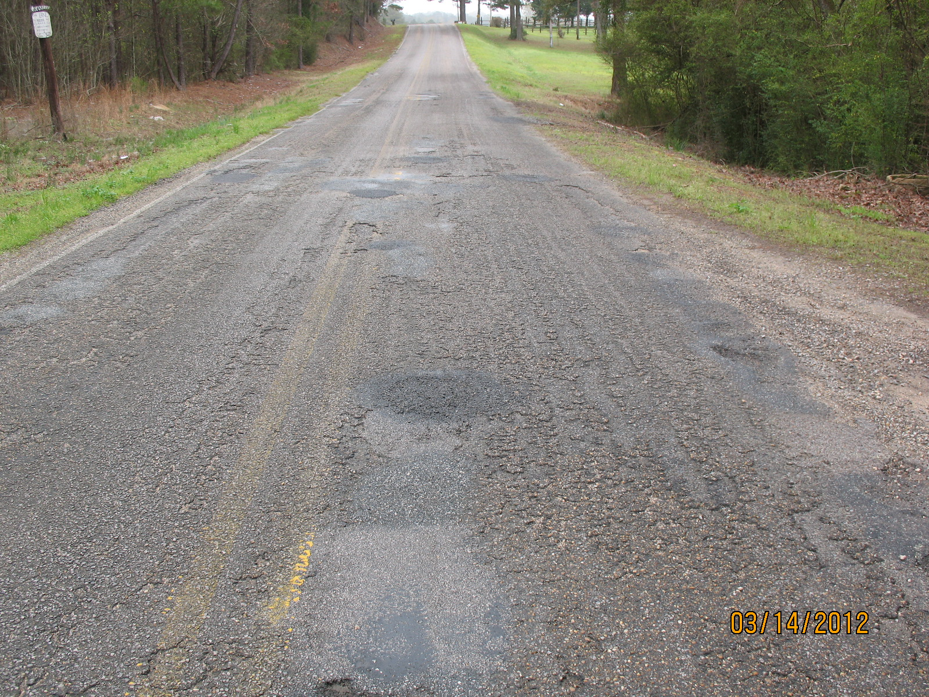
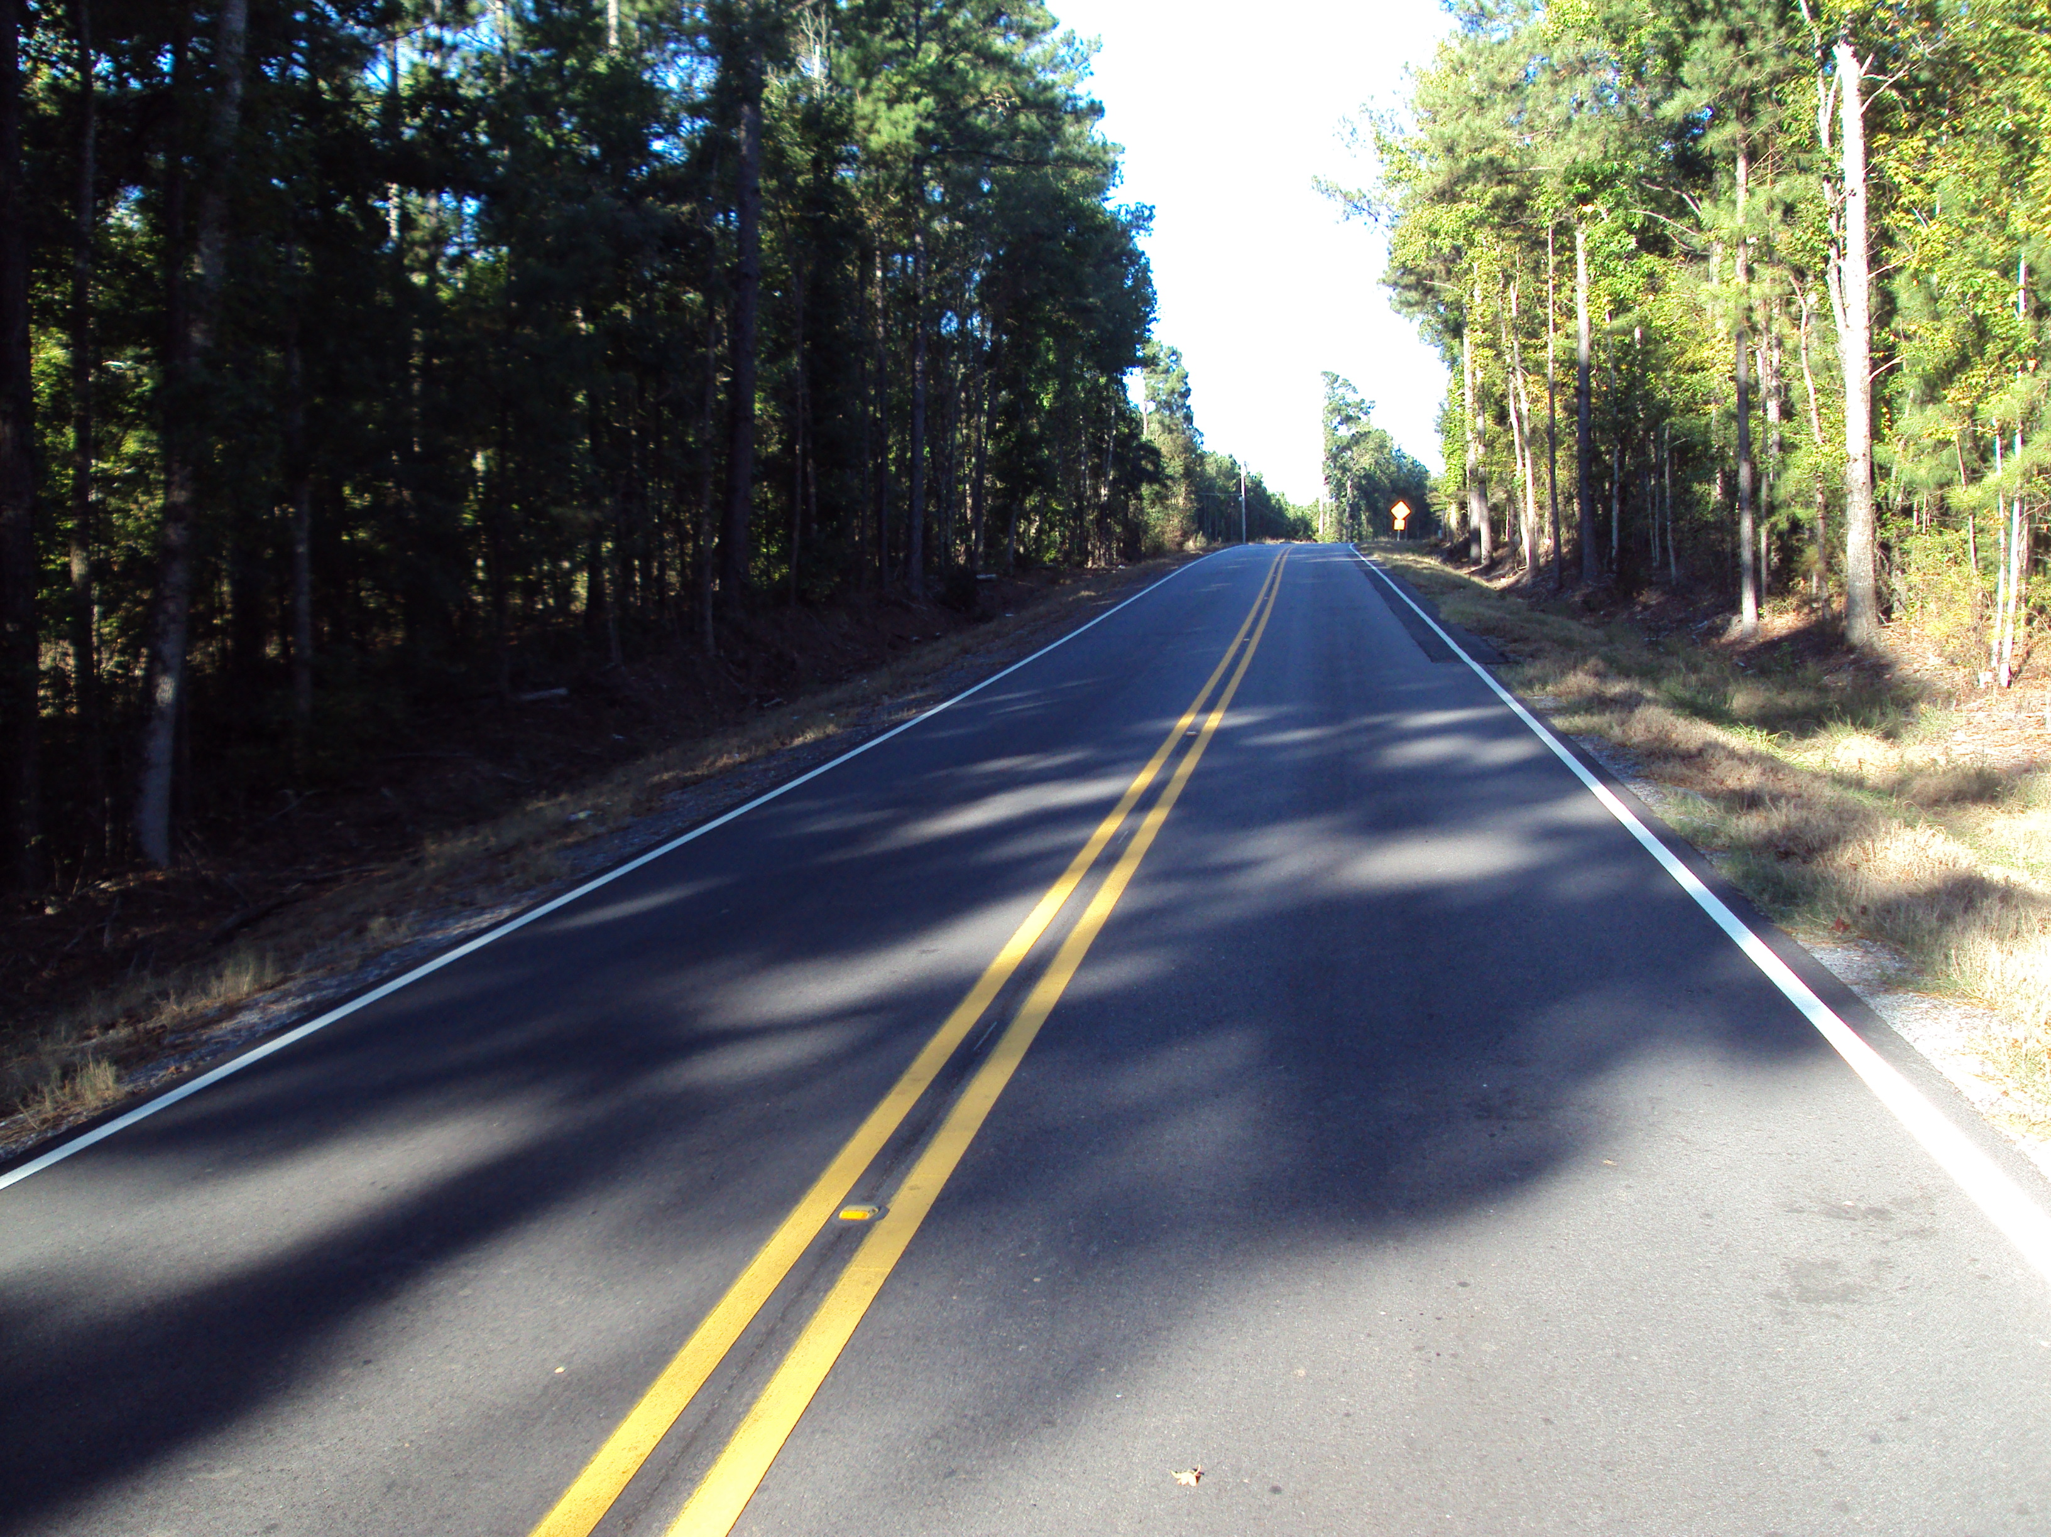
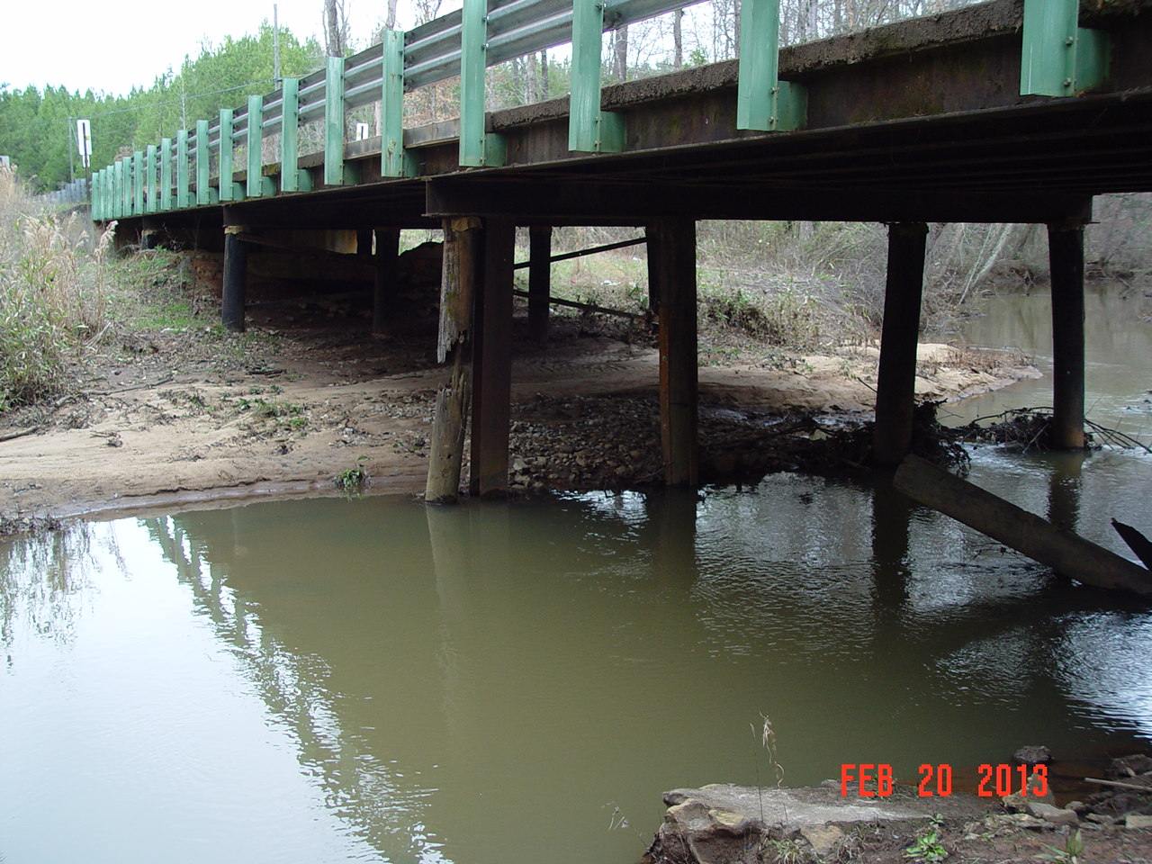
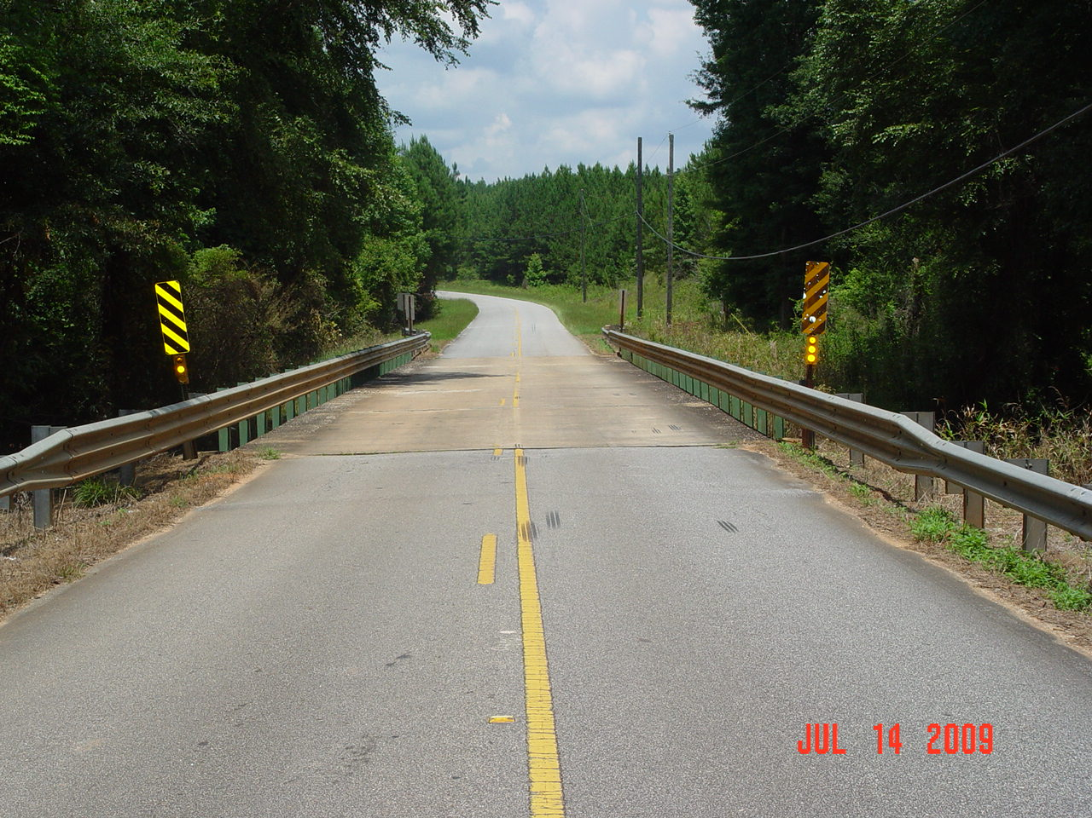
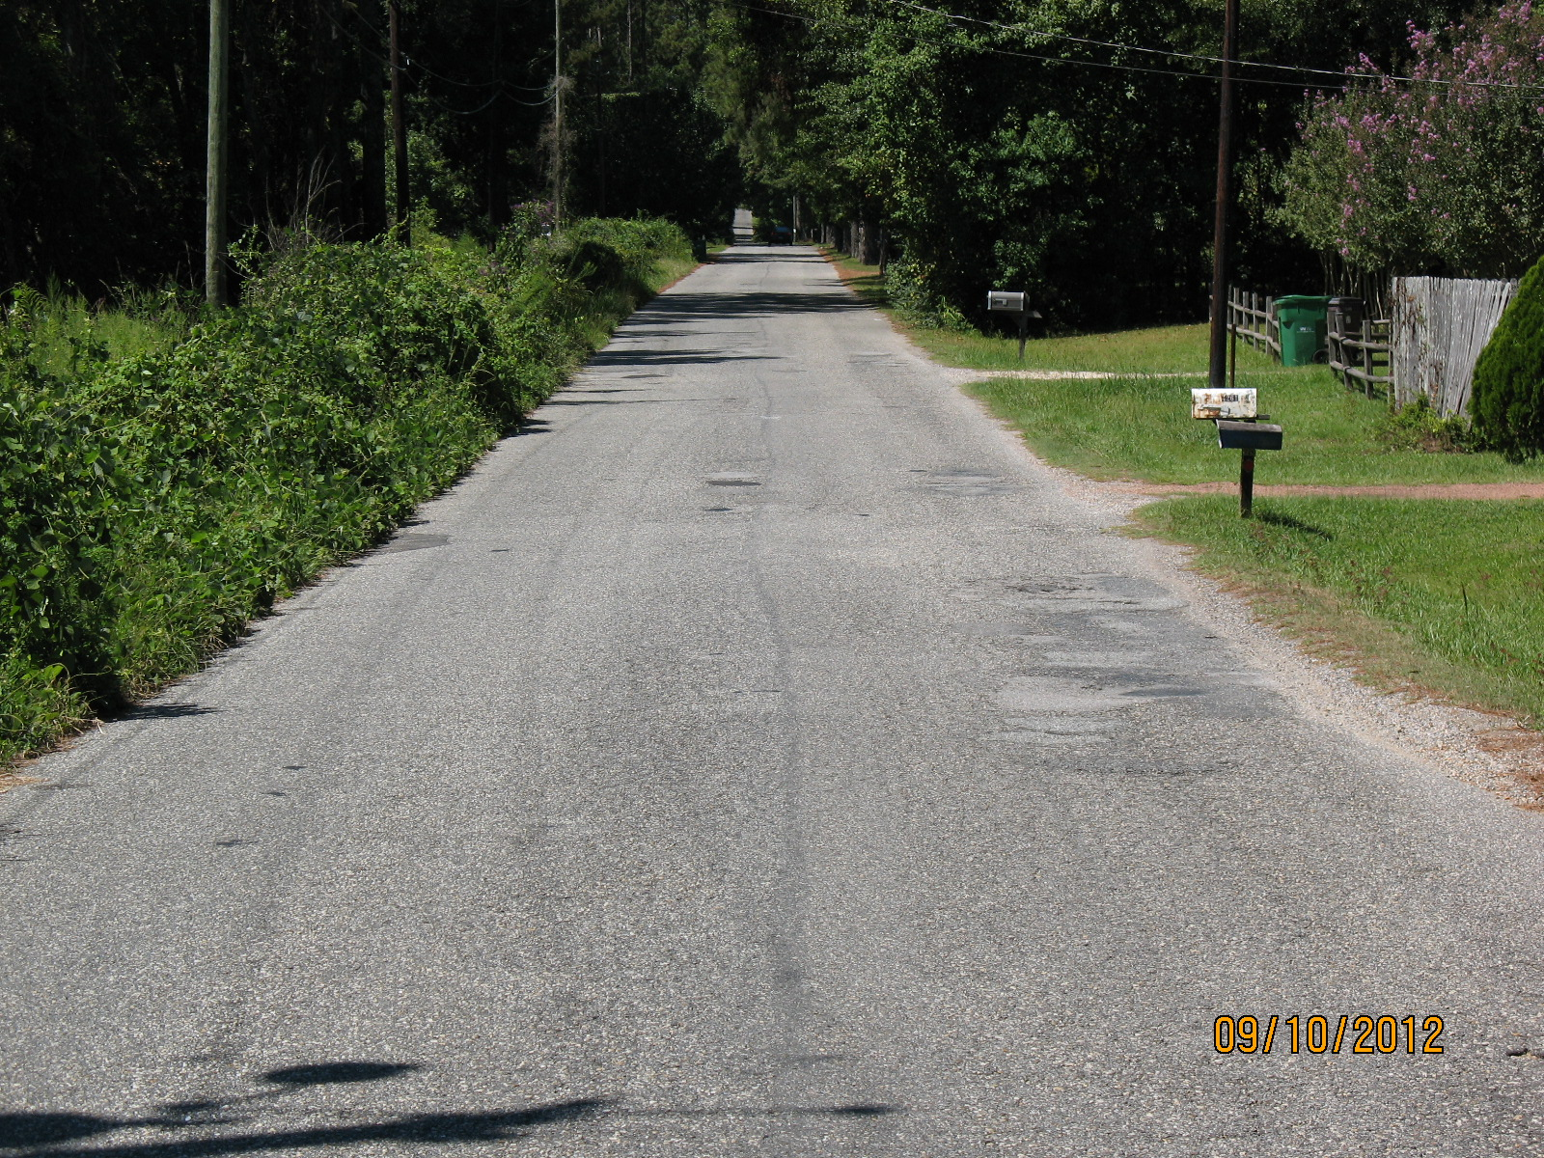
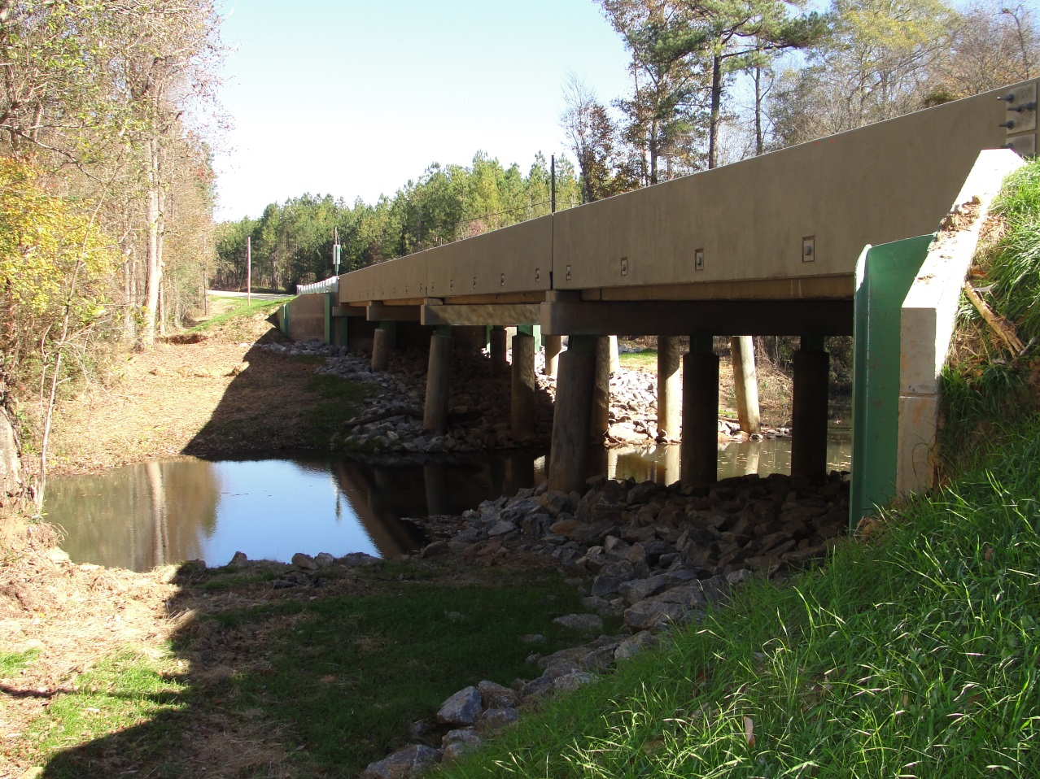
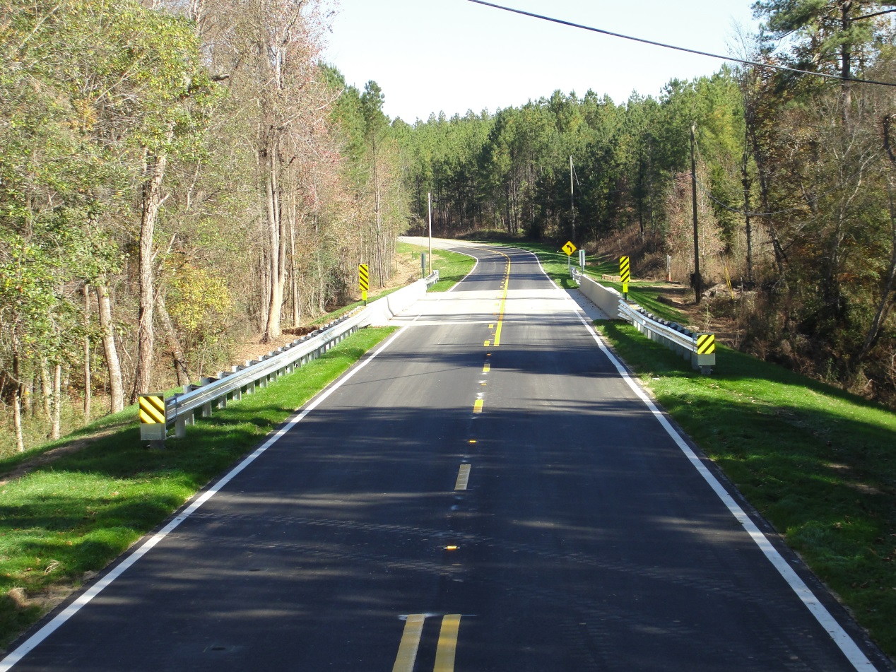

Anatomy of the TEMPLATE- worth 1000 words…

Slide 13
What Do We Need to ACCOMPLISH PROJECT IMPACT?
Gather the Data using the supplied chart adding any site specific factors that the project impacts;
Insert the data in a narrative format supplied;
Submit quality before and after photos of the ATRIP project;
Submit one, some or all projects for Impact Report formatting;
Association will transform the given data into a publishing quality document within a week of receipt.

Slide 14
WHAT CAN BE DONE WITH THE IMPACT DATA?
Commission Reports
Legislative Delegation Updates
Community Updates
Media Updates
ACCA Website Clearinghouse and Map

Slide 15
Next Steps
Sonny Brasfield

