Slide 1
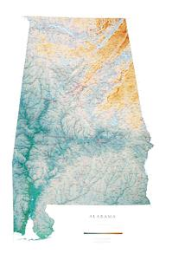
Justice Reinvestment in Alabama
Implementing SB67:
What Will Change at the Local Level?
ACCA Annual Convention
August 19, 2015
Andy Barbee, Research Manager
Sarina Rosenberg Asher, Project Manager
Kate Vacanti, Policy Analyst

Slide 2

Council of State Governments Justice Center
National non-profit, non-partisan membership association of state government officials
Engages members of all three branches of state government
Justice Center provides practical, nonpartisan advice informed by the best available evidence

Slide 3
CSG Justice Center and Alabama Justice Reinvestment
A data-driven approach to reduce corrections spending
and reinvest savings in strategies that can
decrease recidivism and increase public safety
The Justice Reinvestment Initiative is supported by funding from The Pew Charitable Trusts and the U.S. Department of Justice’s Bureau of Justice Assistance (BJA).

Slide 4
21 states have worked with the CSG Justice Center in the Justice Reinvestment process
WA
NH
VT
ID
WI
MI
RI
NV
NE
PA
CT
OH
IN
KS
WV
NC
AZ
OK
AL
TX
Past JR States
Current JR States
HI

Slide 5
CSG Justice Center’s work also includes extensive technical assistance to counties across the country
Hillsborough County, NH
Franklin County, OH
NYC, NY
(5 Counties)
Salt Lake County, UT
Johnson County, KS
Dallas County, TX
Bexar County, TX

Slide 6

Collaboration with counties to address system pressures

Slide 7
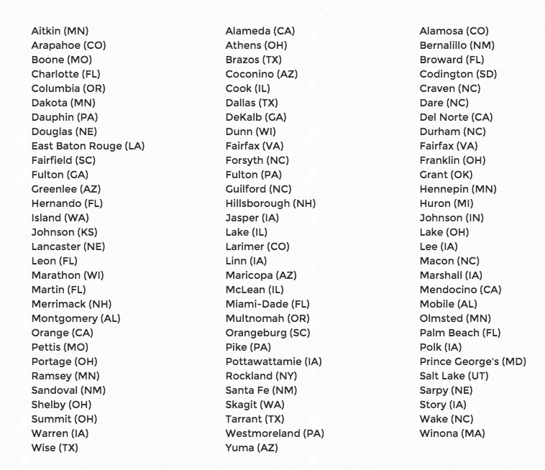
89 counties to date have passed “Stepping Up” resolutions – 2 in Alabama

Slide 8

Overview
Criminal justice system challenges
SB67 – What will change locally?
Planning for implementation

Slide 9
SB67 policy framework made possible through extensive stakeholder engagement and research
On-site Meetings and Other Stakeholder Engagement
9 focus groups with probation/parole and CCP staff representing 15 counties
Working lunches with judges and prosecutors in 3 judicial circuits
Meeting with nine county-level representatives, including county attorneys, commissioners, jail administrators, and community corrections directors
Visit to LIFE Tech transition center in Thomasville
Visit to Staton Correctional Facility to tour and interview
Victim advocate roundtables in Birmingham and Montgomery
3 days observing Parole Board operations
Attended monthly CCP Directors meeting
Statewide Surveys
Probation/Parole
Sheriffs (jail capacity)
Circuit Judges
CCPs
Data Analysis
Over 250,000 case-level data records spanning past six years

Slide 10
Goal of SB67 policy framework is to increase public safety and reduce prison overcrowding more cost-effectively
Challenge
1
2
3
Strategy
1
2
3
RECIDIVISM. Insufficient supervision and treatment resources, resulting in recidivism.
Strengthen community-based supervision & treatment to reduce recidivism
OVERCROWDED PRISONS. Alabama’s prisons are the most crowded in the country and majority of admissions are supervision violators and those convicted of lower-level property/drug offenses.
Prioritize prison space for violent and dangerous individuals
UNSUPERVISED RELEASES. Increasingly large number of people leaving prison each year without supervision.
Hold offenders accountable
in prison and after release

Slide 11
67% of people in Alabama’s felony criminal justice system are being supervised in the community
Community
Corrections
ADOC Custody Population
Probation
Parole
33%
53%
4%
10%
Two-thirds of Alabama’s felony criminal justice population is supervised in the community
 | Probation | CCPs | Parole
Avg. Population | 44,854 | 3,739 | 8,391
Avg. Supervision Term | 36 months | 18 months | 42 months
Source: Alabama Sentencing Commission felony sentencing data; Alabama Board of Pardons and Paroles probation and parole population data and parole entries data; FY2013 Annual Report, Alabama Department of Corrections.

Slide 12
40% of all admissions to ADOC custody are violators of either probation or parole
Admissions to ADOC Custody by Type of Admission
FY2013 Total Admissions = 8,313
Other
Probation revocations and parole violators combined represented 3,326 prison admissions in FY2013.
According to ADOC intake screening, 39% had either a substance abuse or mental health need (or both).
Parole Violators
Probation Revocations
New Commits
Source: Alabama Department of Corrections prison admissions data.

Slide 13
Significant share of probationers and parolees revoked to prison for technical violations
Admissions to ADOC Custody by Type of Admission
FY2013 Total Admissions = 8,313
36% of parole violators returned to prison are for purely technical reasons
Other
Parole Violators
27% of probation revocations to prison are for purely technical reasons
Probation Revocations
New Commits
Source: Alabama Department of Corrections prison admissions data; and Alabama Board of Pardons and Paroles parole and probation supervision data.

Slide 14
Alabama needs a more structured approach to respond to supervision violations swiftly, consistently, and cost-effectively
Aim
Finding
43% of probationers in jail awaiting a violation hearing are there longer than 2 weeks
Supervision violations are responded to meaningfully without delay
Swiftness
Variation across state in process for sanctioning
Largely dependent on local culture and court schedule
Graduated range of sanctions and incentives guide specific responses to violations
Consistency
Prioritize most expensive, restrictive sanctions for offenders committing the most serious violations
Cost-effectiveness
Little evidence of use of swift & certain sanctions

Slide 15
Overview
Criminal justice system challenges
SB67 – What will change locally?
Planning for implementation

Slide 16
SB67 and anticipated reinvestments impact local communities
Additional Resources for
Supervision Officers & Treatment
Collectively, these investments and changes in practice will:
Improve effectiveness of supervision,
Increase public safety, and
Reduce pressures on jails as well as prison population.
Increased Use of Evidence-Based Practices (EBPs)
Improved Accountability through More Cost-Effective Sanctioning
Ensuring Supervision for
All Released from Prison

Slide 17
Critical reinvestments into supervision workforce and treatment capacity
As a result of Justice Reinvestment…
Additional Resources for Supervision Officers & Treatment
100 additional probation/parole officers – reduces caseloads closer to 100:1
20 new case specialists to assist officers
Annual $8 million targeted for substance abuse and mental health treatment for highest risk probationers/parolees
Doubling of CCP reimbursement appropriations to handle additional diversions from new class D offenses
Increased Use of Evidence-Based Practices (EBPs)
Improved Accountability through More Cost-Effective Sanctioning
Ensuring Supervision for
All Released from Prison

Slide 18
Emphasizing what works to reduce recidivism and improve outcomes
As a result of Justice Reinvestment…
Additional Resources for Supervision Officers & Treatment
Implementing use of validated risk assessment tools for guiding supervision
Better targeting of limited resources towards higher-risk populations
Development of intermediate sanctions for timely and accountable response to supervision violations
Resources for training of officers on EBP core fundamentals and practices
Increased Use of Evidence-Based Practices (EBPs)
Improved Accountability through More Cost-Effective Sanctioning
Ensuring Supervision for
All Released from Prison

Slide 19

Assessing risk to reoffend and focusing supervision resources accordingly reduces recidivism
“One size fits all” approach is ineffective at changing behavior and reducing reoffense patterns
Moving forward, resources will be guided more by risk of reoffense, as measured through a validated assessment tool
Risk
Assess risk of re-offense and focus supervision on the highest-risk offenders
Assess for Risk Level…
…and Focus Accordingly
LOW
10%
re-arrested
MODERATE
35%
re-arrested
HIGH
70%
re-arrested
Low
Supervision/
Program
Intensity
Moderate
Supervision/
Program
Intensity
Risk of Re-offending
High
Supervision/
Program
Intensity
LOW
10%
re-arrested
MODERATE
35%
re-arrested
HIGH
70%
re-arrested

Slide 20
SB67 requires clear policies about focusing supervision resources
Level of Supervision
Treatment Referral
Sanctioning
Higher risk receive more intense supervision
Transitioning up/down intensity of supervision
Preparing for court review to early discharge
Higher risk/needs prioritized over lower risk/needs
Type of treatment
Coordinating treatment and supervision plans
Conditions for successful completion
Imposed according to severity of violation AND individual risk
Clearly communicated to defendant
Explicit checks and balances with local stakeholders (i.e. jail)

Slide 21
Using swift and certain sanctioning to reduce violations and need for more costly responses
As a result of Justice Reinvestment…
Additional Resources for Supervision Officers & Treatment
Policy-driven approach to using confinement in response to technical violations
Legal structure for imposing 2-3 day jail stays (limited total of 18 days)
Limits on length of jail confinement while awaiting hearings for technical violations of supervision
Capping prison stays for technical violations and neutering the “get off probation ticket”
Increased Use of Evidence-Based Practices (EBPs)
Improved Accountability through More Cost-Effective Sanctioning
Ensuring Supervision for
All Released from Prison

Slide 22
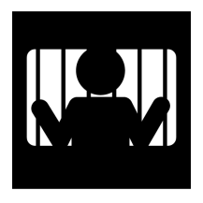
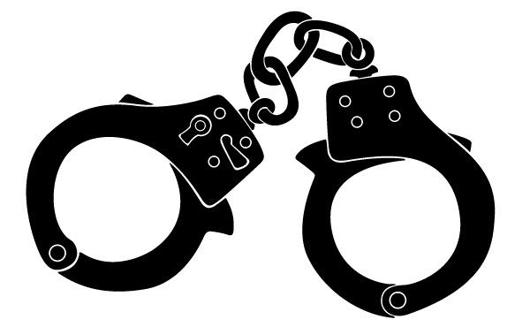

Probation/parole officers already had broad discretion to arrest technical violators and bring to jail
Typically when there were simply too many violations to tolerate any more
Failed drug tests
Missed appointments
Failure to pay fees/fines
But no authority to pull violator out and return to supervision, resulting in reliance on court dockets…
Days?
Weeks?
Months?
Time technical violator occupies jail bed awaiting hearing

Slide 23
Alabama sheriffs indicate numerous jail beds taken up by probation violators
Total Capacity Reported by Jails
9,135
1,202 free beds
22 of Alabama’s 67 counties responded to survey about their jails
These counties represent 59% of the state population
Occupied Beds
7,933
1,503 are probation violators awaiting their court hearing
Represents 16% of jail beds being used for probation violators
Source: Fall 2014 statewide survey of sheriffs for county jail capacity and population statistics.

Slide 24

Traditional stacking of probation violators in county jails
Number of Days in Jail Awaiting Hearing
1
2
3
4
5
6
7
8
9
10
11
12
13
14
15
…the jail would ultimately reach a
daily population of 15 probation violators awaiting their hearing.
If every day
the jail received
a probation violator
who would end up
waiting about 15 days for their revocation hearing…

Slide 25
Swift and sure sanctioning places much less burden on jails
Number of Days in Jail Awaiting Hearing
1
2
3
…the jail would ultimately reach a
daily population of 3 probation violators.
If every day
the jail received
a probation violator
who would spend 3 days
on a sanction and then released back to supervision…

Slide 26
The “math” of swift & sure sanctioning is favorable to local jail pressures
Traditional
Swift & Sure
1 violator per day at 15 days each = jail capacity demand of 15 beds
1 violator per day at 3 days each = jail capacity demand of 3 beds
3 violators per day at 3 days each = jail capacity demand of 9 beds
5 violators per day at 3 days each = jail capacity demand of 15 beds
A “swift & sure” approach would accommodate five times more probationer sanctions than under the traditional approach…without requiring more jail beds.

Slide 27
SB67 creates structures within existing broad discretion of probation/parole officers to arrest and bring to jail
Status Quo
Aim
Simply too many violations to tolerate any more
Local coordination with understanding of swift/certain effectiveness
When appropriate?
How carried out?
Who is measuring?
What are impacts?
Building local understanding and mutual accountability

Slide 28
Swift and sure policies in other states show declining arrests, time spent in jail, and prison population
Hawaii HOPE
Intensive, random drug testing with swift, certain, and brief jail sanctions to supervision violations.
Georgia POM
Prompt sanctions to correct behavior of troublesome probationers.
North Carolina
Swift and certain “dips” of brief jail sanctions and “dunks” of prison sanctions in response to violations.
Arrested
Days in Jail
Prison Admissions
Status Quo
- 55%
Status Quo
- 74%
2011
- 51%
47%
31 Days
15,188
2014
HOPE
7,440
21%
POM
8 Days
Source: An Evaluation of Georgia’s Probation Options Management Act, Applied Research Services, October 2007; Managing Drug Involved Probationers with Swift and Certain Sanctions: Evaluating Hawaii’s HOPE, Hawken, Angela and Mark Kleiman, December 2009.

Slide 29
Effective jail sanctioning requires local collaboration
When Appropriate:
Not all violations, even of the same type, warrant a jail sanction
Determined by policy and guided by risk along with nature of violation
Total of 18 days to work with, but nothing requires using even one day, much less all 18…
Taking into Custody:
Sign-off by probation/parole managers
Follow protocols for securing appropriate warrant
Presenting to Jail:
Appropriate paperwork
Clear information gathered allowing for security and medical screening by jail
Release from Jail:
Clear orders as to release date (never more than 2-3 days)
Violator shall return to supervision

Slide 30
Reducing instances of prisoners being released back into communities unsupervised
As a result of Justice Reinvestment…
Additional Resources for Supervision Officers & Treatment
All Class C sentences to prison will be splits guaranteeing release on the back-end
Remaining non-life straight sentences to prison will have a guaranteed term of post-release supervision ranging from 3-12 months depending on original prison sentence length
Increases post-release supervision to cover more than 95% of all prisoners released into communities
Increased Use of Evidence-Based Practices (EBPs)
Improved Accountability through More Cost-Effective Sanctioning
Ensuring Supervision for
All Released from Prison

Slide 31
Overview
Criminal justice system challenges
SB67 – What will change locally?
Planning for Implementation

Slide 32
It’s all about collaboration…
Implementation Oversight Structure
Alabama Criminal Justice Implementation and Oversight Council established by Executive Order
Local Engagement and Implementation Sub-Committee
Representation from the ACCA, Alabama Sheriff’s Association, and Community Corrections Program Directors
Engagement Opportunities
Education and training on SB67 changes at county association conferences
Potential county-level pilot to track and measure the impact of intermediate sanctions on county resources
More Information
Q&A breakout session for Sheriffs 1:30-3:30 pm (8/19, ACCA Convention)
AL Justice Reinvestment webpage: www.csgjusticecenter.org/jr/al
Notes:
Oversight Structure
CSG will continue to provide technical assistance throughout the implementation phase, made available by the U.S. Department of Justice, Bureau of Justice Assistance (BJA), and work with all system stakeholders, at both the state and local level, to pursue of common goal of ensuring that Alabama’s JR policies are implemented successfully and on time.
The Oversight Council was created by Executive Order and is responsible for overseeing implementation. The Council will engage state and local leaders to help plan for development of policies and strategies to fulfill the objectives of SB 67, to address operational challenges, and monitor the impact of policy changes on the local level.
The Local Engagement Sub-Committee will include representation from the ACCA, Sheriff’s Association, and CCP Programs and will make sure that local stakeholders are in the loop on the development of policies and procedures and have an opportunity to provide input. We are still in the process of determining the membership of this group and developing a work plan.
Engagement Opportunities
CSG and members of the Oversight Council will be speaking at conferences to train and educate system stakeholders on SB 67
We are slated to speak at upcoming judicial conference and CCP Director conference. We are open to suggestions for other opportunities to speak to system stakeholders.
We are currently exploring the possibility of working with some counties on a pilot to closely track and measure the impact of intermediate sanctions at the county level.
We are also looking into the possibility of creating a website to disseminate information and updates on SB 67 implementation and provide educational resources.

Slide 33
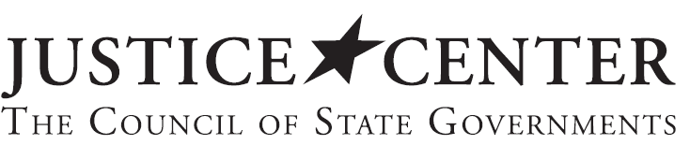
Thank You
Kate Vacanti
Policy Analyst
kvacanti@csg.org
CSGJUSTICECENTER.ORG/SUBSCRIBE
This material was prepared for the State of Alabama. The presentation was developed by members of the Council of State Governments Justice Center staff. Because presentations are not subject to the same rigorous review process as other printed materials, the statements made reflect the views of the authors, and should not be considered the official position of the Justice Center, the members of the Council of State Governments, or the funding agency supporting the work.

