Slide 1
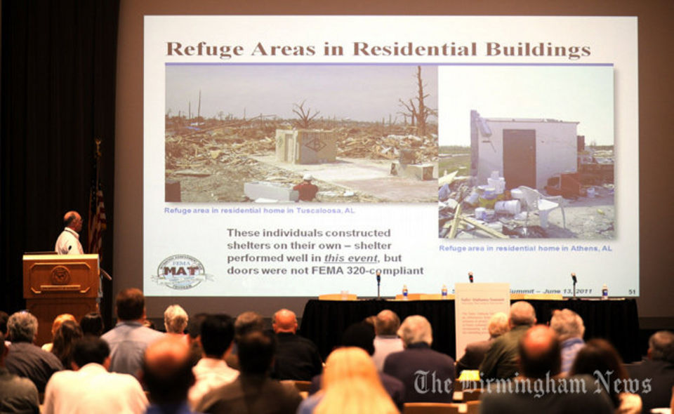
FUEL UP FOR A NEW DAY: SAFE ROOMS IN ALABAMA
The Birmingham News Photo

Slide 2
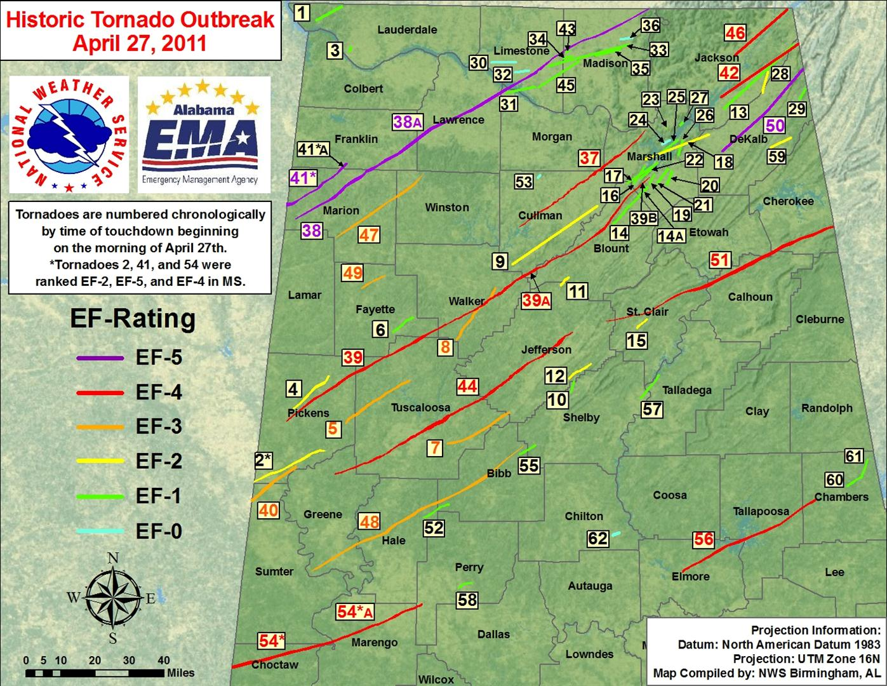
FUEL UP FOR A NEW DAY: SAFE ROOMS IN ALABAMA

Slide 3
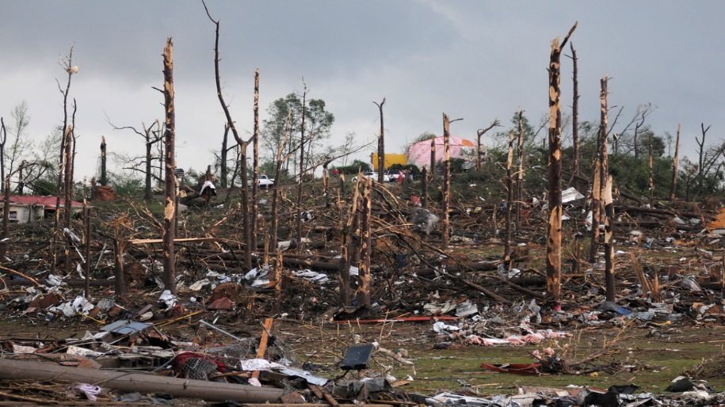
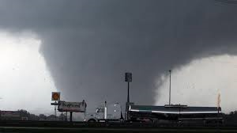
FUEL UP FOR A NEW DAY: SAFE ROOMS IN ALABAMA
The April 27, 2011, outbreak a path that stretched 1177 miles long, 20 miles wide, and an area of 23,540 square miles.
In total, there were 62 confirmed tornadoes across the State of Alabama.
National Weather Service / ESRI
http://www.srh.noaa.gov/bmx/?n=event_04272011

Slide 4
FUEL UP FOR A NEW DAY: SAFE ROOMS IN ALABAMA
“Safe Rooms”
As you may well know a “Safe Room” is a hardened structure specifically designed to meet the Federal Emergency Management Agency (FEMA) criteria and provide near-absolute protection in extreme weather events, including tornadoes and hurricanes.
Near-absolute protection means that, based on our current knowledge of tornadoes and hurricanes, the occupants of a safe room built in accordance with FEMA guidance will have a very high probability of being protected from injury or death.
Types of “Safe Rooms” include Residential, Community, and Special Needs shelters.

Slide 5
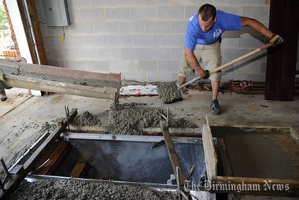
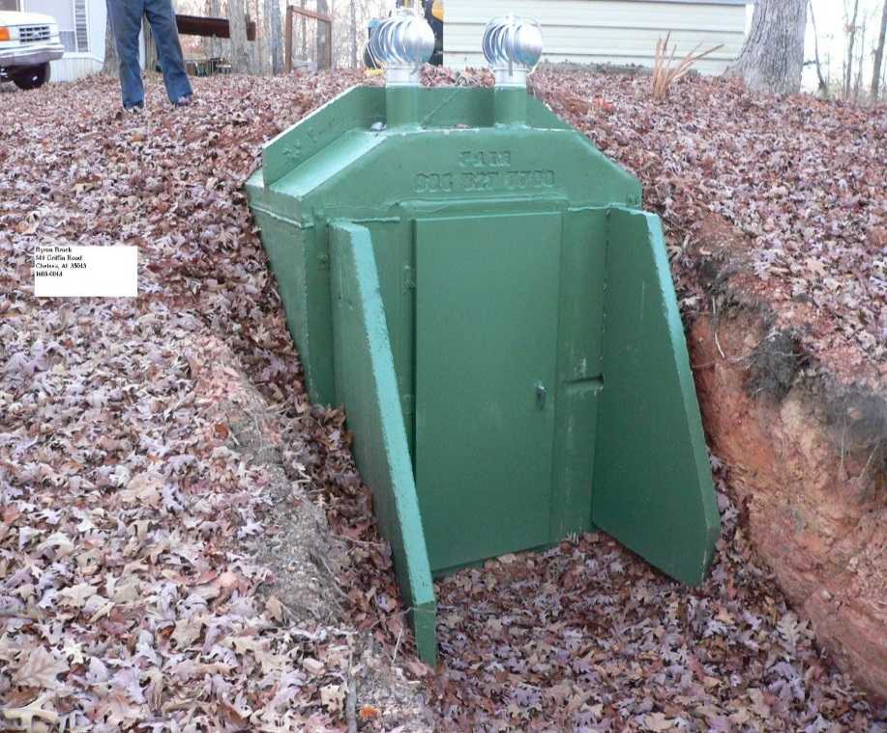
RECOVERY
Residential Safe Rooms Approved: 4078

Slide 6
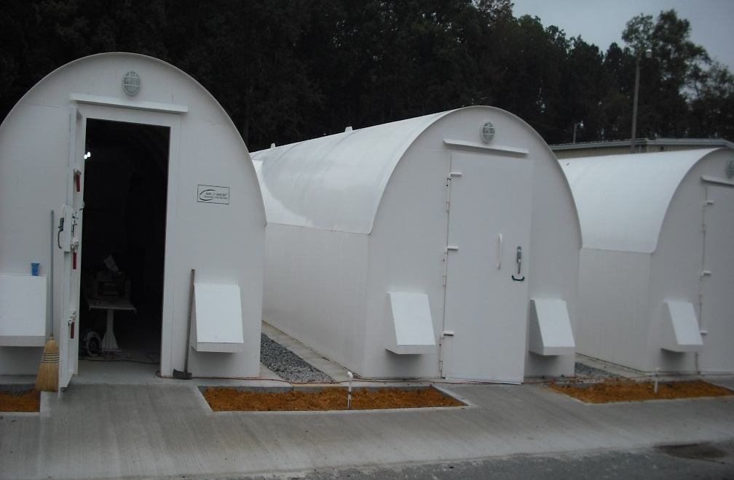
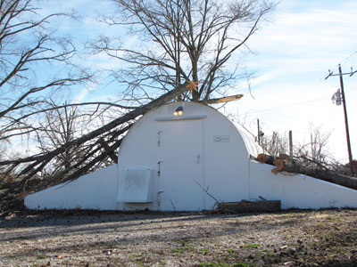
RECOVERY
Community Safe Rooms Approved: 286

Slide 7
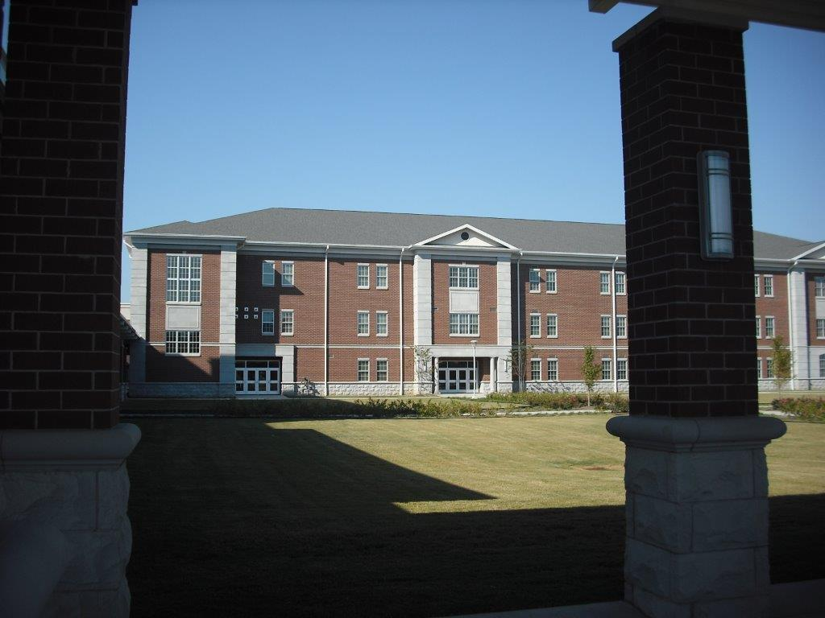
FUEL UP FOR A NEW DAY: STORM SHELTERS IN ALABAMA
TYPES OF SAFE ROOMS
Public and Community Safe Rooms
New Enterprise High School

Slide 8
FUEL UP FOR A NEW DAY: SAFE ROOMS IN ALABAMA
In order to mitigate the risks from a variety of natural hazards such as tornados, wind storms, hurricanes, winter weather, lightning, and severe thunder storms to name a few, Alabama created a comprehensive severe weather mitigation program that includes:
Public education
Utilization of a variety of funding sources
Participation in the Hazard Mitigation program for Safe Rooms. The Safe Room program uses funding to help communities construct safe rooms and community shelters

Slide 9
FUEL UP FOR A NEW DAY: SAFE ROOMS IN ALABAMA
Shelter program applicants and proposed projects are subject to state and federal Hazard Mitigation Grant Program (HMPG) requirements and must follow all guidelines, rules, and regulations.
Additionally, the state developed a strategy to administer this program through the Alabama Emergency Management Agency and in partnership with FEMA and County Emergency Management Agencies.
The strategy included prioritizing shelter HMPG applications in accordance with the Safe Room program goals.

Slide 10
FUEL UP FOR A NEW DAY: STORM SHELTERS IN ALABAMA
Things you can do now to prepare:
Be ready for the next round of funding in the event of a disaster
Know whom to speak with as you work to educate you and your staff about the application process
Prepare the “Letter of Intent” application ahead of time pending a disaster declaration so you will be ready to apply
Ensuring that the local match (25%) is dedicated and identified ahead of time
Align priority mitigation projects with the local Hazard Mitigation Plan in the event demand exceeds available HMPG funding.
You will have the opportunity tomorrow in the AAEM Breakout Session to meet Jeff Smitherman, AEMA Director of Recovery Operations, as he presents on the topic of “AEMA Regional Mitigation Plans”. Jeff will also be able to answer questions should you have any regarding the mitigation and recovery process.

Slide 11
FUEL UP FOR A NEW DAY: STORM SHELTERS IN ALABAMA
Closing Remarks

