Slide 1
Procedural Requirements For Force Account Work on Federal and State Projects
2015 ACCA Conference Orange Beach, Alabama

Slide 2
Notes:
When I talk to some local agencies like yourselves and ask them about force account, this is typically the look I get

Slide 3
Notes:
Why? Because , lets be realistic. You probably don’t do many of them that often and it is perceived to be so much paperwork involved that frankly it isn’t worth your time. Then you have to consider deciphering the specs and how to pay for it…it can be overwhelming

Slide 4
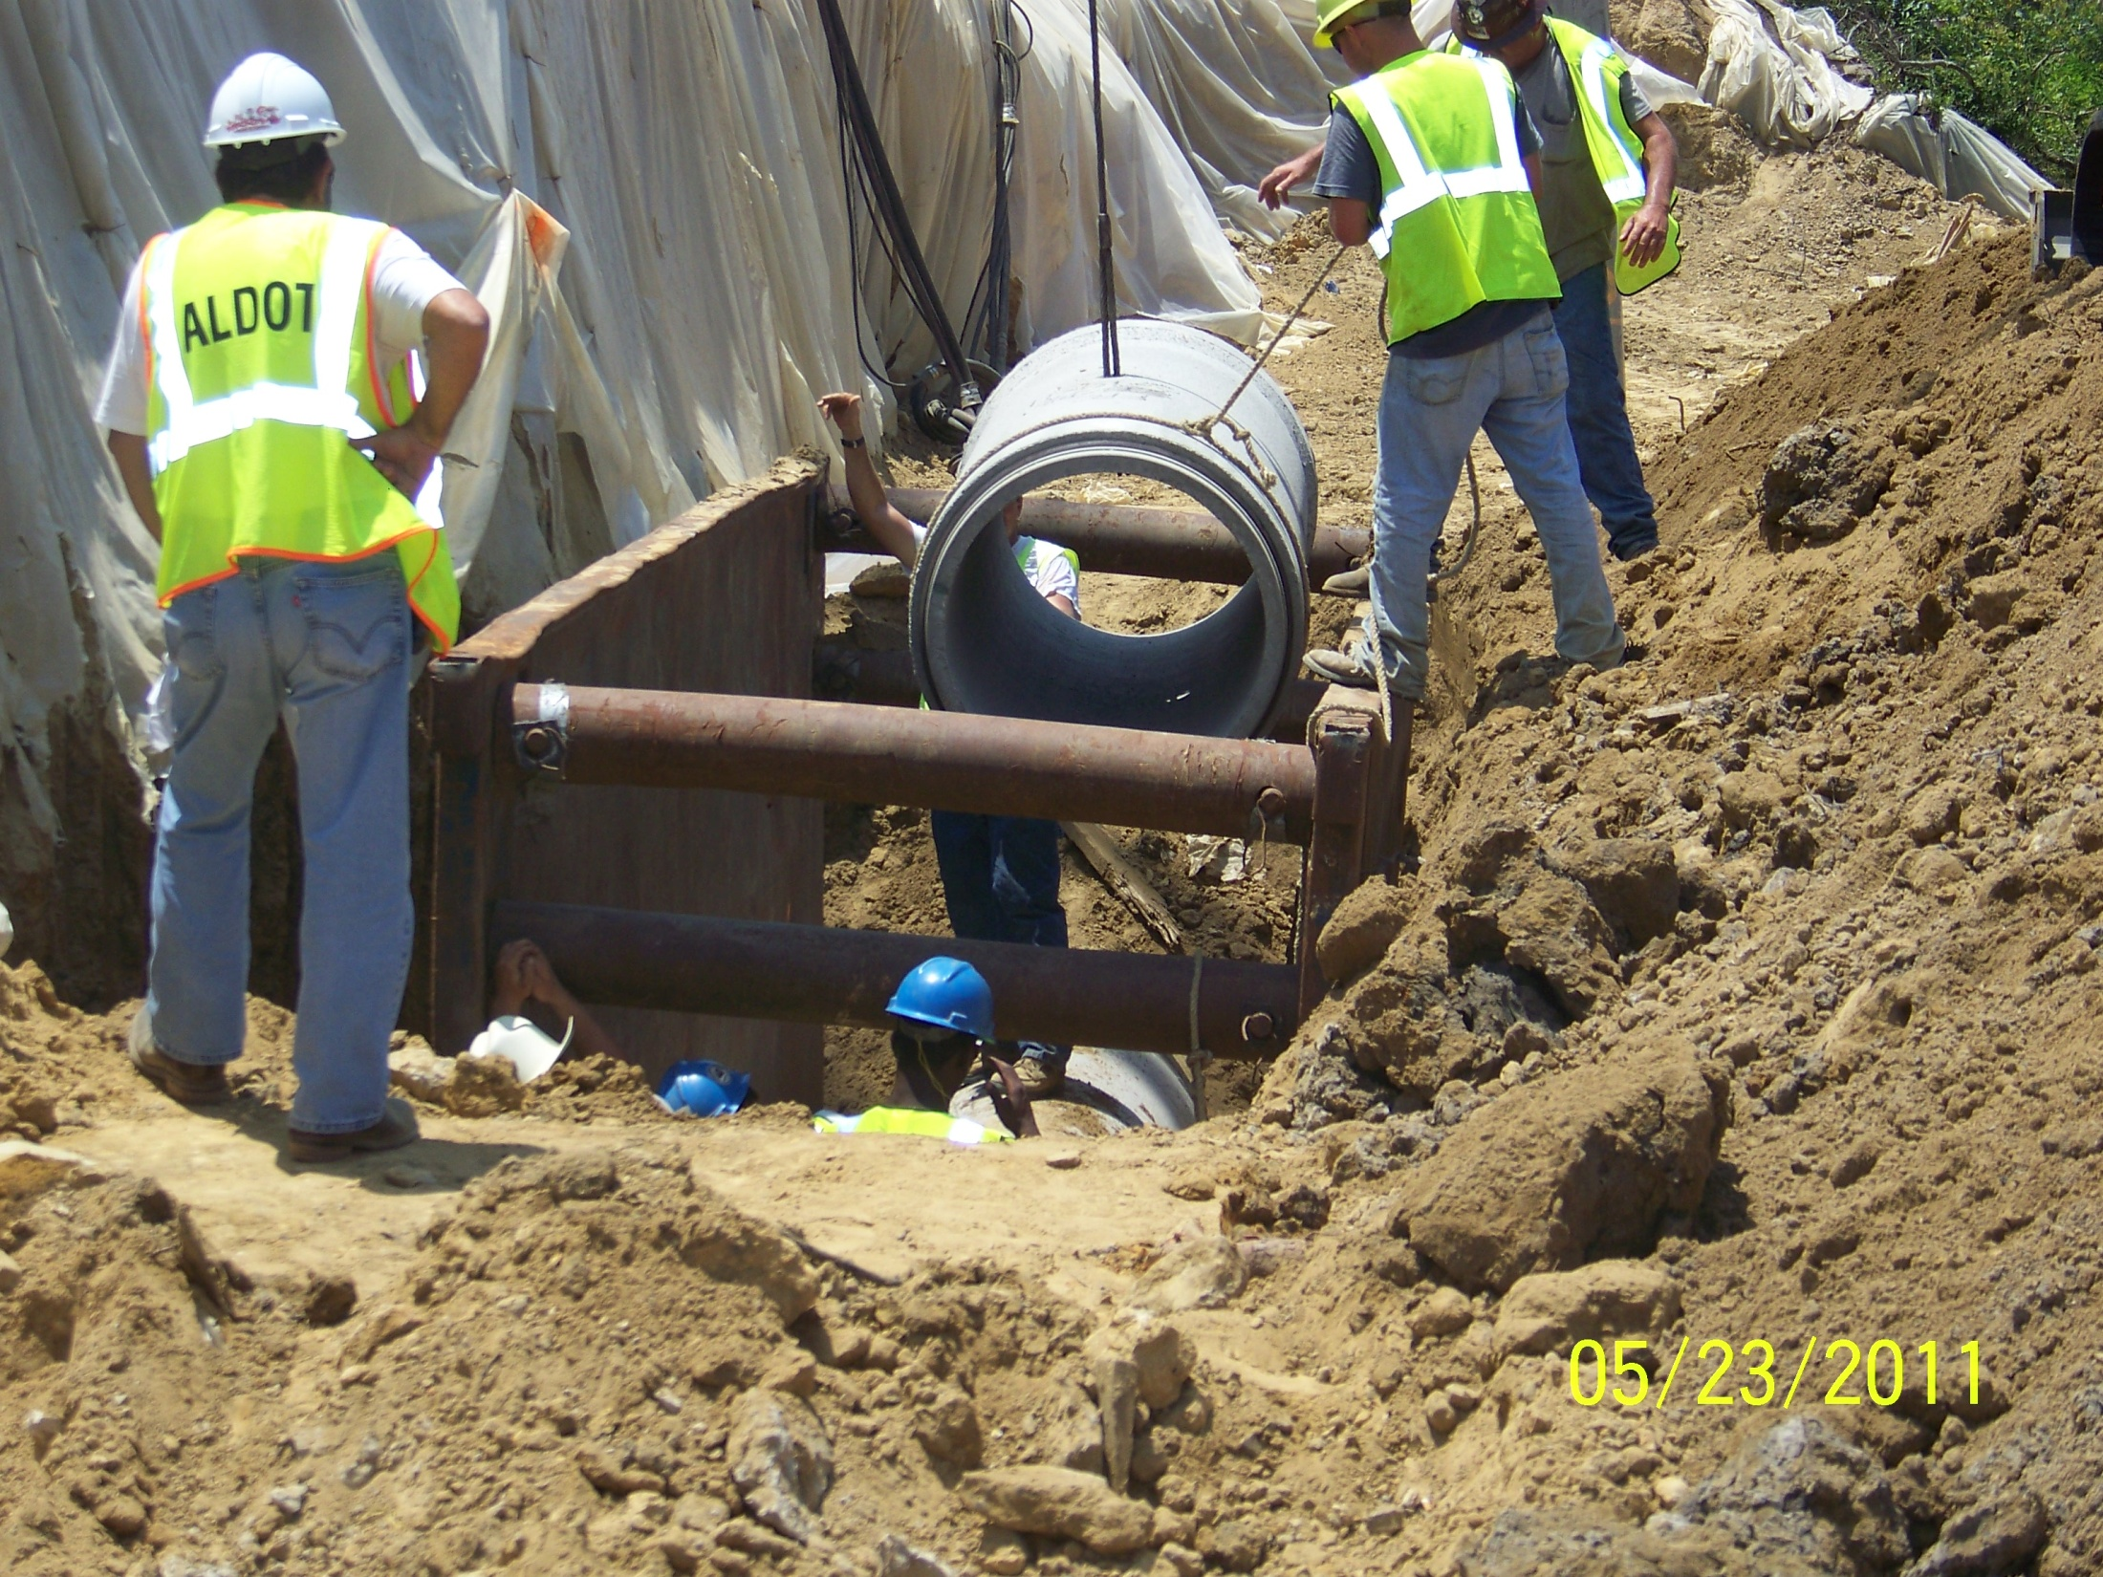
Storm Drain Operation
Notes:
Normal operations aren’t always as it appears and occasionally something unique and interesting confines or restrains from constructing items of work using normal operations and equipment

Slide 5
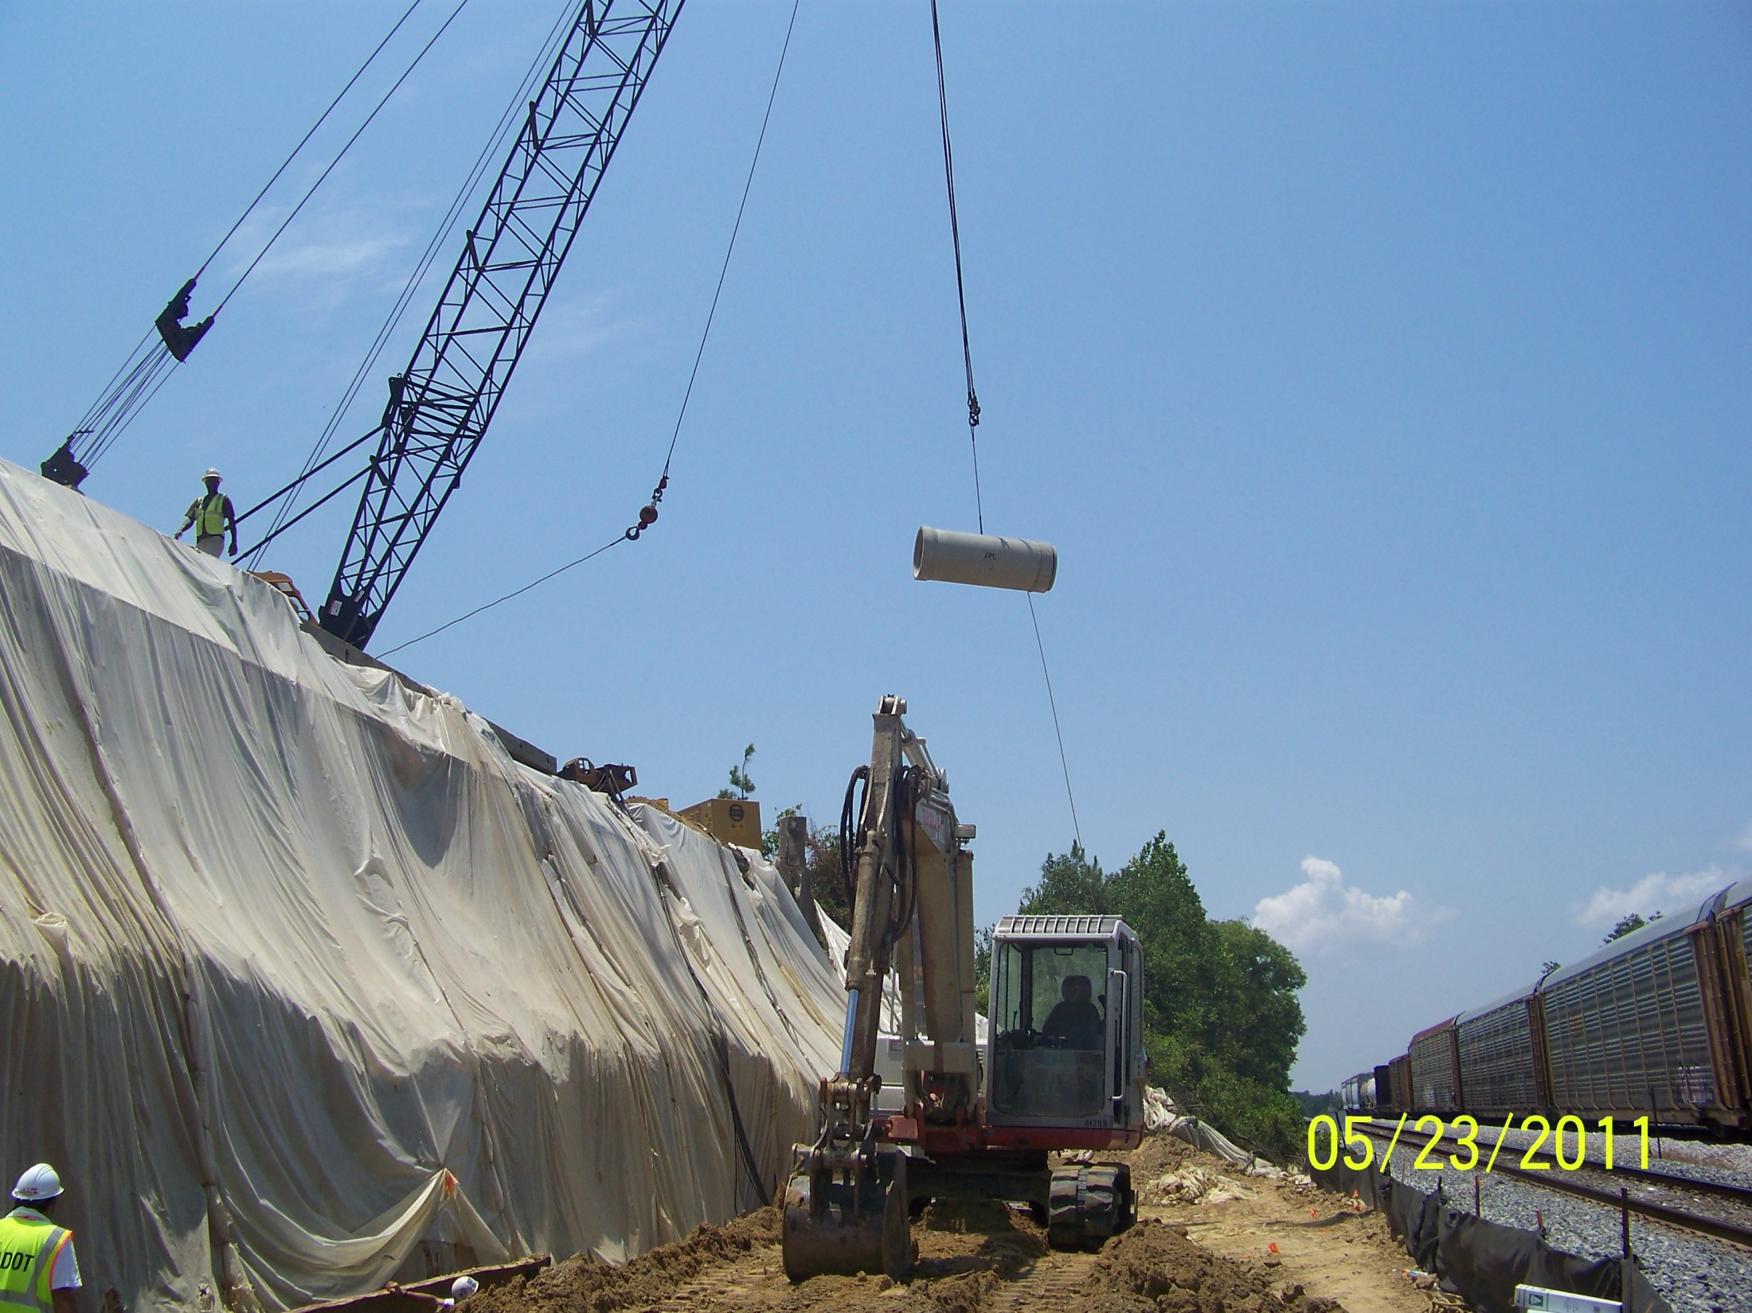
Notes:
For example. Laying 48” storm drain pipe with a crane due to existing bridge footings that were in conflict and a restriction by the RR that no large equipment could be in the vicinity of the tracks

Slide 6
Definition of Force Account
Article 109.04/ Special Provision 12-0769
Extra & Force Account Work
Method of paying contractor forces for extra work encountered and deemed not a part of the original scope of work in the contract. “Cost plus”
Used when pricing cannot be negotiated between both parties
Good tool for establishing prices for unique work
Notes:
In these cases and many others, this work is accomplished and the contractor is compensated under force account. Force account used on projects when extra work is encountered and deemed not a part of the original scope of work. In addition, this is used when pricing cannot be negotiated between both the owner and the contractor. Payment for such work is defined in the Standard Specifications under Section 109.04

Slide 7
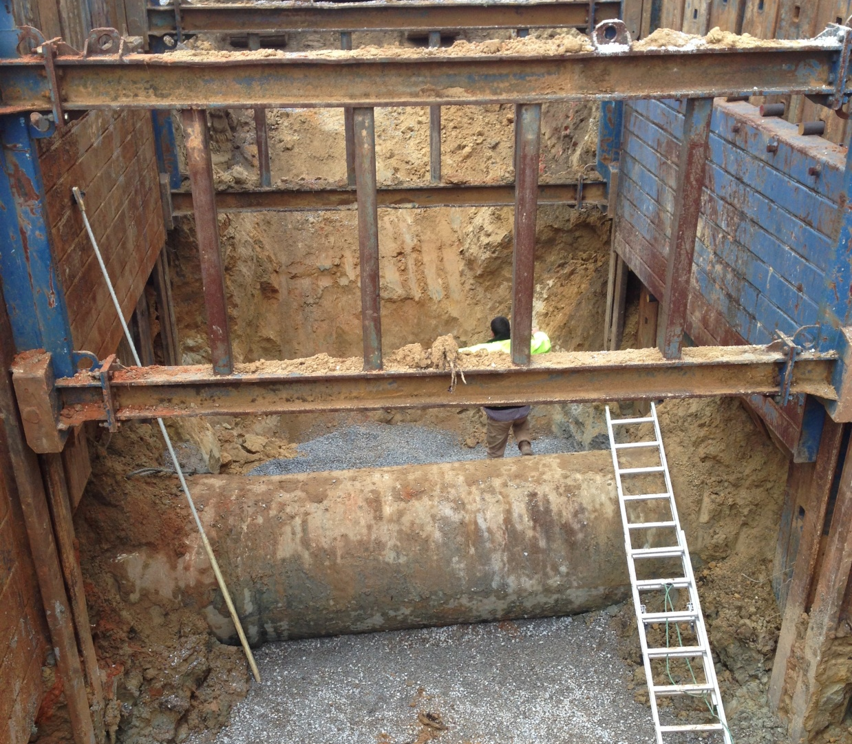
Cases for Force Account
Unexpected utility conflicts
Notes:
48” force main sewer in conflict with roadway drainage. Same project overhead……ATRIP

Slide 8
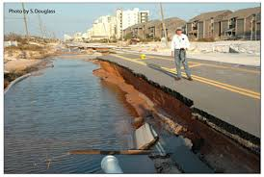
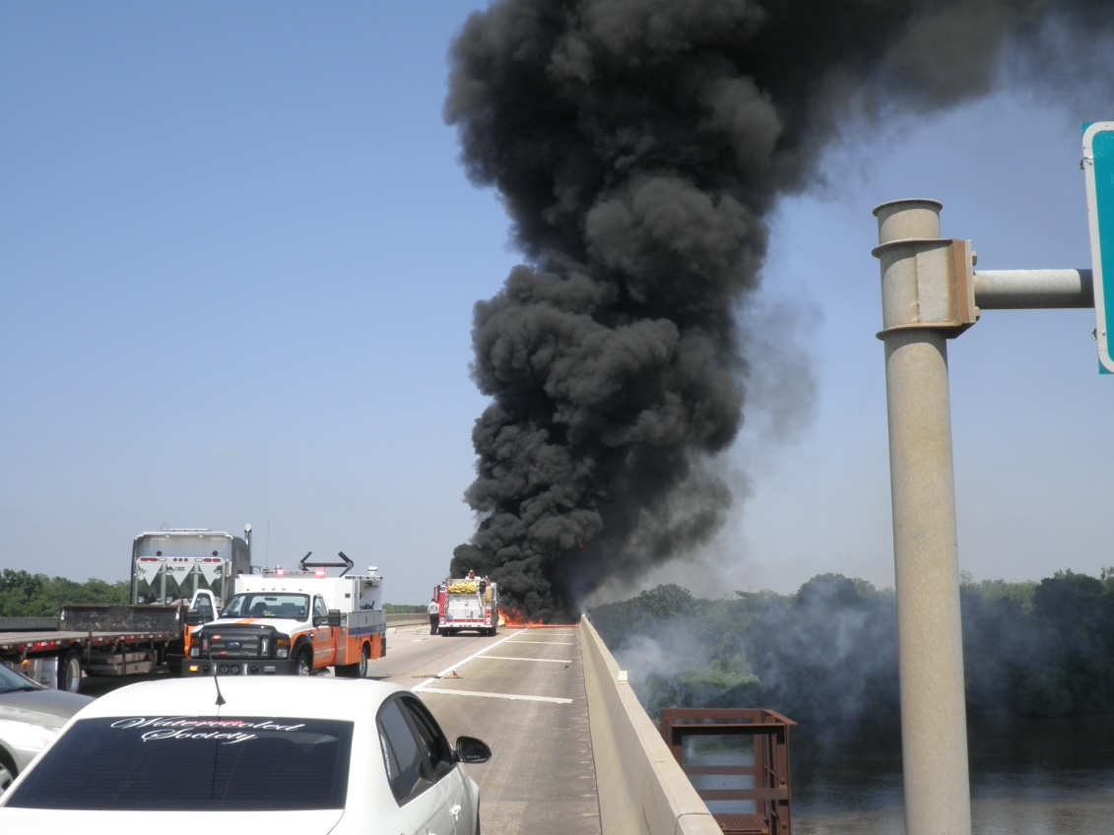
Cases for Force Account
Unexpected utility conflicts
Emergency events (natural acts of God, accidents, etc…)
Notes:
Hurricane Ivan and Delta Bridge repair

Slide 9
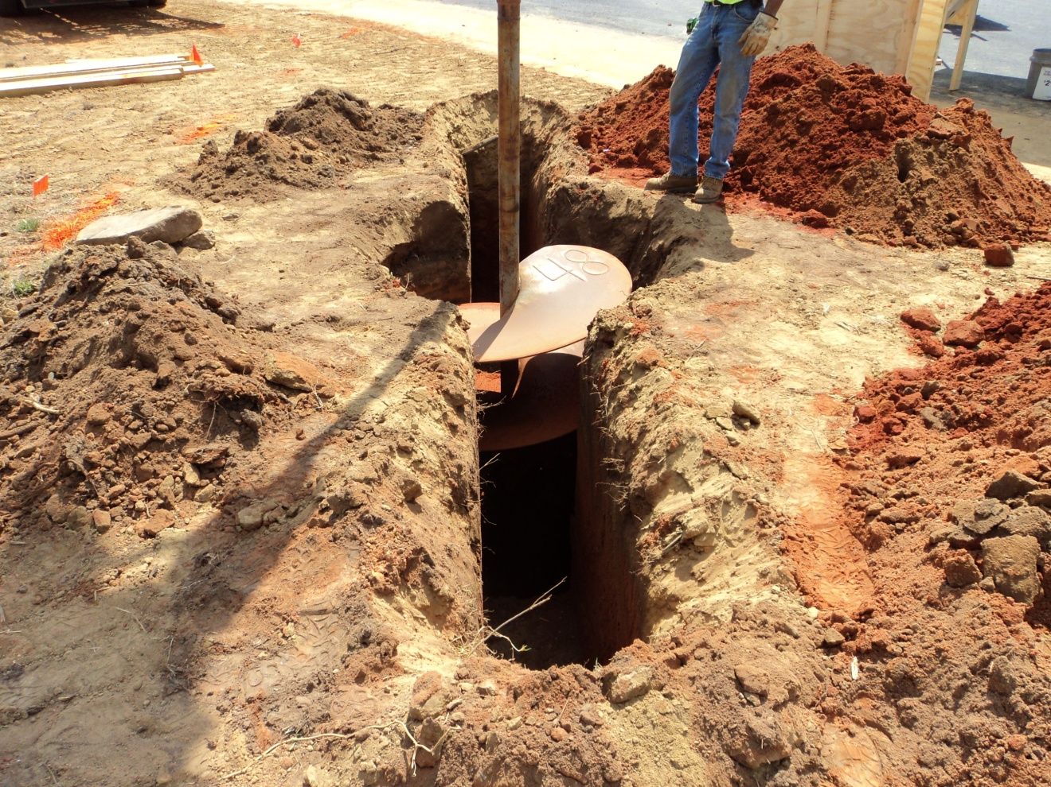
Cases for Force Account
Unexpected utility conflicts
Emergency events (natural acts of God, accidents, etc…)
Items for which
prices cannot be
agreed upon or
lack of bid history
to compare
Notes:
Torsion wings required for signal pole foundation- lack/no bid history, each foundation is a little different size, depth, etc.. based on the geotech’s design

Slide 10
Contract Force Account Section 109.04
Labor
Materials
Equipment
Bond, Insurance, Payroll Tax
Administrative Allowance
Markup
Notes:
Essentially, we you are considering force account, you are compensating the contractor for basically his costs in the work. His costs, per specs, include the labor, materials, equipment, bonds, taxes, insurance, administrative allowances and a fair profit.

Slide 11
Force Account Specifications Special Provision 12-0769
Labor
Include pay for Superintendent
Overall markup to labor is 25%
Includes Per diem provision; plus 5% markup
Includes travel time provision
Equipment
Includes travel time
Professional Services
Includes section regarding payment for such
Administrative Allowance
Markup set at 5% total, regardless of dollar performed
Includes allowance on professional service
Notes:
New changes to section 109.04 became effective April this year. Those changes include the following:

Slide 12
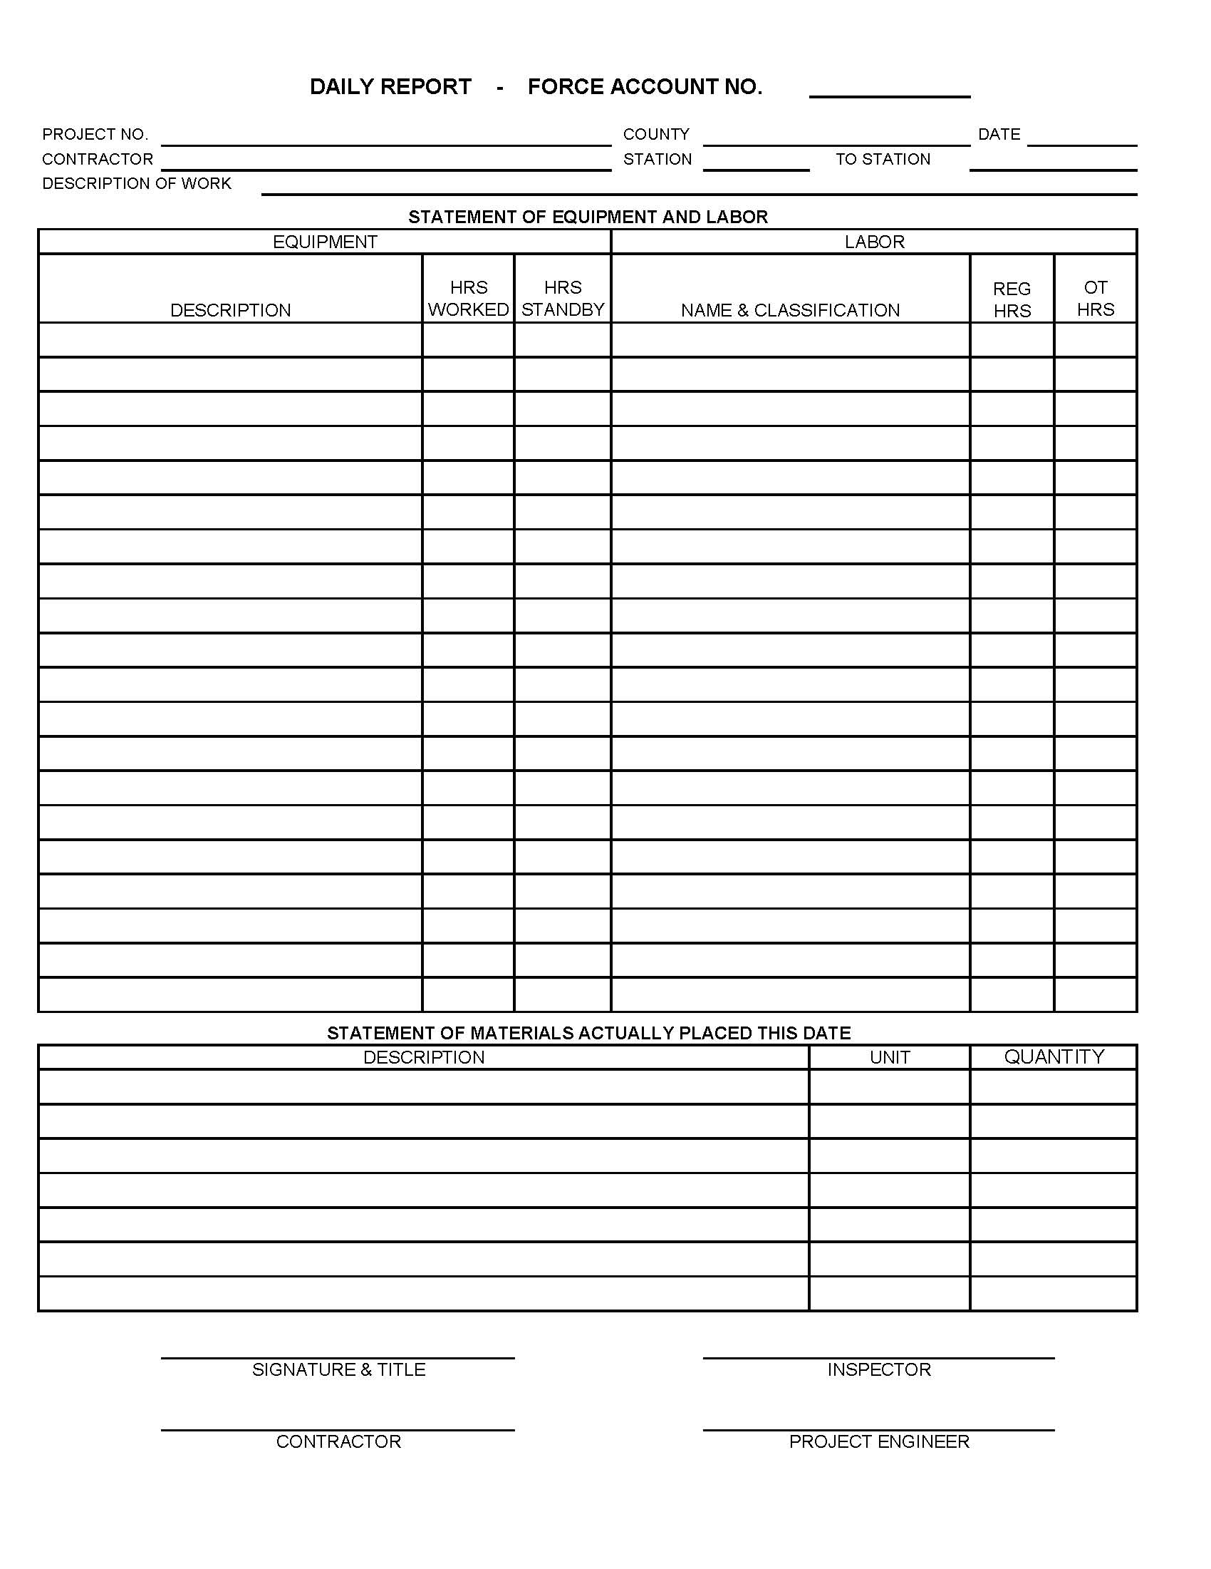
Procedural Requirements -Daily Work Reports
EQUIPMENT
Description
Year
Make
Model
Equipment Specifics- Articulated,
4WD, telescoping, etc…
* No allowance made for small tools
Hours Worked/Standby
Hours actually worked on force account
Standby Hrs based on 40 hr full work week (40 minus Operating Time) OR 8 hr work days (for partial weeks) computed daily
Rental equipment paid by certified or paid invoice
No standby consideration given until AFTER it becomes active
Notes:
The heartbeat of a force account is the Daily Work Report. This is the main tracking document of the force account, where it is imperative that correct information is obtained and recorded is the Daily Work Report. Information including project number, contractor, station of work and description of work occuring helps to ensure costs are not double paid and ensures better accounting for the project

Slide 13
Procedural Requirements -Daily Work Report
LABOR
Name & Classification
Laborers
Operators
Foremen
Superintendents (engaged in or directly
supervising the force account work)
* NO ALLOWANCE FOR GENERAL SUPERINTENDENCE
Regular Hrs Worked/OT Hrs
Record hours actually worked on force account
Travel times to/from jobsite- establish time and require approval prior to work
OT shall be pre-approved prior to work
Use Certified Payrolls for verification of
personnel, wages, travel times, etc…

Slide 14
Procedural Requirements -Daily Work Report
MATERIALS
Description of material placed
Quantity of material placed ( haul tickets, weight tickets, field measurements)
Unit of pay (Linear Ft, Cubic Yard, Each, etc…)
*Machinery rentals excluded

Slide 15
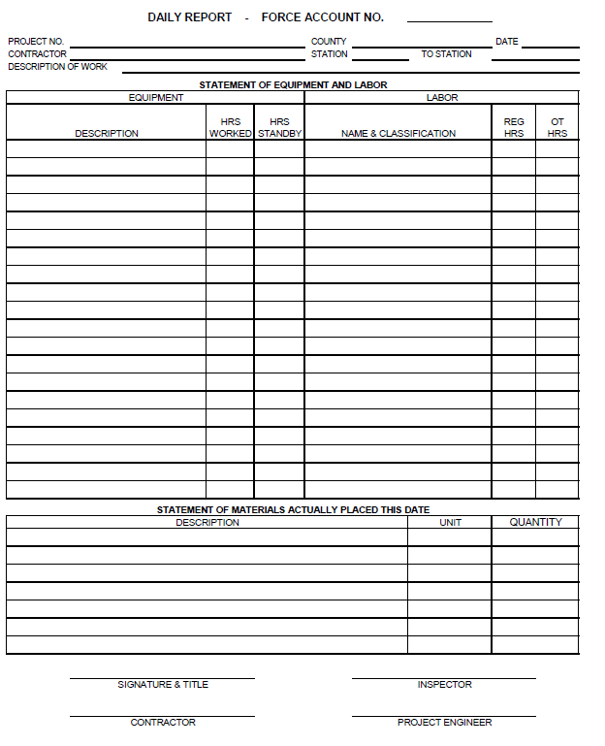
Procedural Requirements -Daily Work Report
Concurrence between contractor and ALDOT daily on Daily Work Report
Require Contractor, Inspector and Project Engineer Signatures
Notes:
Every daily work report has a signature line where ALDOT and the contractor should sign, which acknowledges agreement between both parties regarding operating hours, standby time, equipment onsite and personnel as well

Slide 16
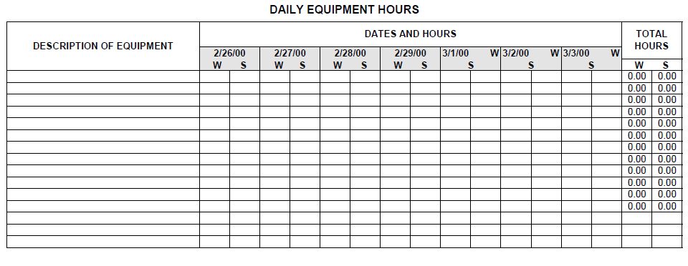
Procedural Requirements -Compiling the Force Account…
Notes:
Once you have daily reports coverd, Remainder is essentially a lot of summarizing. Going through the daily work reports and transposing that information into the summary sheets. For us, it is an excel file that once plugged in, automatically populates the other fields in the work book, which reduces errors. Summary sheets that are a part of the package include summaries for labor, equipment.

Slide 17
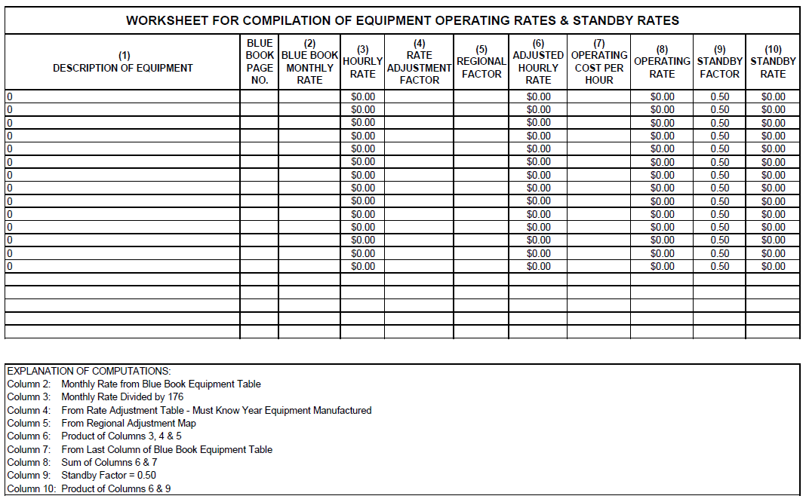
Procedural Requirements -Compiling the Force Account…
Blue Book rates
www.Equipmentwatch.com
Differences based on equipment years, specific features
Adjustment Factors
Non-rented equipment
Notes:
Worksheet for compiling non-rented equipment. Accurate descriptions of the equipment is so important as years, models and especially features affect the pricing very differently. Each piece of equipment is adjusted based on the regional factors and rate factors to derive a usable operating and standby rate. Standby factor is listed as .50

Slide 18
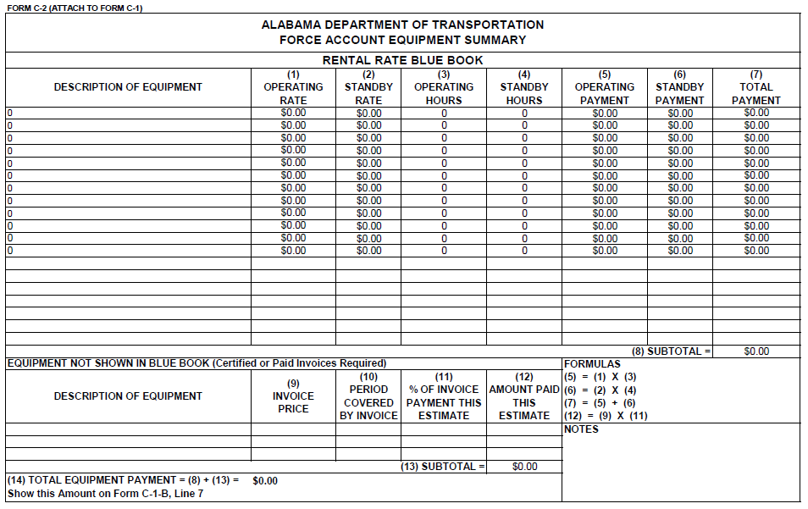
Procedural Requirements -Compiling the Force Account…
Form C-2 “Equipment Summary”
Used to calculate total equipment payments
Includes section for invoiced equipment (rented)

Slide 19
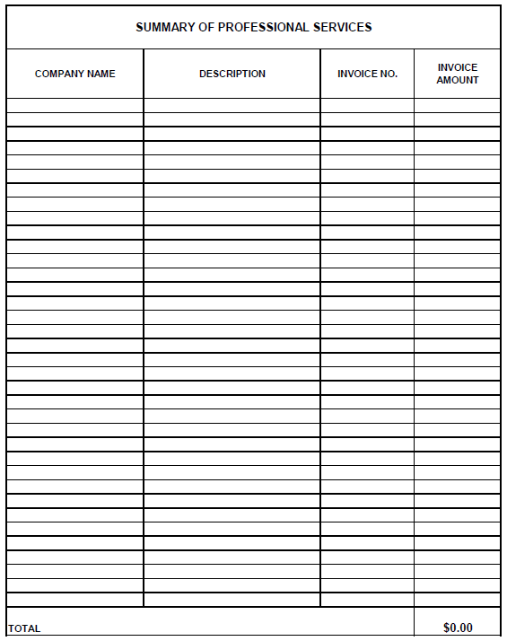
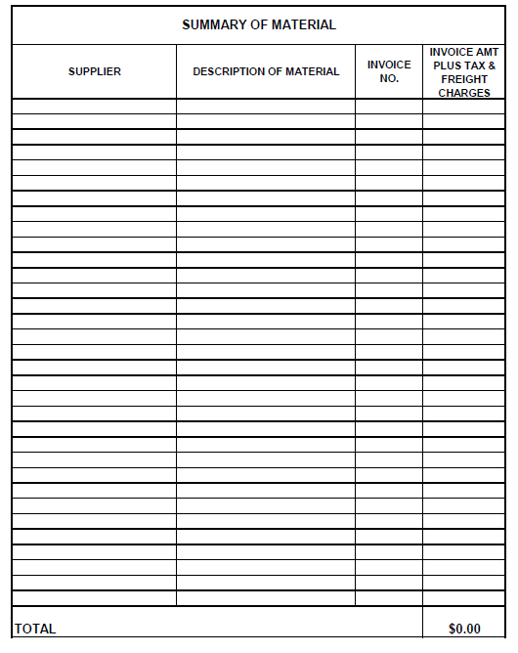
Procedural Requirements -Compiling the Force Account…
Notes:
Professional services summary as well as a material summary. Example would be performing video inspection of pipe. Material summary totals all material invoices along with amounts, which include freight charges and tax

Slide 20
Force Account Final Summary Form C-1-A
FORM C-1-A REVISED 4/1/14
ALABAMA DEPARTMENT OF TRANSPORTATION FORCE ACCOUNT SUMMARY
PROJECT NO. |  |  |  |  |  |  |  |  | COUNTY
DESCRIPTION / LOCATION OF WORK
WORK PERFORMED FROM |  |  |  | TO
PAID ON ESTIMATE NO.
 |  |  |  |  |  |  | FINAL SUMMARY
1 | TOTAL LABOR/SUBCONTRACTORS
2 | TOTAL MATERIAL/SUBCONTRACTORS
3 | TOTAL EQUIPMENT/SUBCONTRACTORS
4 | TOTAL PROFESSIONAL SERVICES
5 | SUBTOTAL = 1 + 2 + 3 + 4 |  |  |  |  |  | $0.00
ADMINISTRATIVE ALLOWANCE (IF APPLICABLE)
6 | $0.00 |  |  | @ 5% |  |  | $0.00
7 | TOTAL PAYROLL INSURANCE |  |  |  |  |  | $0.00
8 | TOTAL PAYROLL TAXES |  |  |  |  |  | $0.00
9 | TOTAL SUBCONTRACTORS BOND |  |  |  |  |  | $0.00
10 | TOTAL LABOR/PRIME
11 | TOTAL MATERIAL/PRIME
12 | TOTAL EQUIPMENT/PRIME
13 | SUBTOTAL = 5 + 6 + 7 + 8 + 9 + 10 + 11 + 12 |  |  |  |  |  | #VALUE!
14 | PRIME CONTRACTOR'S BOND = |  |  |  |  | OF 16
15 | GROSS RECEIPTS TAX = 5% OF 16
16 | FORCE ACCOUNT PAYMENT = 13 / [100% - (% OF 14 + 5%)]
Notes:
Forms C-1A & C-1B. Summary of entire force account. Administrative allowance, insurance, taxes, bonds, gross receipts. Overall it is a self calcuating spreadsheet for most part

Slide 21
Force Account Final Summary Form C-1-B
FORM C-1-B REVISED 4/1/14
ALABAMA DEPARTMENT OF TRANSPORTATION FORCE ACCOUNT SUMMARY
PROJECT NO. |  |  |  |  |  |  |  |  | COUNTY
DESCRIPTION / LOCATION OF WORK
WORK PERFORMED FROM |  |  |  | TO
PAID ON ESTIMATE NO. |  | SUBCONTRACTOR/CONTRACTOR/ PROFESSIONAL SERVICES
LABOR
1 | DIRECT LABOR
2 | 25% ADDITIVE = 1 X 0.25 |  |  |  |  |  | $0.00
3 | TOTAL LABOR = 1 + 2 |  |  |  |  |  | $0.00
MATERIAL
4 | INVOICE COST
5 | 15% ADDITIVE = 4 X 0.15 |  |  |  |  |  | $0.00
6 | TOTAL MATERIAL = 4 + 5 |  |  |  |  |  | $0.00
EQUIPMENT
7 | TOTAL EQUIPMENT (FROM FORM C-2)
INSURANCE / TAXES
8 | PAYROLL INSURANCE 1 X |  |  | ___________%
9 | PAYROLL TAXES 1 X |  |  | __________%
10 | TOTAL INSURANCE / TAXES = 8 + 9 |  |  |  |  |  | $0.00
11 | SUBTOTAL = 3 + 6 + 7 + 10 |  |  |  |  |  | $0.00
SUBCONTRACTOR BOND
12 | ___________% |  | OF 14
13 | PROFESSIONAL SERVICES
14 | TOTAL PAYMENT |  |  |  |  |  | $0.00
Notes:
Forms C-1A & C-1B. Summary of entire force account. Administrative allowance, insurance, taxes, bonds, gross receipts. Overall it is a self calcuating spreadsheet for most part

Slide 22
“Dirty” Force Account
Negotiating on pricing for additional work that will be supplemental agreement or change order
“Cost Tracking” to establish pricing/verify submitted pricing by the contractor
Use force account documentation for check/balance
Notes:
Good example is having to perform multiple partial inlet construction with varying dimensions/sizes and tracking the first 2 or so to help establish a price for the work

Slide 23
- Recent “DIRTY” Example
Project NH-0158(509)
Mobile County
Plans omitted “Pilot Car” pay item
Contractor submitted price $10,000 each
Bid History Range $ 0.01 - $ 134,580.00
Project length, lane closure times, etc..
PM tracked costs- totaled $5,500
SA processed in amount of $5,500 referencing price justified via tracking of costs
Notes:
Nightime resurfacing of a 2 lane roadway. This is just one example but there are numerous other situations that you can utilize this same method for not only extra work but in verification of pricing

Slide 24
Procedural Requirements -Submission of Documents
Contractor assembles the force account package
Submits to the Agency for review and processing of payment
Partial payments can be made if approved
Notes:
There is good news, kinda I suppose. The contractor is the one who puts these force account packages together when it is a true force account. The bad news is…the contractor is the one who puts these force account packages together
Bear in mind, some of these contractors are professionals at it; some are not. So it is important that you as the agency know how to compile this information as well. And each line has to be gone through and the math checked for accuracy; make sure a formula in excel calculates correctly, etc...

Slide 25
Keys to Force Account Success
Contractor must request in writing that extra work in question be paid under force account
LPA is to obtain
concurrence from
the Oversight
Agency prior
to work beginning
Notes:
First of all the contractor is to submit some letter or email asking to track under force account. The local agency is then required to obtain concurrence from Oversight Agancy prior to work occurring on the project.

Slide 26
Keys to Force Account Success
Regular meetings (initial, daily, weekly) to discuss schedules, resources, etc..
Notes:
At the time the force account is approved, an initial meeting should be held & several things should be discussed- establish normal working times; is overtime approved?
Afterwards, good practice to hold regular weekly or even daily meetings should be held to discuss the contractors schedule for the day, week; to discuss equipment, manpower and resources that are to be put on force account and to help be accountable to the work taking place At that time,

Slide 27
Keys to Force Account Success
Inspection Personnel onsite daily while contractor is present and active in force account work
Notes:
This is absolutely essential when it comes to consolidating hours and verifying that the contractor actual worked when he said he did. That inspector covering the work is the most important tool your agency has on the jobsite at that time. His records

Slide 28
Keys to Force Account Success
Concurrence
between contractor
and ALDOT required daily
on Daily Work
Report
Notes:
One of the hardest things to do is reconcile daily work report time after it is all said and done. To prevent that, Every daily work report has a signature line where ALDOT and the contractor required to sign, which acknowledges agreement between both parties regarding operating hours, standby time, equipment onsite and personnel as well. It is a simple requirement but makes like so much easier

Slide 29
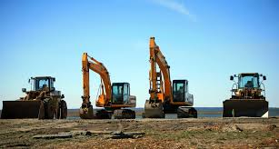
Keys to Force Account Success
Accurate recording of make, model and year of equipment, preferably before beginning work
Accurate recording of working versus standby time

Slide 30
Procedural Requirements for Force Account Work…
Brian S. Aaron, P.E.
Alabama Dept. of Transportation
SW Region Construction Engineer (Mobile Area)
aaronb@dot.state.al.us
251-470-8250
Notes:
In closing, force account is in fact a useful tool. It helps ensure that the contractor costs are covered and he doesn’t get hurt and it ensures that the Agency is paying a fair price for the work. Both contractor and agency are made whole.
Can it be a pain? Yes. Does it utilize your time and resources? Yes.
But it is an effective and accepted method of performing work on state and federal aid projects as long as the proper procedures and requirements are followed.
Thank you.

