Slide 1
Saving Money Through Reappraisal
ACCA Annual Convention
August 20, 2015
Don Armstrong, ACTA
Property Tax Commissioner
Shelby County, AL

Slide 2
Property Tax Plan for Equalization
-Alabama Legislature passed House Bill 59 signed by Governor George C. Wallace on January 19, 1972. Act 160 created the statewide property reappraisal program.
Code of Alabama – 1975 (40-7-60)
-Fair and reasonable market value is the basis for valuation of properties for Ad Valorem taxation in the State of Alabama.
Code of Alabama – 1975 (40-7-62)

Slide 3
Introduction
Mass Appraisal
Is defined by the International Association of Assessing Officers in Property Appraisal and Assessment Administration as the process of valuing a group of properties as of a given date, using standard methods, and allowing for statistical testing.

Slide 4
Funding
Code of Alabama – 1975 (40-7-68)
Created a method of funding the equalization program by requiring the cost be prorated by the governing body to each agency based on the proportion of money received by each agency in the county.
(Acts 1971, No. 160, p. 4404, §2)
Appraisal and Mapping Budgets allow the Tax Official to accomplish Annual Ad Valorem Equalization.

Slide 5
Budgeting
Revenue Sources
Real & Business Personal Property Tax
Motor Vehicle Tax
Appraisal (Budget)
Sales / Use Tax
Mortgage / Deed Recordings
County Building / Space Rentals
Building Permits
Probate Fees
Property Tax Fees (Assessor & Collector)
Interest Earned
Other

Slide 6
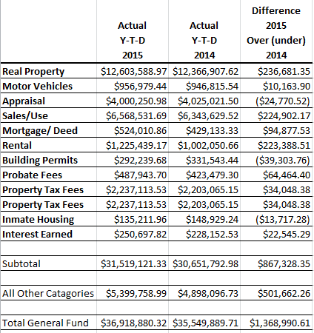
Shelby County 6 Month Financial Review- General Fund Revenues For Fiscal Year 2015

Slide 7
Commissions'
Calculations for State & County General Fund
Where collections exceed $12,000:
10% 1st - $5,000
5% next $4,000
4% on $3,000
1 ½% on the remainder up to $15,000
1% on the remainder above $15,000
Code of Alabama – 1975 (40-4-2)

Slide 8
Commissions‘ (continued)
All Agency’s receiving Ad Valorem Tax:
2% on all Special Taxes
(County, State, Road & Bridge, School and Cities.)
2% - Assessor and 2% - Collector = 4%
Fees & commissions on:
Late assessments, delinquent fees, tax sale fee, advertising, mail fee, etc. are all paid to the county General Fund.
Code of Alabama – 1975 (40-4-2)

Slide 9
Commissions‘ (continued)
Counties where Assessor and Collector are paid on salary, commissions are paid to the General Fund.
Code of Alabama – 1975 (40-4-3)
No Fees & commissions on:
Errors made on assessments or abatements and real estate bid by the state at tax sale.
Code of Alabama – 1975 (40-4-4)

Slide 10
Expenses
Line Item Budget:
Supernumerary Salaries:
If a county has a supernumerary official that was charged with assessing or collecting or both of Ad Valorem taxes, the collector shall from the first money collected by the official, pay to the county governing body the sum which shall be paid to the supernumerary official as heretofore set forth.

Slide 11
Expenses (continued)
Line Item Budget:
Supernumerary Salaries: (continued)
The sum shall be deducted on a pro rata millage basis from payments to the state, county and all subdivisions and agencies except municipalities.
Code of Alabama – 1975 (40-6-3)

Slide 12
Expenses
Line Item Budget:
Supernumerary Pay Based on 7% Deduction:
The governing body shall deduct from the salary of the tax official charged with the assessment or collection, or both, of any ad valorem taxes of the county, if the officials are paid by salary, an amount equal to 7%.

Slide 13
Expenses (continued)
Line Item Budget:
Supernumerary Pay Based on 7% Deduction:(continued)
This deduction is withheld each pay period by the County Commission and is paid back to the tax collector or disbursement official in late September of each year and he pro-rates it to the different agencies on the October 15th disbursement.
Code of Alabama – 1975 (40-6-4)

Slide 14
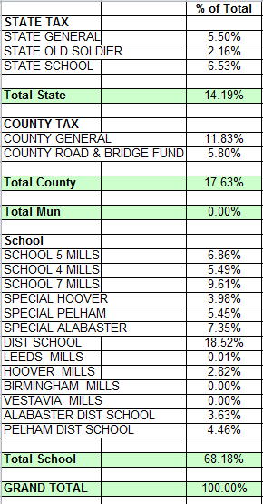
Shelby County 2014 Supernumerary Budget

Slide 15
Expenses (continued)
Line Item Budget:
Tax Official Salary:
The tax official shall be paid on a pro rata basis out of the money collected into the General Fund. The pro rata share is to be paid by each agency receiving Ad Valorem taxes. The pro rata share shall be determined in each county by computing the percentage that the total collections for each fund or agency bears to the total collections of Ad Valorem taxes.

Slide 16
Expenses (continued)
Line Item Budget:
Tax Official Salary: (continued)
With the exception to municipalities. In respect to a municipality, they pay the lessor of the pro rata share on fees and commissions.
Code of Alabama – 1975 (40-6A-2)

Slide 17
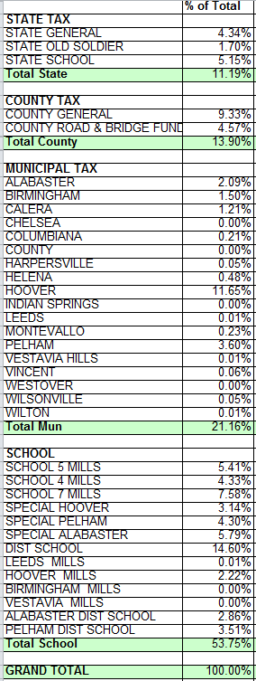
Shelby County 2014 Tax Official Salary

Slide 18
Expenses
Line Item Budget:
Personnel Salaries
Fringe Benefits (Retirement, Health/Dental Ins., Social Security, etc.)
Miscellaneous Expenditures (3 general categories)
Capital Expenditures
Travel Expenses

Slide 19
Expenses (Continued)
Line Item Budget:
Education (Job related courses only.)
Purchases, Repairs & Maintenance (appraisal and mapping equip.)
Motor Vehicle Cost (purchase & maintenance)
Communication Equipment
Utilities for Mapping & Appraisal Office
IAAO & AAAO Membership Dues
Code of Alabama – 1975 (40-6A-5)
)

Slide 20
Expenses
SHALL NOT INCLUDE:
Rent on satellite office space or prorated rents on courthouse space.
Cost for repairs, maintenance, upkeep or insurance on office or building space and grounds.
Dues, fees or other charges for membership in organizations for any person not under the criteria specified in 1.a. (11). (IAAO and AAAO membership fees for employees certified under the Alabama Department of Revenue Education and Certification Program.

Slide 21
Expenses
SHALL NOT INCLUDE:
(continued) Note: The certification must be current and the employee must be eligible for the annual Certification Incentive Award.) This includes but is not limited to, the Appraisal Institute, IAAO or AAAO. (The Property Tax Division Director will consider funding on a case-by-case basis, when individual membership in a local board of realtors is required as a condition of legitimately subscribing to a multiple listing service.)

Slide 22
Expenses
SHALL NOT INCLUDE:
Application, license, and examination fees associated with licensing and/or certification with the Alabama real Estate Appraisers Board.
Property Tax Plan for Equalization (pg. F 1-9)

Slide 23
Submission of Budget
Must be submitted by June 20th to the Director of Property Tax Division. (They review & return.)
County Commission approves and submits on/or before Oct. 1 to the Property Tax Division.
The county Tax Collector/Revenue Commissioner will be given a pro rata breakdown of each agency’s share of the Appraisal & Mapping budget along with authorization to withhold the monies from collections. The Tax Collector/Revenue Commissioner will remit the withheld monies to the County Commission.

Slide 24
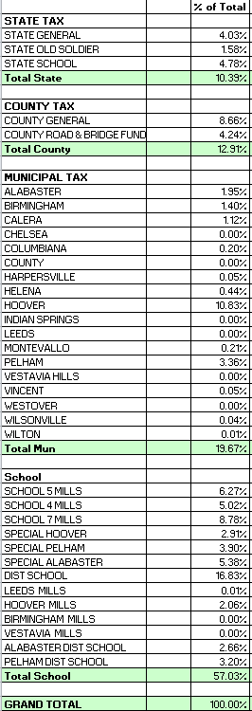
Shelby County 2014 Budget

Slide 25
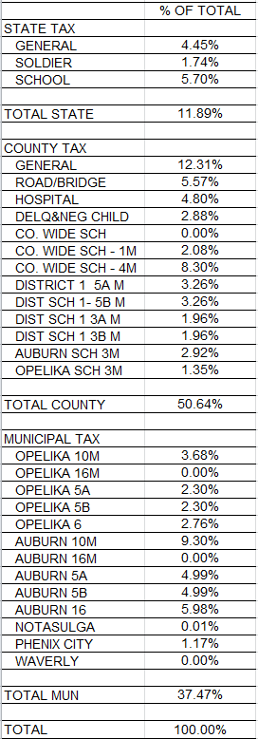
Lee County 2014 Budget

Slide 26
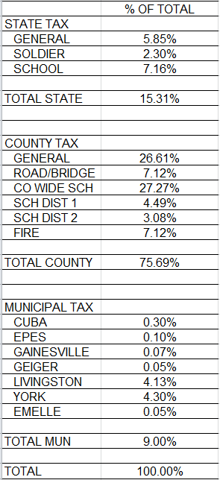
Sumter County 2014 Budget

Slide 27
Data Processing
All data processing directly associated with computerization of the appraisal and mapping may be charged to the Appraisal Budget; subject to the Department of Revenue’s approval.

Slide 28
Equalization of Ad Valorem; costs
The cost of any program for the equalization of ad valorem taxes shall be prorated by each county governing body to each agency therein on the basis of the proportion of the money's received by each agency in the county to the total amount received by all agencies of such county.
Code of Alabama – 1975 (40-7-68)

