Slide 1
Association of County Commissions of Alabama
Alabama Department of Corrections Update
Commissioner Jeff Dunn
Professionalism – Integrity – Accountability

Slide 2
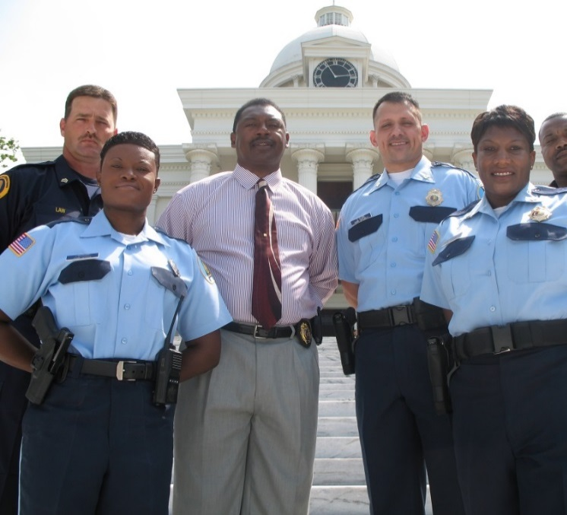
Alabama Department of Corrections
ADOC operates 28 prisons
16 Major Facilities
12 Work Release/Community Work Centers
Oldest
Draper Correctional Facility (1939)
Tutwiler Prison for Women (1942)
Newest
Bibb Correctional Facility (1998)
General Fund Appropriation FY15: $394.3M
Approximately 3,900 employees
Approximately 24,700 inmates
Correctional Staff
Total Authorized: 4,249
Total Assigned: 2,910 (68%)
Professionalism – Integrity – Accountability

Slide 3
Alabama Department of Corrections
Prison Capacity and Inmate In-House Population
Custody Level Design Capacity Prison Population Percentage
Close 5,103 7,871 154%
Medium 6,065 12,869 212%
Minimum 1,900 3,938 207%
13,318 24,678 185.3%
Professionalism – Integrity – Accountability

Slide 4
Alabama Department of Corrections
Since 1985, average yearly admissions have increased 37%.
1985 1995 2005 2014
4,407 6,209 10,677 11,849
Top 5 Convictions
Drug Possession: 2,318
Drug Trafficking: 1,648
Theft Related Offenses: 1,458
Burglary 1-3: 1,272
Robbery 1-3: 960
Total: 7,656 (65%)
Professionalism – Integrity – Accountability

Slide 5
Alabama Department of Corrections
Jurisdictional Population (31,764 Inmates)
1st Alabama Previous Total
Incarceration Incarceration Contributed Percent
Jefferson 2,613 2,327 4,940 15.6%
Mobile 1,975 1,510 3,485 11.0%
Montgomery 1,182 947 2,129 6.7%
Madison 812 831 1,643 5.2%
Houston 876 619 1,495 4.7%
Tuscaloosa 779 676 1,455 4.6%
Etowah 596 481 1,077 3.4%
Calhoun 528 460 988 3.1%
Baldwin 595 342 937 2.9%
Talladega 342 284 626 2.0%
Morgan 553 410 963 3.0%
Lee 387 264 651 2.0%
Russell 411 184 595 1.9%
Shelby 301 289 590 1.9%
Cullman 254 263 517 1.6%
Professionalism – Integrity – Accountability

Slide 6
Alabama Department of Corrections
ADOC – County Relationships/Support
County jail numbers
County jail leased bed contracts
9 contracts for 350 inmates at $15 per day
K-9 support
Assistance to 29 counties, searching for missing persons, murder suspects, escapees, and contraband
Food service agreements
24 counties/over $500,000
Inmate labor
22 counties/130,000 mandays = $4 million savings to counties
Recycling
4 counties and growing
Professionalism – Integrity – Accountability

Slide 7
Alabama Department of Corrections
Professionalism – Integrity – Accountability

Slide 8
Alabama Department of Corrections
ADOC – County Relationships/Support
County jail numbers
County jail leased bed contracts
9 contracts for 350 inmates at $15 per day
K-9 support
Assistance to 29 counties, searching for missing persons, murder suspects, escapees, and contraband
Food service agreements
24 counties/over $500,000
Inmate labor
22 counties/130,000 mandays = $4 million savings to counties
Recycling
4 counties and growing
Professionalism – Integrity – Accountability

Slide 9
Alabama Department of Corrections
ADOC K-9 Facilities
Easterling – Drug Canine Units
St. Clair – Tracking Canine Units
Ventress – Tracking Canine Units
Bibb – Drug and Tracking Canine Units
Donaldson – Drug and Tracking Canine Units
Fountain – Drug and Tracking Canine Units
Kilby – Drug and Tracking Canine Units
Limestone – Drug and Tracking Canine Units
Staton – Drug and Tracking Canine Units
Professionalism – Integrity – Accountability

Slide 10
Alabama Department of Corrections
ADOC – County Relationships/Support
County jail numbers
County jail leased bed contracts
9 contracts for 350 inmates at $15 per day
K-9 support
Assistance to 29 counties, searching for missing persons, murder suspects, escapees, and contraband
Food service agreements
24 counties/over $500,000
Inmate labor
22 counties/130,000 mandays = $4 million savings to counties
Recycling
4 counties and growing
Professionalism – Integrity – Accountability

Slide 11
Alabama Department of Corrections
ADOC – County Relationships/Support
Authority to issue $60 million bond for prison construction
Contract with architectural/engineering firm to assess appropriate construction priorities
Issues to consider
New vs. Renovation
Location
Cost of debt service
Ability to staff
Accessibility to off-site healthcare
FY16 Potential budget impacts
Level funding creates $15 million deficit
Jeopardizes current CCP funding stream
Limits ADOC’s ability to affect prison reforms
Professionalism – Integrity – Accountability

Slide 12
Alabama Department of Corrections
ADOC – General Fund Budget Issues
5% cut in the General Fund budget creates a $43 million deficit
Close 3 prisons and pack displaced inmates into remaining facilities. (Overcrowding increases to $213%)
Eliminates all county leased bed contracts
Reduces inmate population at CES facility in Columbiana
County jail numbers impacted by our ability to admit inmates into saturated facilities
Forget prison reform
Professionalism – Integrity – Accountability

Slide 13
Alabama Department of Corrections
ADOC – Prison Reform Issues
Additional reimbursements through CCP for evidenced based programming
Oversight counsel established to provide broad policy guidance
Working committees to flesh out details – transportation/mileage reimbursement issues to be worked together
Professionalism – Integrity – Accountability

Slide 14
Alabama Department of Corrections
Questions?
Professionalism – Integrity – Accountability

