Slide 1
Regional Hazard Mitigation Plans Jeff Smitherman Director of Recovery Operations Alabama Emergency Management Agency

Slide 2
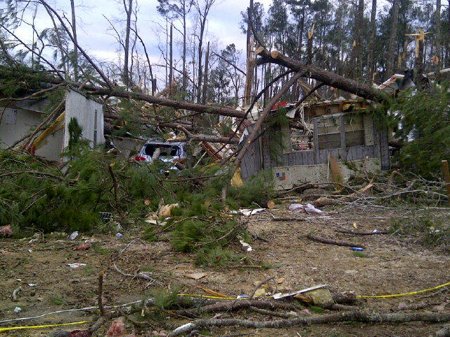
Standing Priorities
Life Saving
Incident Stabilization
Protection of Property
Needs/Damage Assessment

Slide 3
AEMA Responsibilities
Provide timely and accurate information for senior elected officials and the general public.
Manage the flow of state/federal/private resources, services, and personnel to the incident.
Establish and provide a unity of response, recovery, coordination, and control.

Slide 4
Existing Regional Mitigation Plans
Plan Name Participating Counties Division
Southeast Alabama Barbour, Butler, Coffee, B
Regional Multi- Covington, Geneva, Henry
Jurisdictional Hazard Houston (Crenshaw, Pike, &
Mitigation Plan Dale to be added)*
Northwest Alabama Colbert, Franklin, Marion, E
Regional Mult- Winston
Jurisdictional Hazard
Mitigation Plan
* There is a process to add an entity to an existing plan

Slide 5
Why Join a Regional Plan
When included in a larger plan, less money may be needed by individual governments to update the plan
NACOG Plan: 4K vs 7K matching
Shared resources: local experts/emergency response capabilities
Similar geography: similar natural hazards
Pooled funding facilitates broader contract bidding
Improved efficiency and less work for the local government’s Emergency Management and Planning Departments
The cost of the update process maybe split between jurisdictions according to the decision of the group

Slide 6
Why Join a Regional Plan
If a grant is received to fund the update the local cost share can be split between the participating counties
The cost share is typically paid through service-in-kind

Slide 7
Why Join a Regional Plan
AEMA’s funding priority for planning grants places Regional Planning as FIRST priority and considers Multijurisdictional Plans on a case by case basis
Regional Planning allows AEMA to stretch the planning grant funding further thereby reducing the cost burden on the local governments

Slide 8
RETAIN POWER AND AUTHORITY
Each Hazard Mitigation Planning Committee (County) has the authority to manage and update their own portion of the plan. Also, updates can be made with or without the whole group.
As a Jurisdiction actively participating in a FEMA approved Regional Hazard Mitigation Plan ALL participating jurisdictions retain the right to apply as a Sub Grantee for Hazard Mitigation Grant Program eligible projects.
This means you DO NOT need to have permission from any of the other jurisdictions in the plan to apply for grant funding.
The grant applications from Regional Jurisdictions have a higher priority than they would if you are in a Single Jurisdictional or Multijurisdictional Plan.
Notes:
This does not mean we will leave you hanging during a disaster in your area. But it does mean the PDM Grants and HMGP Grant applications from disaster declarations which do not directly effect your county area or branch will be heavily scrutinized.

Slide 9
Questions?

