Slide 1

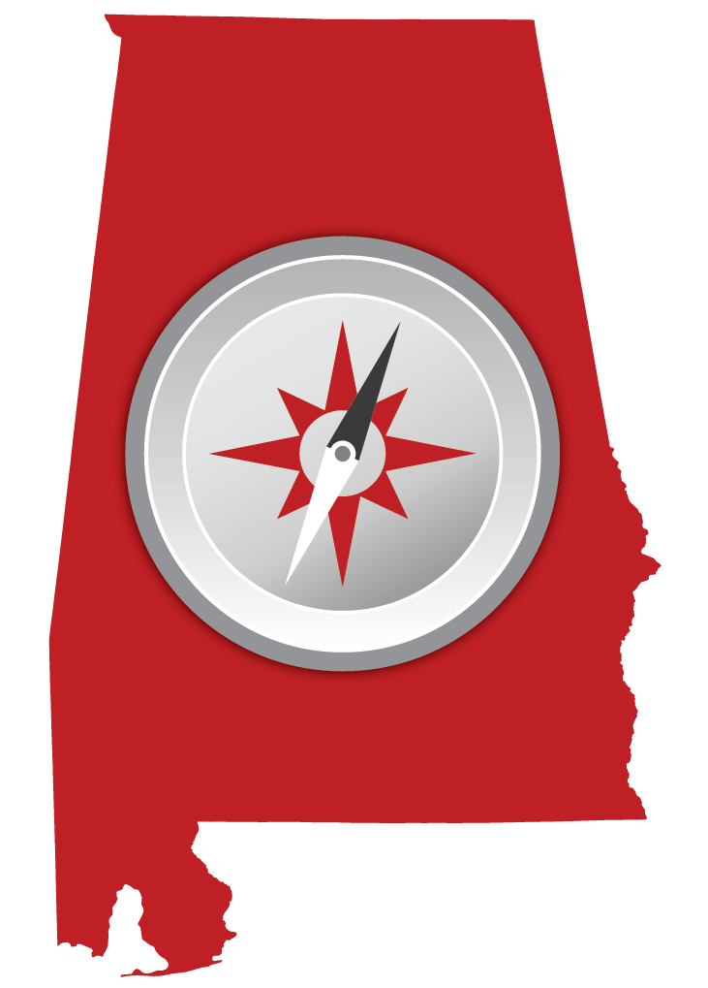
Free resource for entrepreneurs and small business owners
Information on taxes, insurance, financing, and safety
State and local resources in downloadable PDFs
Business basics, tips, and terms
Integration with State Departments and Agencies
(in progress) per Governor’s Exec Order 3
Potential for county and municipality integration
Developed in partnership with the Alabama Small Business Commission and Advisory Committee (appointed by the Governor in 2014 by Exec Order 47)

Slide 2
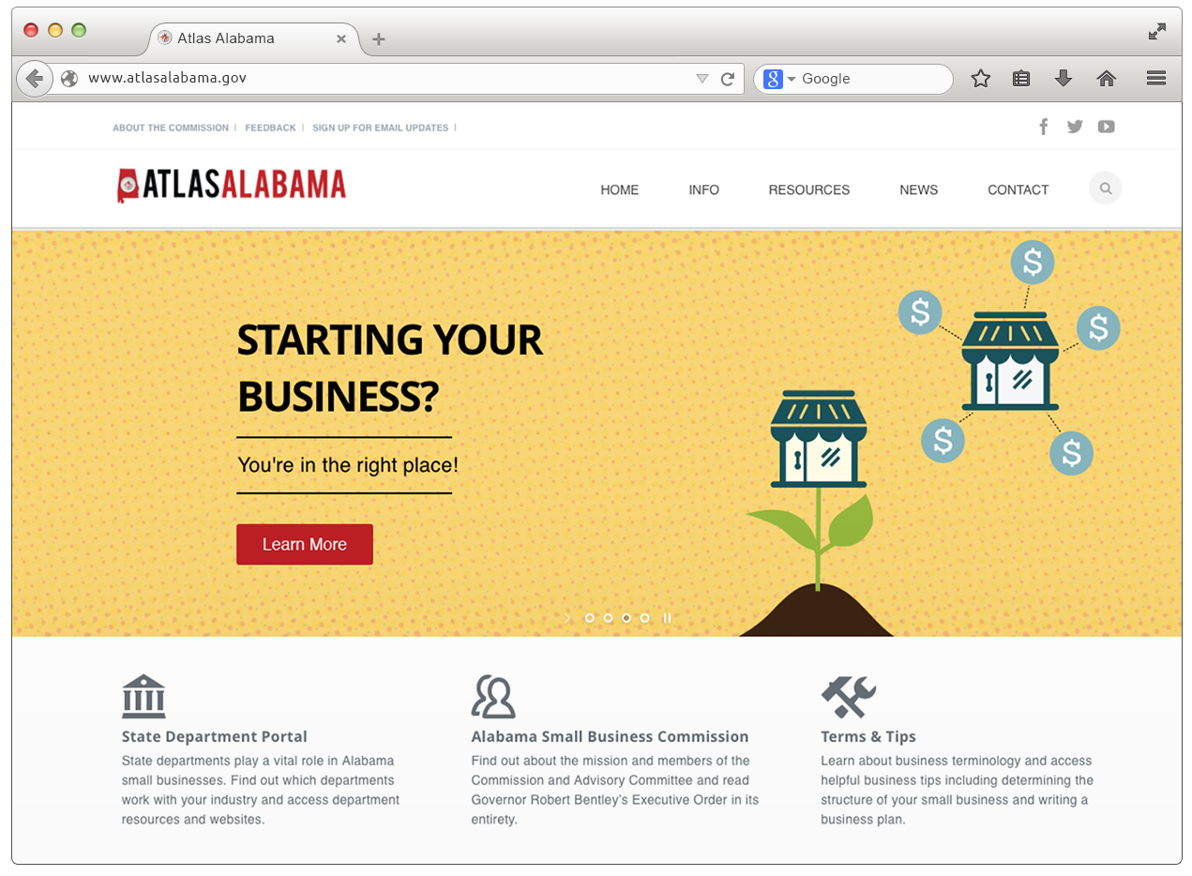
LEARN
basic business information about insurance, licenses, taxes, loans
and financing.
ACCESS
A directory of state and national resources and download county specific resource PDFs.
READ
the latest news items and policies about small business in our state.
CONNECT (coming soon)
with Alabama State Departments that provide small business resources. Access industry-specific information through their websites.
FIND
more about the Alabama Small Business Commission and Advisory Committee including its mission and member bios.
DISCOVER
helpful business tips such as how to write a business plan and determine business structure.

Slide 3
PUBLIC AWARENESS CAMPAIGN
Statewide multimedia campaign
November 2014 – January 2015
TV, Radio, Print, Digital, Paid Search, OOH (billboards), in-store digital signage, social media
Featured testimonials from local business owners
Next phase of marketing will highlight new features such as State Department integration

Slide 4
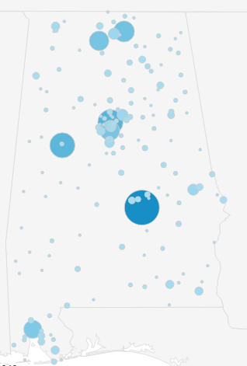
SITE ANALYTICS since October 2014 launch
70%
of all sessions occur in Alabama
15,275 Visitors
18,609 Sessions
2:38 Minute Avg. Session Duration
2.16 Pages per session
64.22% Bounce Rate* (above average)
Montgomery: 2043
Birmingham: 1068
Tuscaloosa: 1020
Huntsville: 726
Decatur: 655
*percentage of visitors to a particular website who navigate away from the site after viewing only one page.

Slide 5
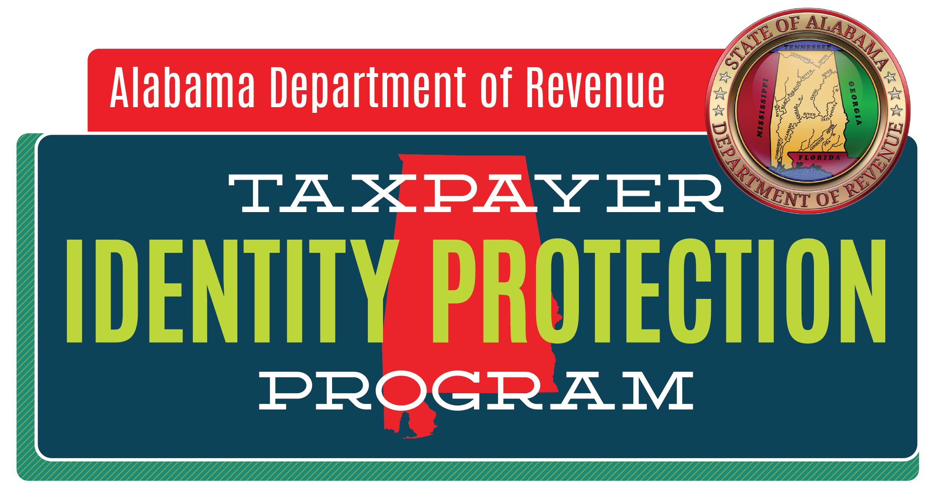
ID theft is a widespread problem that can affect all Alabamians.
This year, the Alabama Department of Revenue took extra steps to protect taxpayers from identity theft and tax fraud. Tax returns were processed using new tools intended to detect possible fraud.

Slide 6
PUBLIC AWARENESS CAMPAIGN
Statewide multimedia campaign
January – April 2015
TV, Radio, Print, Digital, Paid Search, OOH (billboards), in-store digital signage
Letters and posters sent to libraries, top 50 employers, community organizations, sheriff’s offices
Press releases sent to all major media

Slide 7
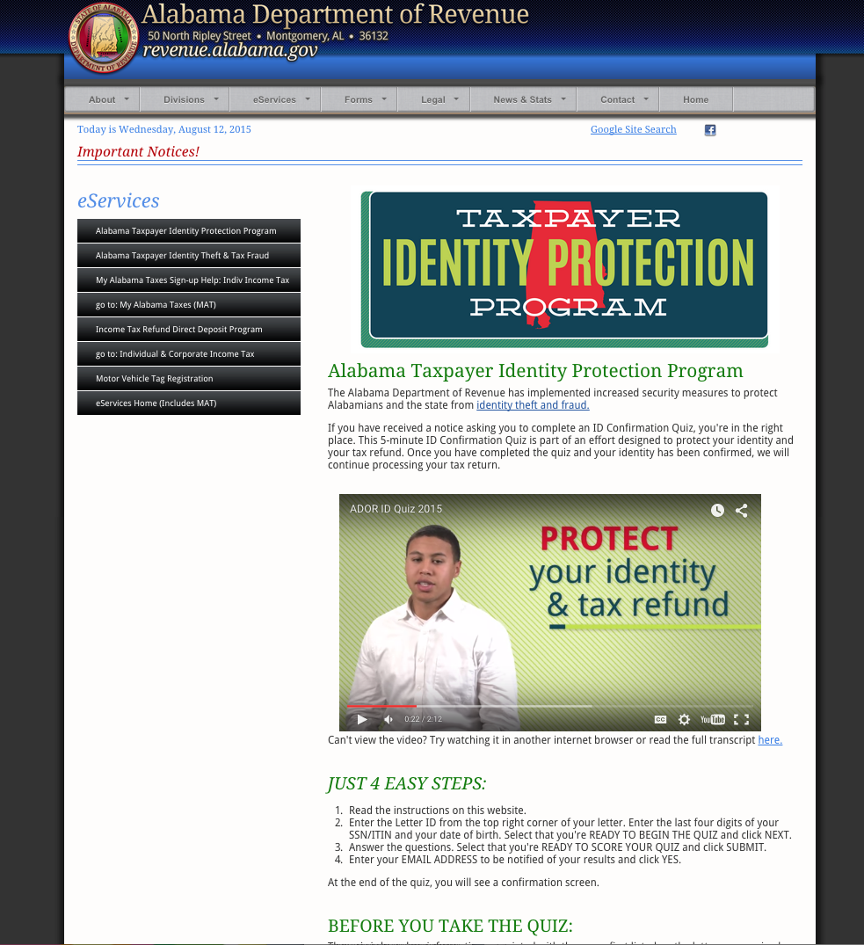
SITE ANALYTICS since February 2015 launch
ID Quiz Page
39,464 Visitors
46,697 Sessions
ID Theft Page
10,894 Visitors
12,156 Sessions
57% of sessions resulted directly from digital ads

Slide 8
Results so Far?
Returns
Savings
With the help of our partner LexisNexis, ADOR screened more than 940,000 income tax returns for suspicion of identity theft.
Approximately 35,000 returns were delayed and processed as suspicious, and those taxpayer were asked to complete an online identity quiz.
Out of those 35,000 returns, 12,500 were confirmed as fraudulent and stopped.
Program saved taxpayers and the state more than $3.4 million.

