Slide 1
Loose clicks sink ships – a CyberFright

Slide 2
Let’s Go Phishing: The Common Elements
Unauthenticated email address: Because addresses can be spoofed, so it’s up to you to verify if the sender is legit.
Typos and grammatical mistakes: Fraudulent emails often insert spelling or grammar errors to bypass email filters.
Awkward greeting: Email may not refer to you by name.

Slide 3
Common Elements
Sense of urgency: Phishing emails rely on language that encourages you to take action immediately (social engineering).
Random numbers: May have what appears to be specific account numbers in order to create a sense of legitimacy.
Links: Numerous phishing emails rely on external links.

Slide 4
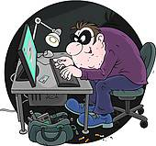
Common Elements
Company logos: Fraudulent emails often contain authentic business logos, addresses and phone numbers to trick you into taking them seriously. (Such as NACHA or other banking institution logos)

Slide 5
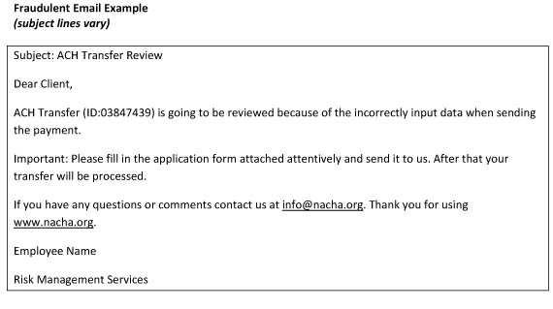
Getting you to bite

Slide 6
Hook, line, and sinker
Phish tale:
Over 3 days one December hackers were able to wire $3.8 million from the online accounts of the Duanesburg Central School District in New York. On Dec. 18 the bad guys wired $1.8 million to an overseas bank; Dec. 21 they made multiple transfers totaling $1.2 million; Dec. 22 they attempted another $759k to multiple overseas accounts but were finally blocked by the bank. This blocked transaction led to the discovery of the previous two transfers. Luckily, the bank was able to recover $2.5 million – a $1.3 million loss.

Slide 7
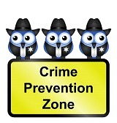
Avoiding the bite
No matter how many anti-virus, anti-malware, and firewalls you have – something always gets through. Your second (and most important) line of defense is your employees:
Education
Training
Pop Quiz
Vigilance

Slide 8
Kellie Graff, CCA
County Administrator
St. Clair County Commission
klgraff@stclairco.com
205.594.2100

