Slide 1
BUSINESS EMERGENCY OPERATIONS CENTER

Slide 4
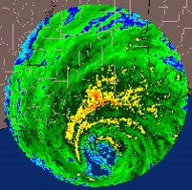
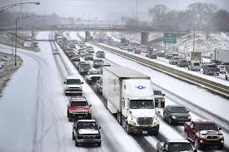
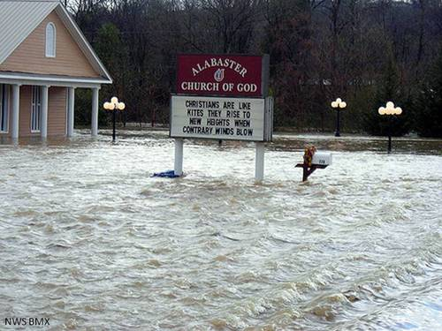
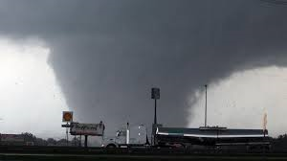
A DECADE OF DISASTER’S, RESPONSE, RISKS, AND CHALLENGES

Slide 5
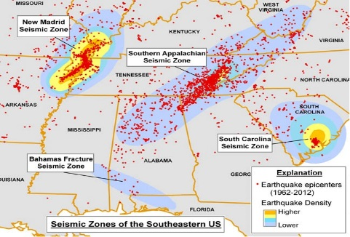
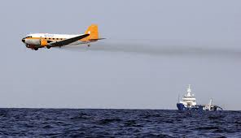
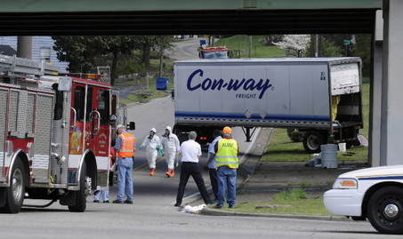
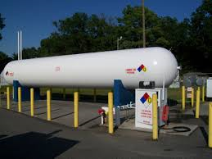
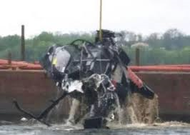
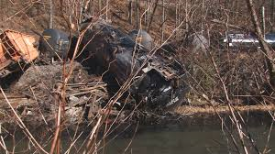
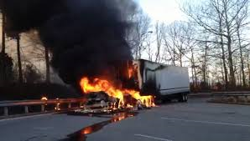
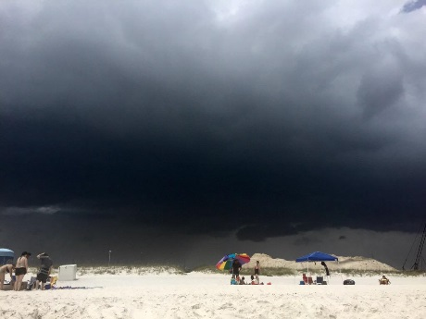
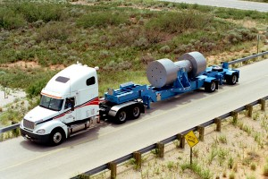
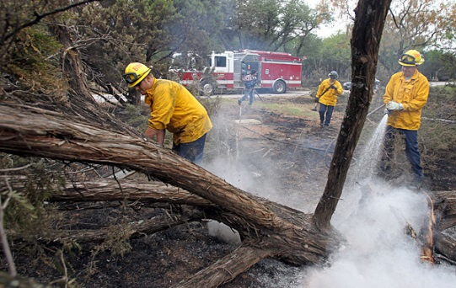
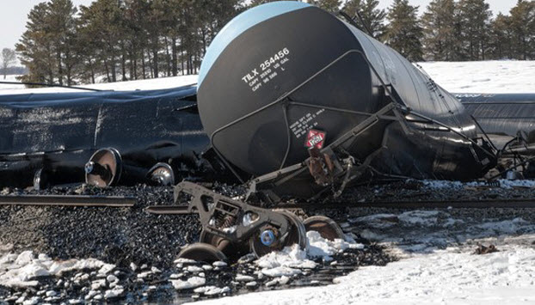
RISKS: MAN-MADE AND NATURAL EVENTS

Slide 6
ASSESSING RISKS IN THE STATE OF ALABAMA
4,728 miles rail lines hauling 93.5 million tons of cargo annually
Nearly 15,000 miles of inland waterways and 64 lakes for recreational use
2 nuclear power plants
1,035.27 miles of Interstates
2 Major Airports, 6 Regional Airports and 18 Local Airports
1 Air Force Base (Maxwell-Gunter) and 4 military installations.
1 major port (Mobile)
61 colleges and universities
From September 2011 to June 30, 2015 the USGS has registered 34 earthquakes (seismic events) in the state.
Tornado’s, Severe Weather, Hurricanes, Flooding, Winter Weather, Extreme Heat and Drought, and Post Storm Safety.

Slide 7
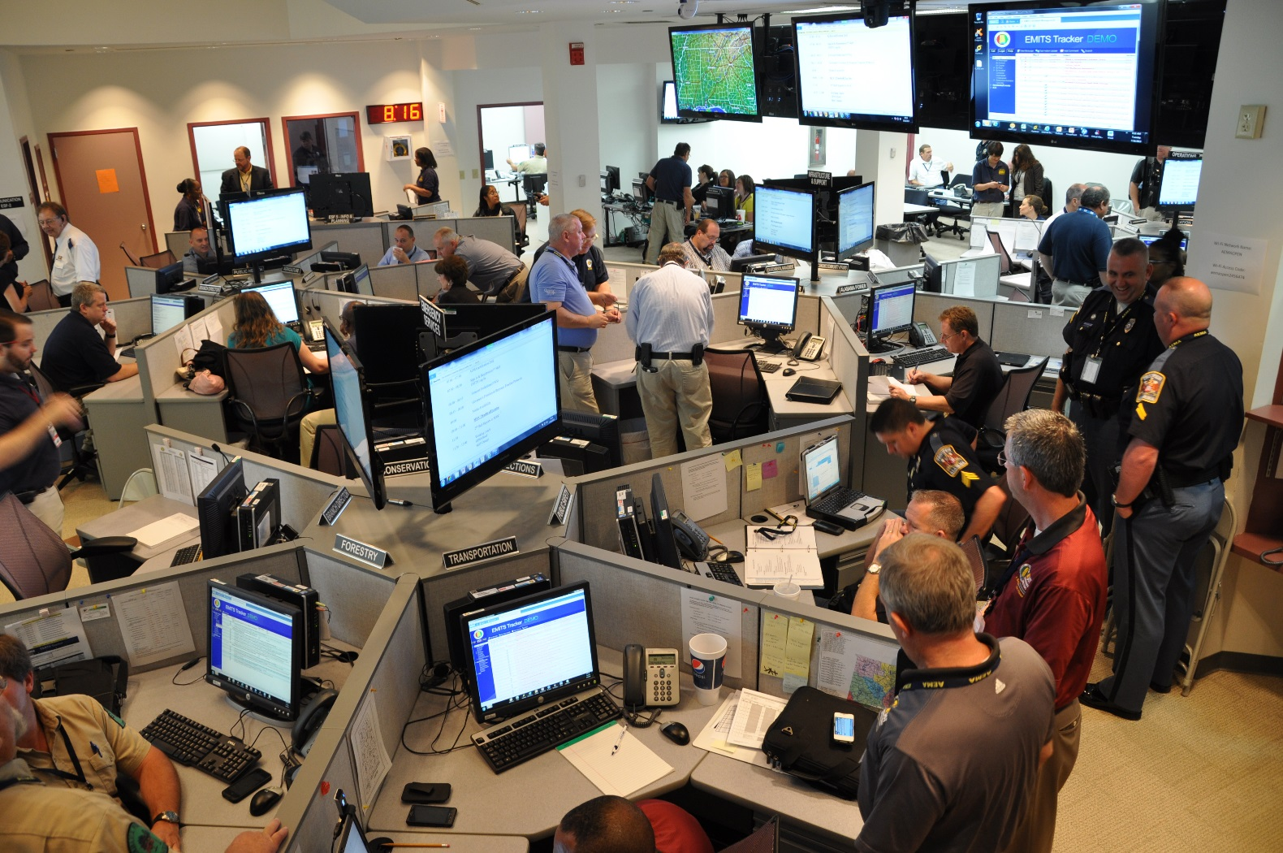
ALABAMA EMERGENCY MANAGEMENT AGENCY
State Emergency Operations Center DURING AN ACTIVATION

Slide 8
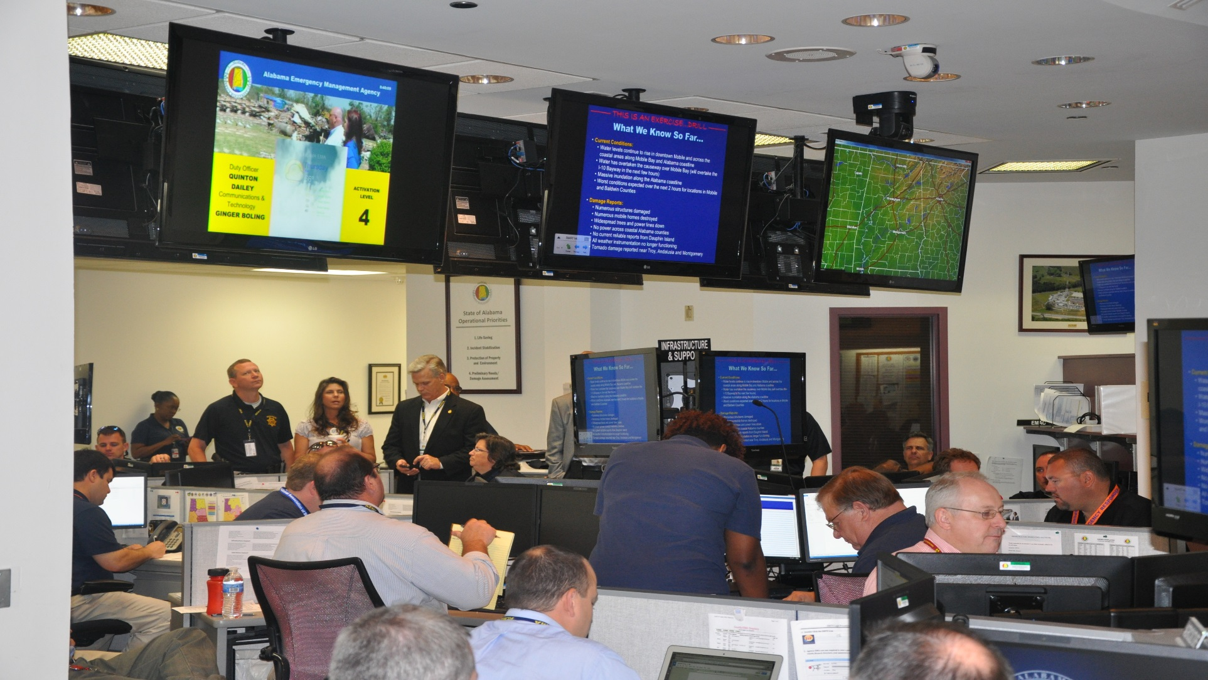
ALABAMA EMERGENCY MANAGEMENT AGENCY
SEOC DURING AN ACTIVATION

Slide 9
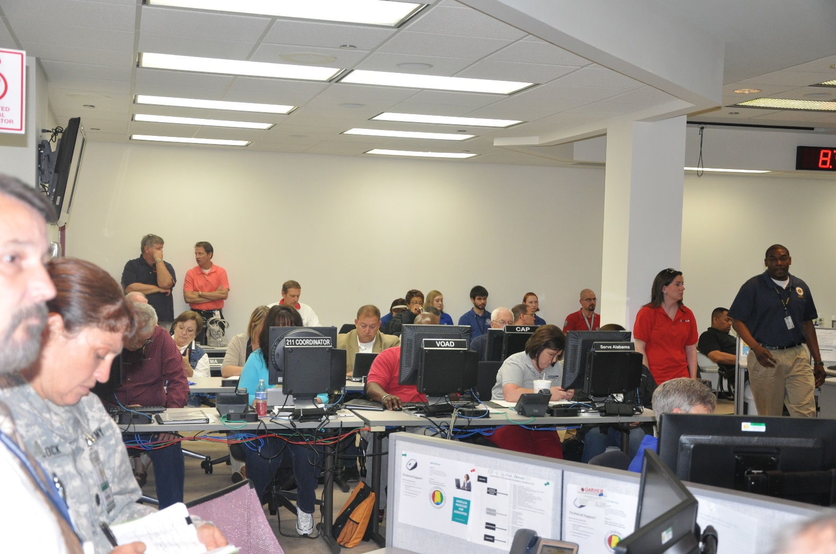
ALABAMA EMERGENCY MANAGEMENT AGENCY
SEOC DURING AN ACTIVATION

Slide 10
BUSINESS EMERGENCY OPERATIONS CENTER
The Unmet Need for Public-Private Sector Collaboration
The terrorist attacks of September 11, 2001 and Hurricane Katrina in August 2005 generated a great deal of discussion in public policy and disaster management circles about the importance of increasing national resilience to rebound from catastrophic events.
Improved public-private coordination strengthens both sectors!
“Vision: The public and private sectors share data and data feeds in both directions to enable timely lifesaving and property-protecting decision-making”
FEMA, Private Sector
Building Progress Report, 2011

Slide 11
BUSINESS EMERGENCY OPERATIONS CENTER
The Unmet Need for Public-Private Sector Collaboration
The Challenges:
Little guidance existed to help emergency management and elected officials identify non-governmental partners and integrate them into the emergency management process.
The private sectors reluctance to engage in the process for multiple reasons: reimbursement, liability, data sensitivity, trust.
The private sectors need for guidance and practice to become a functional emergency management partner with its host communities.
Common denominator of cross-sector knowledge is slowly improving.

Slide 12
BUSINESS EMERGENCY OPERATIONS CENTER
What is the purpose of a Public Private Partnership (PPP)?
Provides direct private sector expertise to the State, County, and Local government to prepare for, respond to and recover from disasters.
Improves efficiency and effectiveness of public and private sector emergency response capabilities.
Engages private sector from the outset of an emergency, enabling strategic use of all community resources.
Consolidates requests for assistance from government agencies and the community.
Facilitates sharing of expertise and best practices between sectors.

Slide 13
BUSINESS EMERGENCY OPERATIONS CENTER
Benefits of a Public Private Partnership During a Crisis
Creates a trusted environment for information sharing, collaboration, and problem solving between the public and private sectors.
Acts as a single point of contact for private sector organizations to engage within the emergency management infrastructure.
Facilitates public-private training and exercise activities.
Businesses need to come back quickly after a disaster to help communities recover. The quicker we can return to “normal” the better!
"There's no way government can solve the challenges of a disaster with a government centric approach. It takes the whole team.“
FEMA Administrator Craig Fugate

Slide 14
EXAMPLE OF PRIVATE SECTOR SUPPORT DURING A CRISIS
Critical Infrastructure & Key Resources
State EMA
Banking and Finance
Healthcare
Agriculture and Food
Chemical
Communications
Transportation Systems
Shipping
Critical Manufacturing
Commercial Facilities
Hotel / Motel
Assoc.
Notes:
The LA BEOC hosts key representatives from the business community along with government counterparts from the State’s Emergency Management and Economic Development agencies.
The LA BEOC facility seats up to 40 business leaders, industry trade associations, and organizations across several of the DHS-identified 18 Critical Infrastructure and Key Resources (CIKR) sectors.

Slide 15
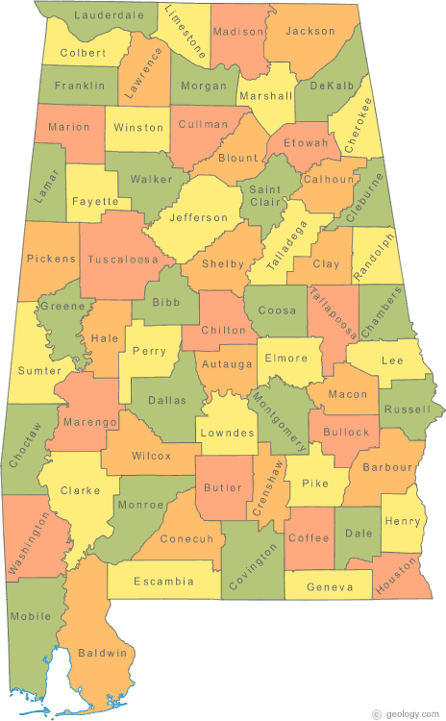
BUSINESS EMERGENCY OPERATIONS CENTER
Statewide Collaboration

Slide 16
BUSINESS EMERGENCY OPERATIONS CENTER
Regional Collaboration

Slide 17
BUSINESS EMERGENCY OPERATIONS CENTER
BEOC Activity is Growing at a National Level
In a crisis, close collaboration between the Federal Emergency Management Agency (FEMA) and the private sector is critical to protecting citizens, rebuilding communities, and returning to “normal” as quickly as possible.

Slide 18
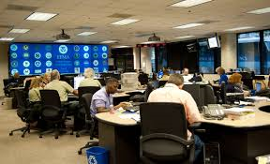
BUSINESS EMERGENCY OPERATIONS CENTER
BEOC Activity is Growing at a National Level
The National Business Emergency Operation Center (NBEOC) is a groundbreaking new virtual organization that serves as FEMA’s clearinghouse for two-way information sharing between public and private sector stakeholders in preparing for, responding to, and recovering from disasters.

Slide 19
BUSINESS EMERGENCY OPERATIONS CENTER
BEOC Activity is Growing at a National Level
Facilitate a public-private sector exchange of information about needs and capabilities
Support the ability of state, local, and tribal governments to recover from disasters by connecting them with FEMA’s regional private sector liaisons and the NBEOC’s national network of resources
Foster cooperative and mutually-supportive relationships that eliminate duplicative partnership development efforts
Improve situational awareness across the affected areas

Slide 20
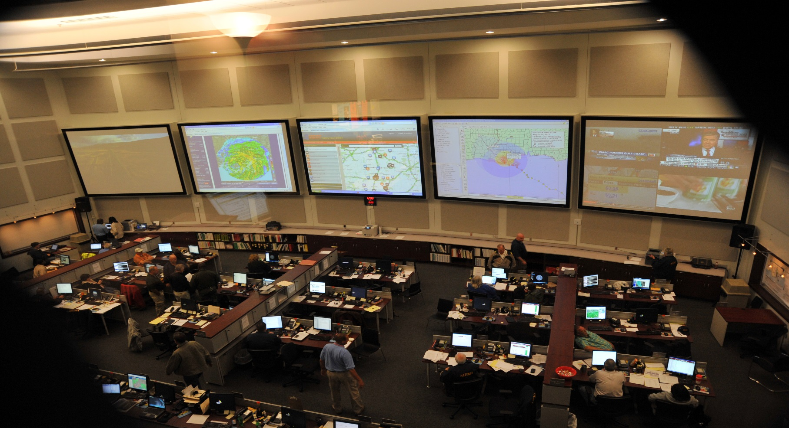
BUSINESS EMERGENCY OPERATIONS CENTER
BEOC Activity is Growing at a National Level

Slide 21
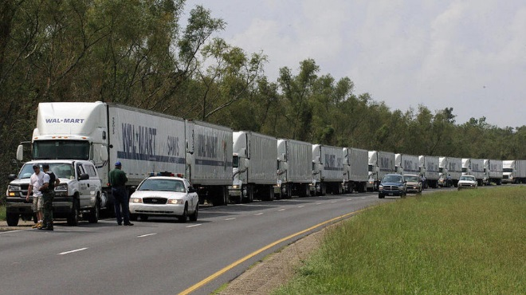
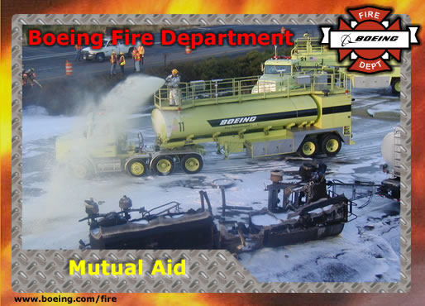
Stimuli for Better Public-Private Sector Collaboration
Katrina/Rita experience imposed both positive and negative reinforcement
Engagement of Private Sector through Emergency Management Assistance Compact (EMAC) showed what could be achieved
Private Sector, Public Sector Organizations, and the Public all shared in the conclusion that “We are on our own.”

Slide 22
Stimuli for Better Public-Private Sector Collaboration
Persistent outreach and inclusion by key public and private organizations is achieving positive results
DHS Private Sector Office, FEMA, State EMA, County EMA, Chamber of Commerce, Business Associations, ….
Public-Private Mutual Aid Agreements work!

Slide 23
What a Public-Private Partnership Is Not
A Public – Private Partnership is not an “inside advantage” or a “jump on the competition” to be ensured of performing work for local or state government.
All bid laws and purchasing laws must be adhered to at all times. In fact, often time sole source vendors are in place well before a crisis occurs.

Slide 24
BUSINESS EMERGENCY OPERATIONS CENTER
As Leaders What Can You Do Now to Prepare:
Learn About the Process of Emergency Management
FEMA Online Courses: https://training.fema.gov/is/
Suggestions:
IS-100.b Introduction to Incident Command System, ICS-100
IS-700.aNational Incident Management System (NIMS) An Introduction
IS-800.bNational Response Framework, An Introduction
FEMA.GOV https://training.fema.gov/emiweb/is/icsresource/trainingmaterials.htm#item1

Slide 25
QUESTIONS
Ricky W Adams
Alabama Emergency Management Agency
External Affairs / Public Information Manager
O) 205.280.2275
C) 205.299.6035
Southern Linc: 1*77*9

