Slide 1

Effective Signage and
Striping for Rural 2-lane Horizontal Curves
Presentation to the Alabama County
Commissioners Association
August 20, 2015
Timothy E. Barnett, P.E., PTOE
State Safety Operations Engineer
Alabama Department of Transportation

Slide 2
County Route Crash Typology
2012-2014
…with over 50% occurring in Curves
…and nearly 60% of them are in Curves
Similarly, nearly 70% of Serious Injuries are Roadway Departures
Over 70% of all Fatal Crashes are Roadway Departures
31% of all Fatal Crashes
Notes:
16% of all crashes occur on the county routes; however, they are over-represented for fatal crashes with 31% of all fatal crashes occur along the county routes.
Of the 656 fatal crashes, over 70%, or 462, were roadway departures. Of those, nearly 60% occurred in curves.
Additionally, nearly 70% of serious injury crashes were roadway departures, with over 50% of them in curves.
So we can see that curves are where we should concentrate are efforts in reducing the occurrence and severity of crashes.

Slide 3
Curve Crash Severity Statistics
2012-2014

Slide 4

Methods to Improve Curve
Related RwD Safety
Reduce the likelihood of vehicle leaving the roadway
Minimize the adverse consequence of leaving the roadway

Slide 5
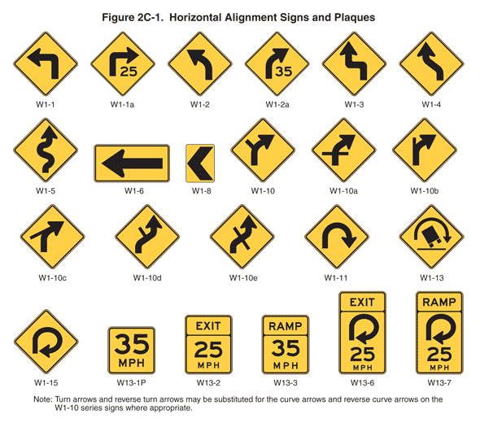
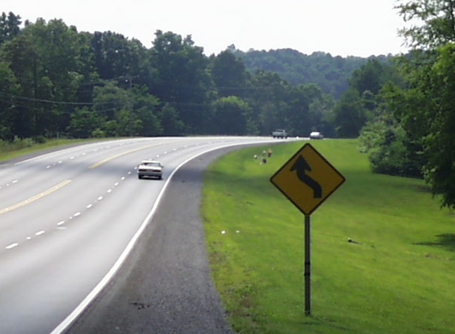



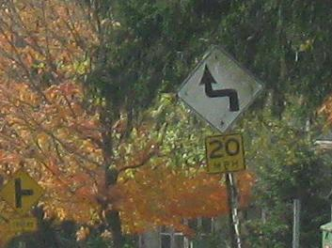
Driver Expectation

Slide 6
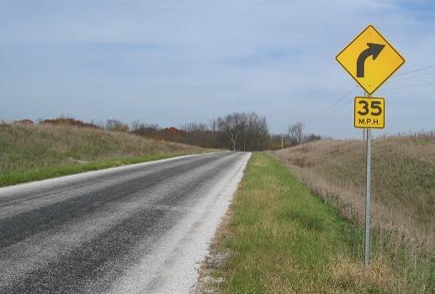
Provide Advance Warning
Providing basic traffic signing reduces
  Curve crashes
  Head-on collisions
  Nighttime crashes
  Other run-off-road crashes
30% Crash Reduction

Slide 7

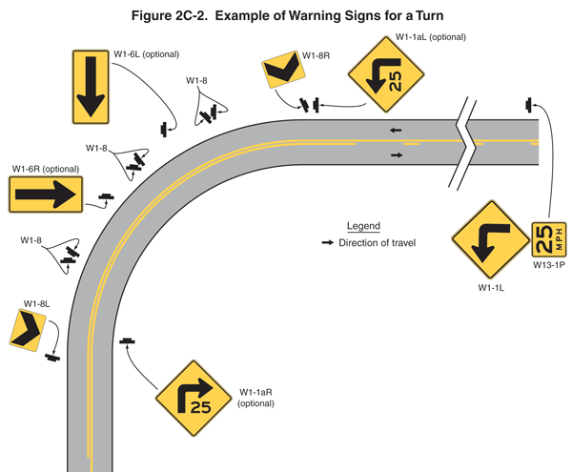
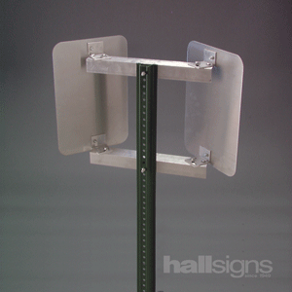
Enhance Delineation
Providing chevrons or other signing
  Improves view of curve from tangent
  Provides continuous positive guidance through curve
Up to 25% Crash Reduction

Slide 8
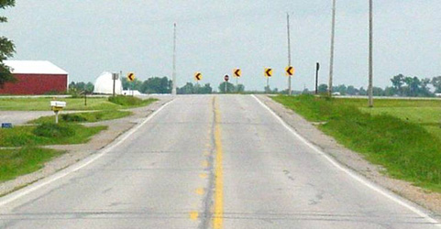
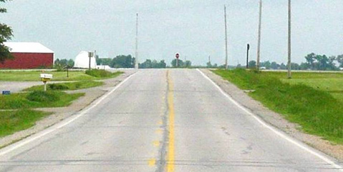
Use of Chevrons at Visual Traps

Slide 9

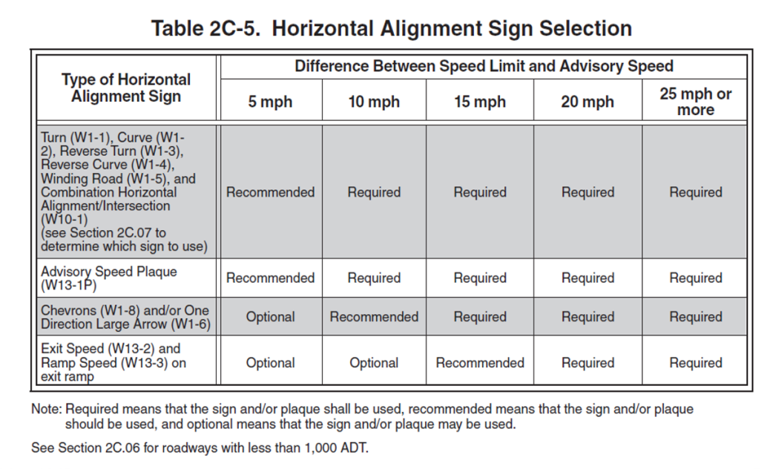
Tools Available
Curve Advisory Reporting Service (CARS) System
MUTCD requirements
Standardized method to evaluate curves
Automated curve speed calculations
Accurate and defensible
Ease of use and low-cost

Slide 10

Provide Edge Lines
Providing edge lines
  Use of edge lines and raised pavement marker
  Significant return on investment, up to 55:1
66% Crash Reduction

Slide 11
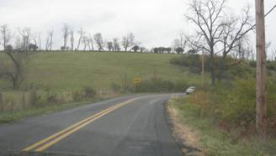
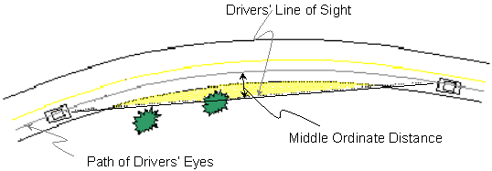
Provide Adequate Sight Distance
Improve horizontal sight distance
  In particular at locations with substantial sight distance restrictions
  More critical when an intersection or driveway is within or just beyond curve
Up to 20% Crash Reduction

Slide 12
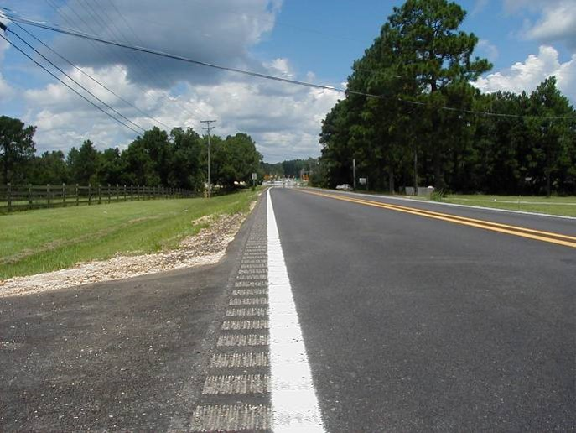
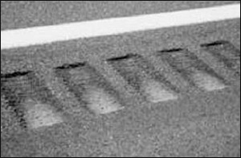
Install Shoulder Rumble Strips
Providing shoulder or edge line rumble strips
  Proportion of vehicles that run off the road is significantly greater on a curve
  An effective means of locating the edge of the travel way during inclement weather
Up to 30% Crash Reduction

Slide 13
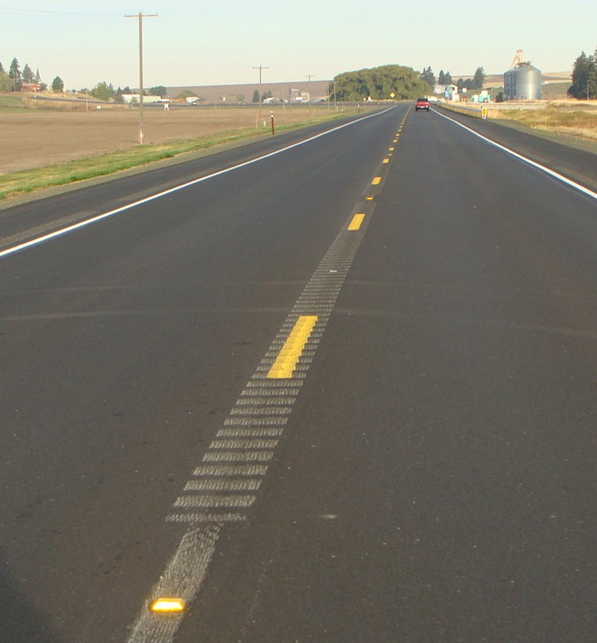
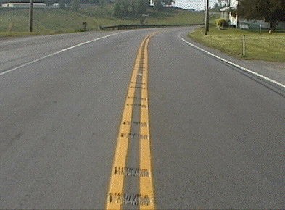
Install Centerline Rumble Strips
Providing centerline rumble strips
  Effective in reducing head-on and opposite direction sideswipe crashes
  No adverse effect on motorcyclist or bicyclists
Up to 37% Crash Reduction

Slide 14


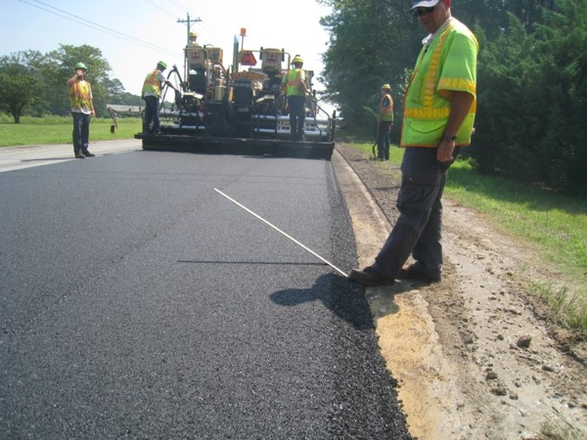
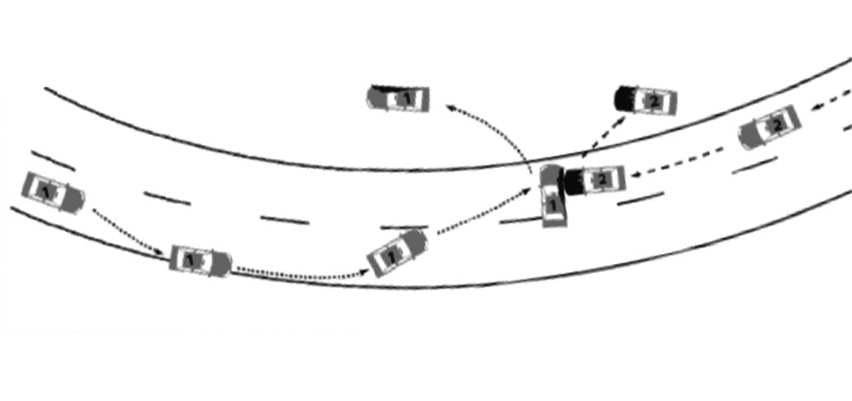
Prevent Edge Drop-offs
Provide a Safety Edge_{TM} treatment
  Virtually eliminates the over-correction RwD crash
  Adds about 1% to asphalt quantities for a typical overlay
Up to 6% Crash Reduction

Slide 15
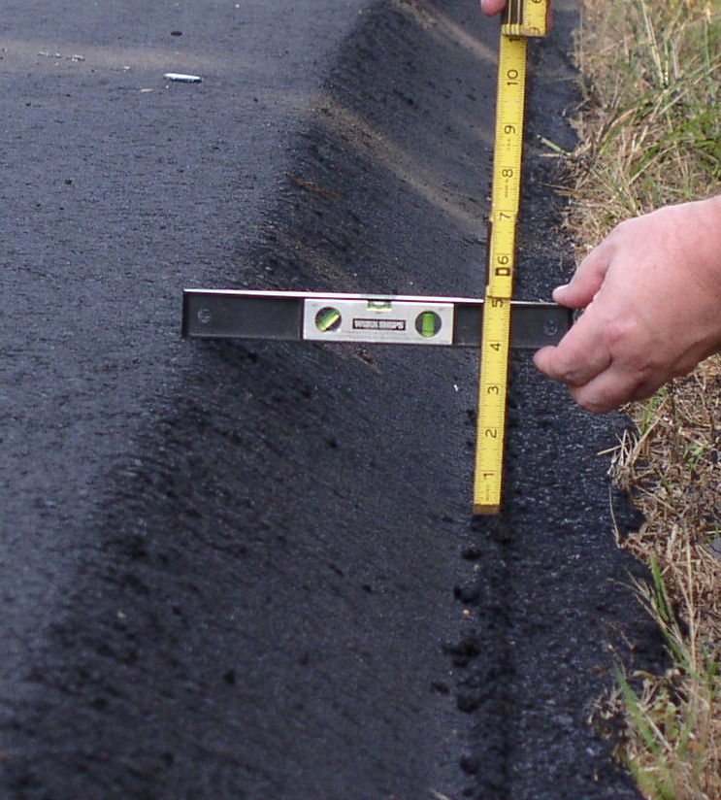
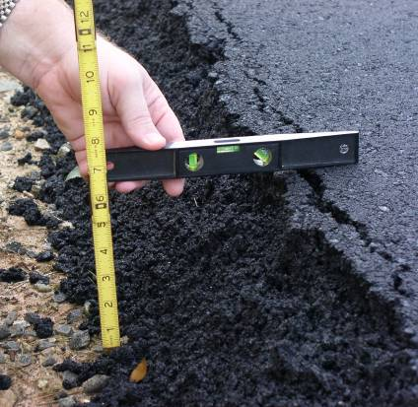
Increased Edge Compaction
With Safety Edge
Without Safety Edge

Slide 16
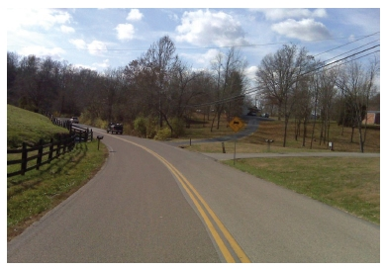
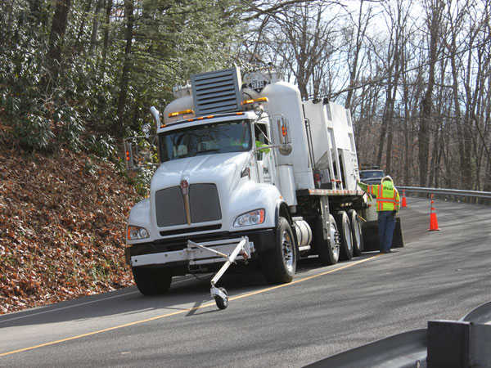
Provide Skid-Resistant Pavement
Providing a skid-resistant pavement surface
  Reduces RwD related to wet-pavement conditions
  May be less expensive than modifications to the alignment or changing the superelevation
Up to 35% Crash Reduction

Slide 17

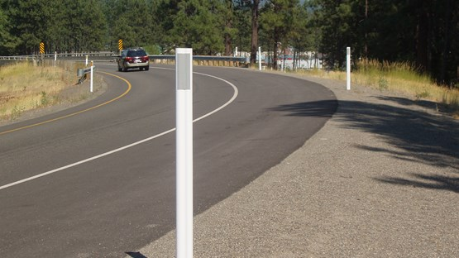
Provide Lighting on the Curve
Providing lighting on curves
  Along county routes, approximately 58% of fatal crashes along horizontal curves took place during nighttime hours
  Can be costly to implement
  Alternate enhancements to delineation may be an interim step
Up to 54% Crash Reduction
(Nighttime Only)

Slide 18
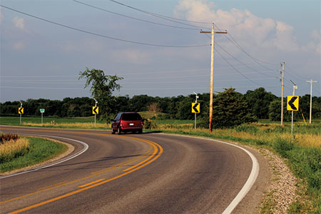
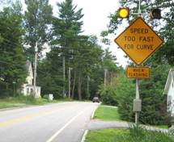
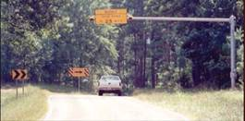
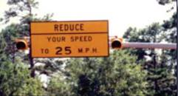
Provide Dynamic Curve Warning
Providing dynamic curve warning devices
  Actuated warning devices
  Either constant operation or speed activated
  More effective for truck related crashes
  Should limit applications
39% for all crashes, up to 71% Crash Reduction for Truck related rollovers

Slide 19
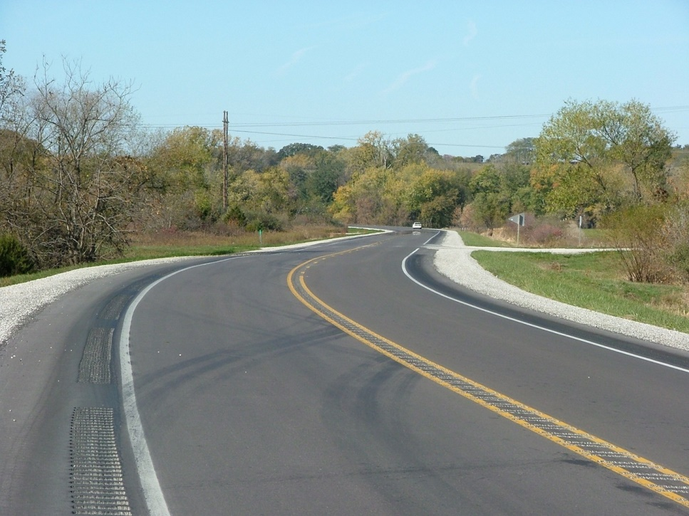
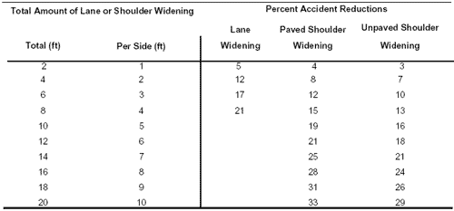
Widen the Roadway
Providing wider lanes
  Design vehicle occupies a greater width because of offtracking
  Drivers experience difficulty in steering their vehicles along the center of the lane
  Improving from 10-ft to 12-ft lanes
Up to 12% Crash Reduction

Slide 20
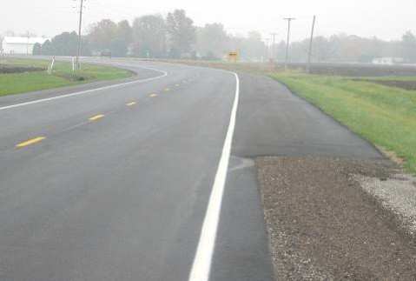
Widen the Shoulder
Providing a wider shoulder
  Can be limited to curve locations
  Inside and outside
    Inside reduces occurrence of over-correction crashes
    Outside provides for an improved recovery for roadway departures
Up to 87% Crash Reduction

Slide 21
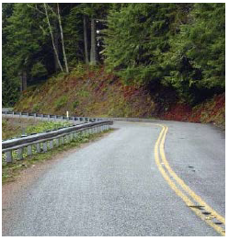
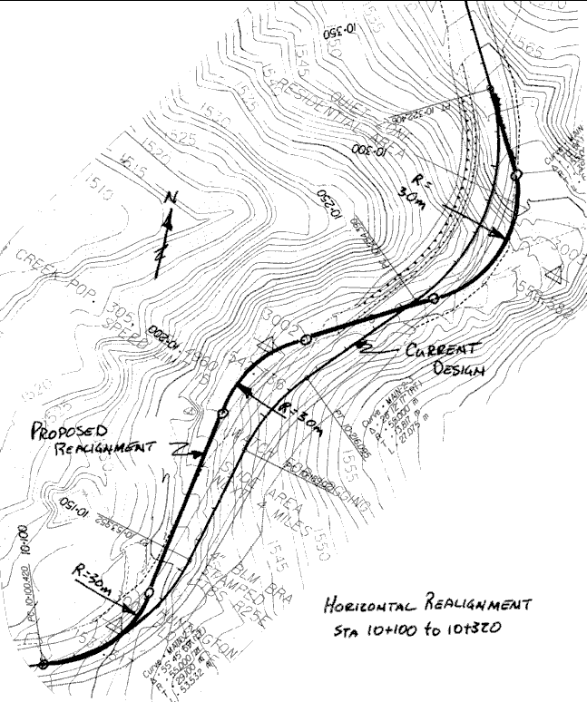
Modify Horizontal Alignment
Modifying horizontal alignment
  Used only at very highly over-represented locations
  Can be very costly
Up to 67% Crash Reduction

Slide 22
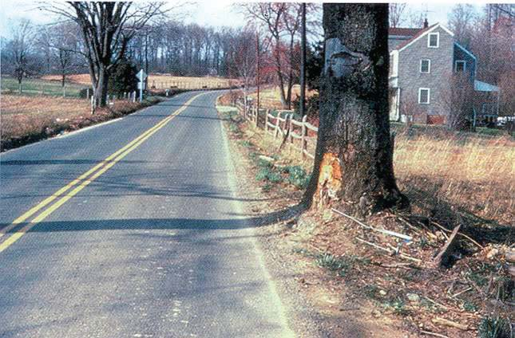
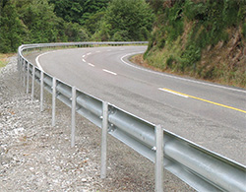
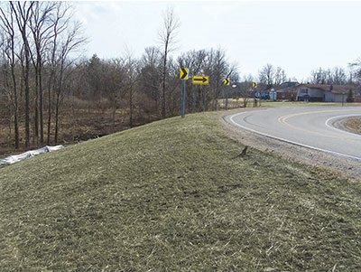
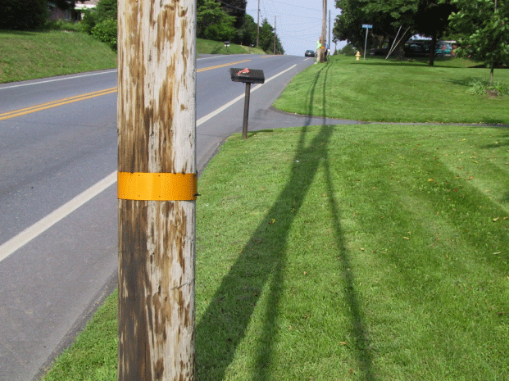

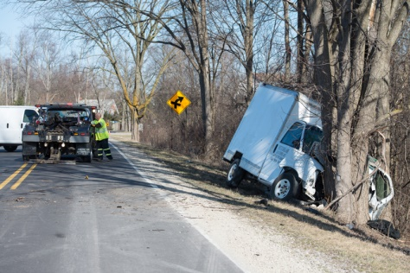
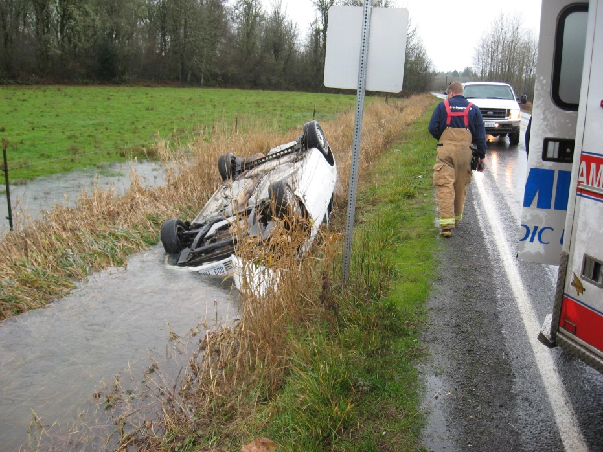
Minimize the Adverse Consequences of Leaving the Roadway
Improve roadside slopes
  90% crash reduction
Remove/relocate objects
  98% crash reduction
Delineate objects
  8% crash reduction
Add roadside hardware
  94% crash reduction

Slide 23
Conclusions and Recommendations
Improvements for curves have the potential to reduce crashes and crash severity on rural roads
Identifying where safety funding should be allocated continues to be a challenge
Focus on the most at-risk crash types
Concentrate on the most at-risk locations
Utilized low-cost countermeasures
Combine countermeasures where appropriate

Slide 25

Questions?

Slide 26
Resources
Safety Effects of Horizontal Curve and Grade Combinations on Rural Two-Lane Highways
  https://www.fhwa.dot.gov/publications/research/safety/13077/13077.pdf
A Guide for Reducing Collisions on Horizontal Curves
  http://www.trb.org/Publications/Public/Blurbs/A_Guide_for_Reducing_Collisions_on_Horizontal_Curv_154782.aspx
Low Cost Treatments for Horizontal Curve Safety
  http://safety.fhwa.dot.gov/roadway_dept/horicurves/fhwasa07002/fhwasa07002.pdf
Horizontal Curve Safety
  http://safety.fhwa.dot.gov/roadway_dept/horicurves/

