Slide 1
July 18, 2018 AAND Workshop Update from the Alabama 9-1-1 Board Prattville, AL

Slide 2
Introduction & Contact Information
Leah Missildine
Executive Director for the Alabama 9-1-1 Board
leah@al911board.com
Office: 334-440-7911
Mobile: 334-235-3324

Slide 3
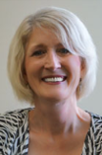
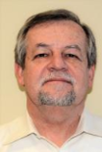
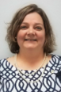
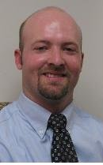
Staff
Helen Andrews, Office Assistant
helen@al911board.com
Ron Cooley, CPA, Financial Analyst
ron@al911board.com
Dana Grubbs, Program Coordinator
dana@al911board.com
Adam Brown, Deputy Director
adam@al911board.com
Helen
Ron
Dana
Adam

Slide 4
Board Member Nominations
Cable/VoIP Provider
Ms. Terry Womack -- Cable ONE (Anniston, AL)
AAND DISTRICT 5 Nominees
____ or
____

Slide 5
Upcoming Training
/
When | What | Where | Who
July 9-13, 16, & 17-20, 2018 | Telecommunicator Rookie School | Blount County 9-1-1, Oneonta, AL | Hosted by: Blount County 9-1-1
July 24, 2018 | Active Shooter | Alabama 9-1-1 Board, Montgomery, AL | APCO, sponsored by Alabama 9-1-1 Board
July 25, 2018 | Active Shooter | Alabama 9-1-1 Board, Montgomery, AL | APCO, sponsored by Alabama 9-1-1 Board
August 13, 2018 | It’s Your Ship-Navigating the Waters of Communications Center Leadership | Huntsville-Madison 9-1-1, Huntsville, AL | Hosted by: Huntsville Madison County 9-1-1
August 14, 2018 | Preventing Telecommunicator Tunnel Vision | Tuscaloosa 9-1-1, Northport, AL | NENA, sponsored by Alabama 9-1-1 Board
August 14, 2018 | People First Leadership | Huntsville-Madison 9-1-1, Huntsville, AL | Hosted by: Huntsville Madison County 9-1-1
August 28, 2018 | Active Shooter: The Tactical side of what field units need from Dispatch | Alabama Power Building, Clanton, AL | Hosted by: APCO, Alabama Chapter

Slide 6
Upcoming Training
/
When | What | Where | Who
September 5, 2018 | Liability Issues in the 9-1-1 Center | Valley Sportsplex, Valley, AL | NENA, sponsored by Alabama 9-1-1 Board
September 26, 2018 | Enhanced Caller Management | Marriott, Prattville, AL | NENA, sponsored by ALNENA
September 27, 2018 | Enhanced Caller Management | Marriott, Prattville, AL | NENA, sponsored by ALNENA
October 17-19, 2018 | 9-1-1 Center Supervisor Program | Gulf Shores Fire Station 1, Gulf Shores, AL | NENA, sponsored by Alabama 9-1-1 Board
October 30, 2018 | Career & Officer Survival for Dispatchers | Dothan/Houston County 9-1-1, Dothan, AL | Hosted by Dothan/Houston County 9-1-1
November 1-2, 2018 | Alabama APCO Two-Day Workshop | SpringHill Suites, Orange Beach, AL | Hosted by: APCO, Alabama Chapter
November 27, 2018 | Overcoming Negativity | Palisades Park, Oneonta, AL | NENA, sponsored by Alabama 9-1-1 Board

Slide 7
Upcoming Training
/
When | What | Where | Who
January 29-31, 2019 | 9-1-1 Center Supervisor Program | Athens State University, Athens, AL | NENA, sponsored by Alabama 9-1-1 Board
February 4-8, 2019 | Center Manager Certification Program (CMCP) | Baldwin County 9-1-1 Center, Robertsdale, AL | NENA, sponsored by Alabama 9-1-1 Board
March 4-6, 2019 | Center Training Officer Program (CTO) | Alabama 9-1-1 Board, Montgomery, AL | NENA, sponsored by Alabama 9-1-1 Board

Slide 8
Upcoming Events
• 7/17-18 AAND Workshop (Prattville)
• 7/19 ALNENA Quarterly Meeting (Prattville)
• 7/19 Public Hearing/Board Meeting
• 8/5-8 APCO 2018 (Las Vegas, NV)
• 8/21-23 Annual ACCA Convention (Orange Beach)
• 9/19 Board Meeting
• 10/14-17 Gulf Coast 9-1-1 Conference (Orange Beach)
• 11/14 Board Meeting (Second Wednesday due to Thanksgiving holiday)

Slide 9
Rulemaking in Progress
585-X-4.08 Distribution Formula-Census Data
Board adopts most recent population data October 1 each year
585-X-4.09 Distributions to Emergency Communication Districts from the Cost Recovery Fund
Make ECDs whole, pay cost recovery to participating carriers, pay ANGEN costs, maintain a minimum balance equal to (90) days operational and administrative costs of the board, and determine if there are additional funds that may be distributed to the ECDs and, if so, do so by 50% equal parts plus 50% by population
585-X-4.10 Statewide 911 Charge Adjustment for the rate of growth in the CPI-U
Increase 9-1-1 service charge from $1.75 to $1.86
Notes:
Timeline for rules:
March 2018 Board Meeting – introduce need for rules and draft language for discussion and revision
May 2018 Board Meeting – approve final draft of rules
No later than May 20, 2018 – file with the Legislative Reference Service for publishing in the Alabama Administrative Monthly on May 31, 2018
Allow not less than 35 or more than 90 days from the date of the notice for interested persons to present their views (June 1st through July 19th)
July 19, 2018 Board Meeting – hold a public hearing immediately prior to the board meeting for presentation of views; during the regularly scheduled board meeting consider fully all written and oral submissions respecting the proposed rule
File the adopted rule (with any revisions) in the office of the LRS within 15 days of adoption and within 90 days after completion of the notice (on our about July 31st)
Adopted rule becomes effective 45 days after filing with the LRS, unless the committee disapproves of or proposes an amendment for pursuant to Section 41-22-23 (on or about September 14th)
For the CPI-U adjustment, specifically, the Board will need to take action during the September board meeting for the adjustment to occur on October 1, 2018

Slide 10
Grant Opportunities
Federal
Focus = Gaps in implementing NG9-1-1
State Important Dates
Opens – July 23, 2018
Closes – August 31, 2018
Webinar – TBD (week of July 30 – August 3, 2018)
Deliberation – September 2018
Board Approval – September 19, 2018

Slide 11
EMD Protocol
20+ agencies
37 instructors
36 practitioners
24 in practitioner classes through the rest of July
Need to know: How many seats are at the participating PSAPs?

Slide 12
ANGEN 2.0
Behind the Scenes:
ASA data center move
911 Logix and Dashboard to PSAPs
Repository for high-level GIS data

Slide 13
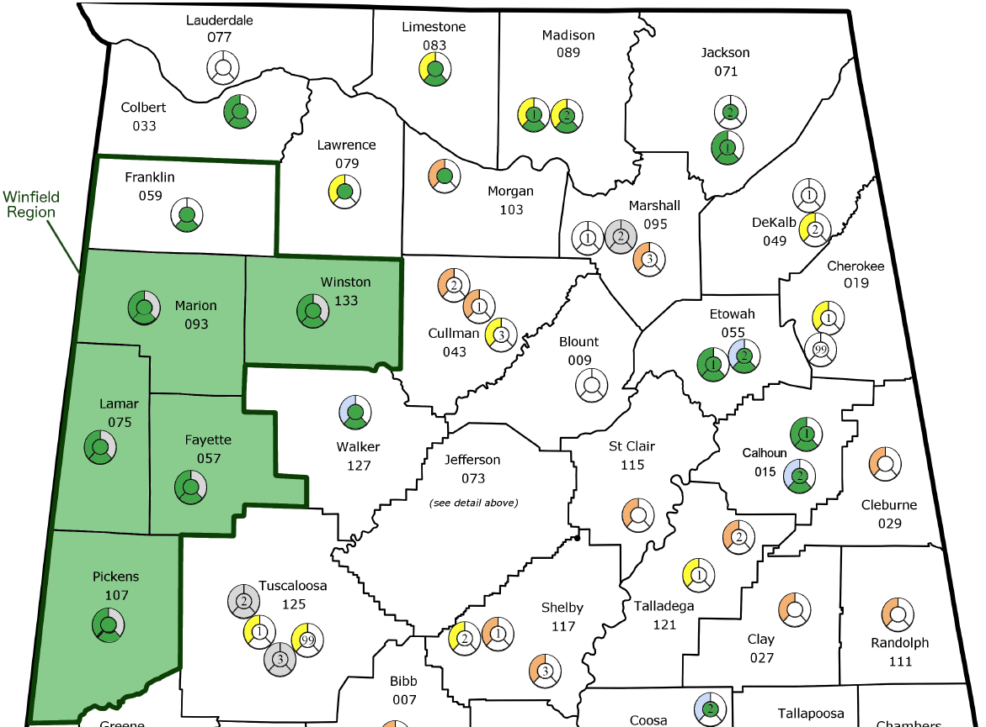
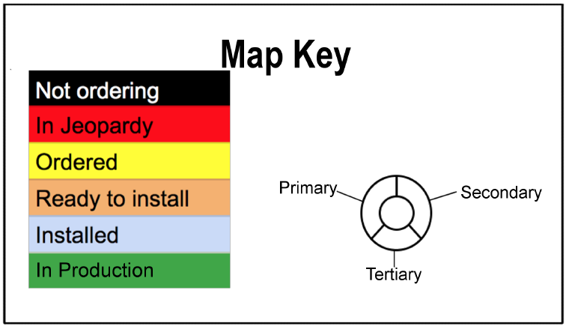

Slide 14
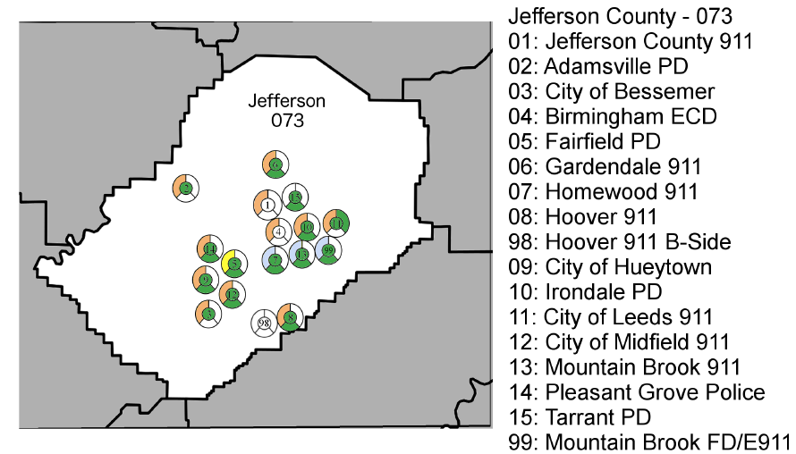

Slide 15
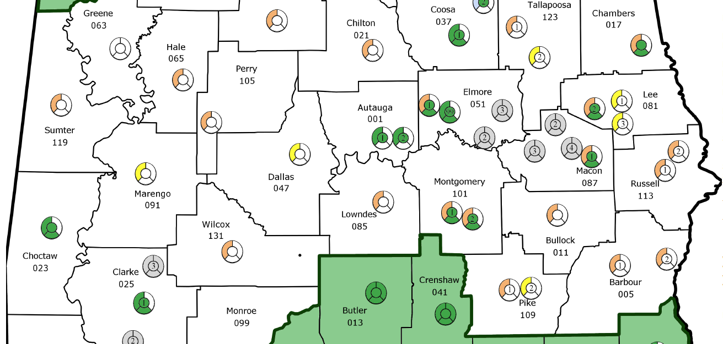

Slide 16
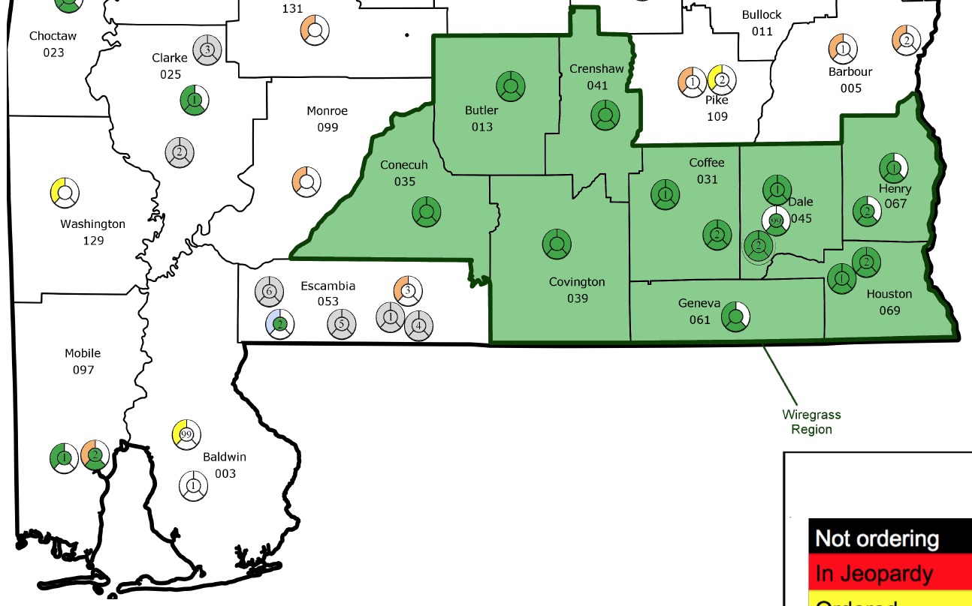

Slide 17
ANGEN 2.0
Current work going on in July
July 24 INdigital to begin wireless ALI conversion for on network ANGEN PSAPs (Winfield & Wiregrass)
CPE Upgrades at Lamar & Randolph will create new interface type to ANGEN
Complete turnup of Choctaw county to ANGEN
Router install at Shelby County

Slide 18
ANGEN 2.0
Planned work in August to September
Shelby County ANGEN turnup (need one additional circuit at City of Pelham)
Autauga County
Jefferson County (ready for next steps)
Homewood
Hueytown
Leeds
Mountain Brook PD
Pleasant Grove
Adamsville
City of Birmingham

Slide 19
ANGEN 2.0
Expected work in September to October
Continuation of Birmingham Metro area:
Bibb
Blount
Saint Clair
Walker
Cullman
Tuscaloosa
Chilton
Other sites that will be ready to move forward:
Montgomery
Limestone
Chambers
City of Auburn
Jackson County

Slide 20
Questions
Leah Missildine
Executive Director for the Alabama 9-1-1 Board
leah@al911board.com
Office: 334-440-7911
Mobile: 334-235-3324

