Slide 1
July 18, 2019 AAND Workshop Update from the Alabama 9-1-1 Board Prattville, AL

Slide 2
Introduction & Contact Information
Leah Missildine
Executive Director for the Alabama 9-1-1 Board
leah@al911board.com
Office: 334-440-7911
Mobile: 334-235-3324

Slide 3
ANGEN 2.0
Behind the Scenes in the last 12 months:
Data center move
Close our existing AFSs with ASA
911 Logix and Dashboard to PSAPs
Continuous development
Repository for high-level GIS data
Preparation for statewide GIS dataset project

Slide 4
ANGEN 2.0
Various Stages of Project:
Stage 0 - Replace the Bandwidth wireless network Completed in 2018. Work included a data center move.
Stage 1 - Build the ESInet to the PSAPs.
Stage 2 - Deliver 911 calls directly to PSAP.
Wireless is active now, the transition continues.
Stage 3 - Convert the legacy wireline service to ANGEN.
Stage 4 - Turnup Texty for non-voice text messaging with the PSAPs

Slide 5
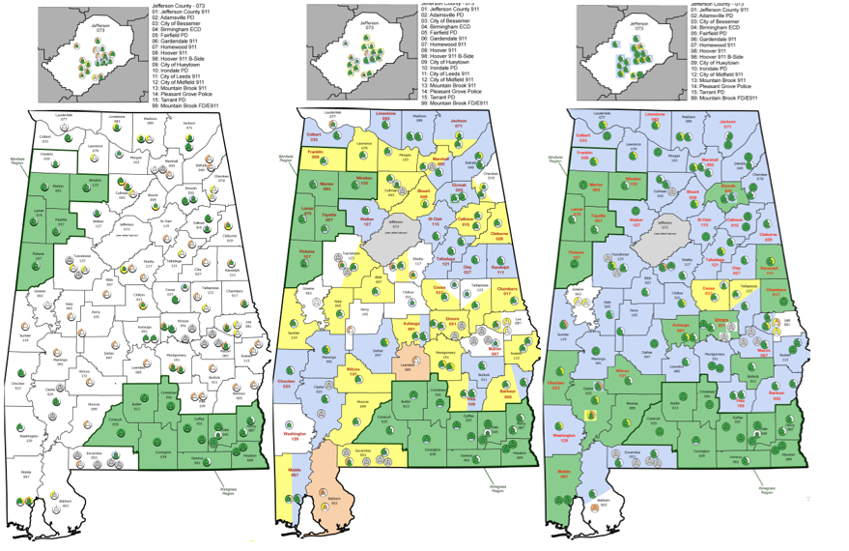
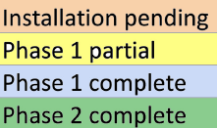
July 2018
February 2019
July 2019
Notes:
Blue counties ready for conversion to ANGEN, green counties are on ANGEN, yellow counties have equipment partially installed, white counties are awaiting circuit and equipment installation.

Slide 6
ANGEN 2.0
Must engage your vendors!
Coordination, coordination, coordination.
Know what state of conversion to ANGEN your PSAPs are in and know who to contact!
INdigital NOC @ 877-469-2010 or support @indigital.net
Caleb as the network manager; State Office as the facilitator of the project
Your vendors, technicians, or service providers
Notes:
INdigital engages the carrier side of the house—provides a playbook
ECDs might consider having a playbook, too.

Slide 7
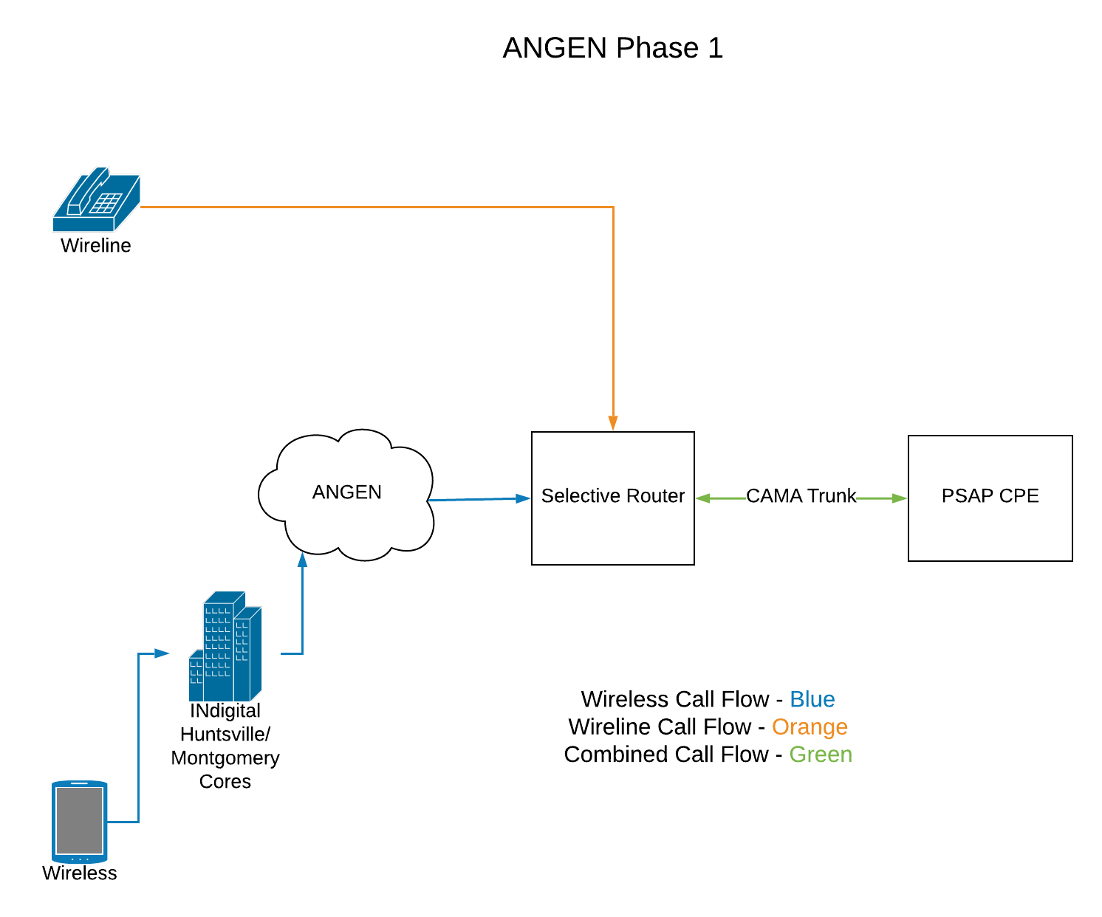

Slide 8
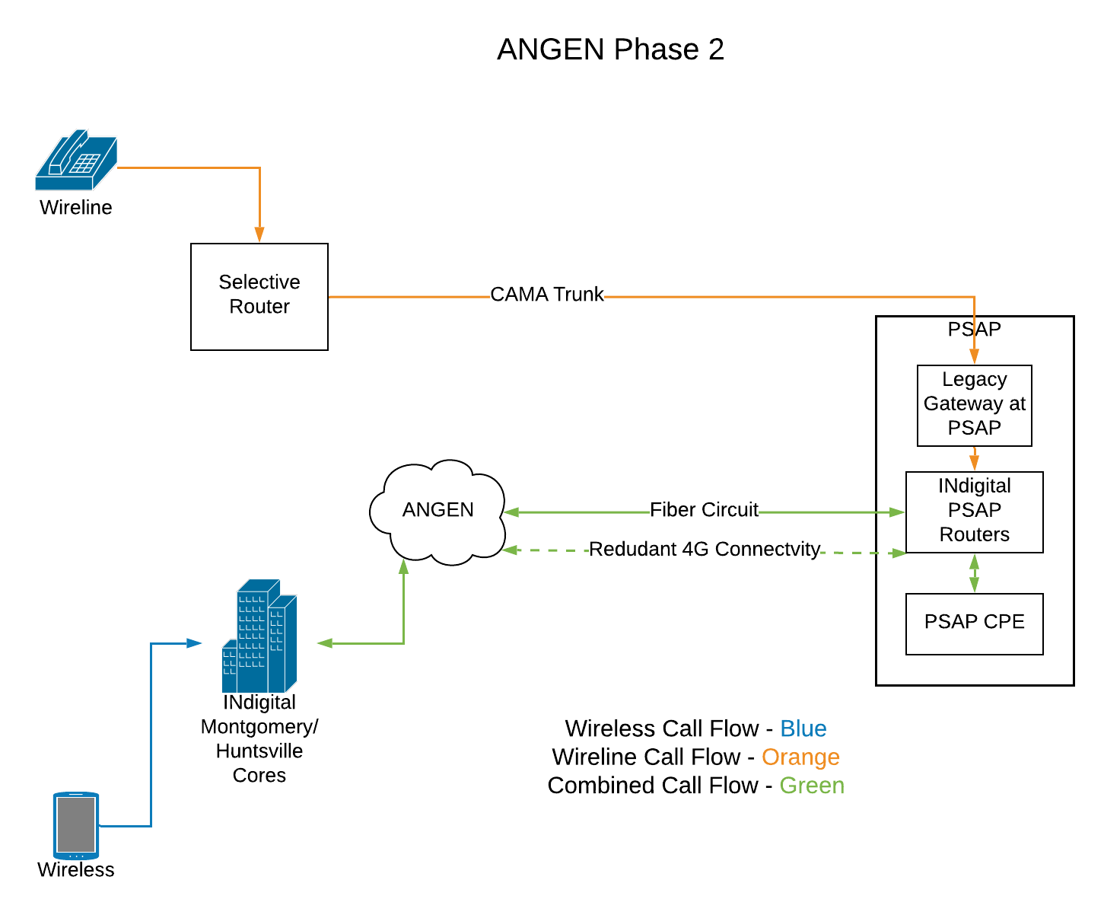
Notes:
The change you see here is that you begin having at least your wireless calls delivered directly to the PSAP.

Slide 9
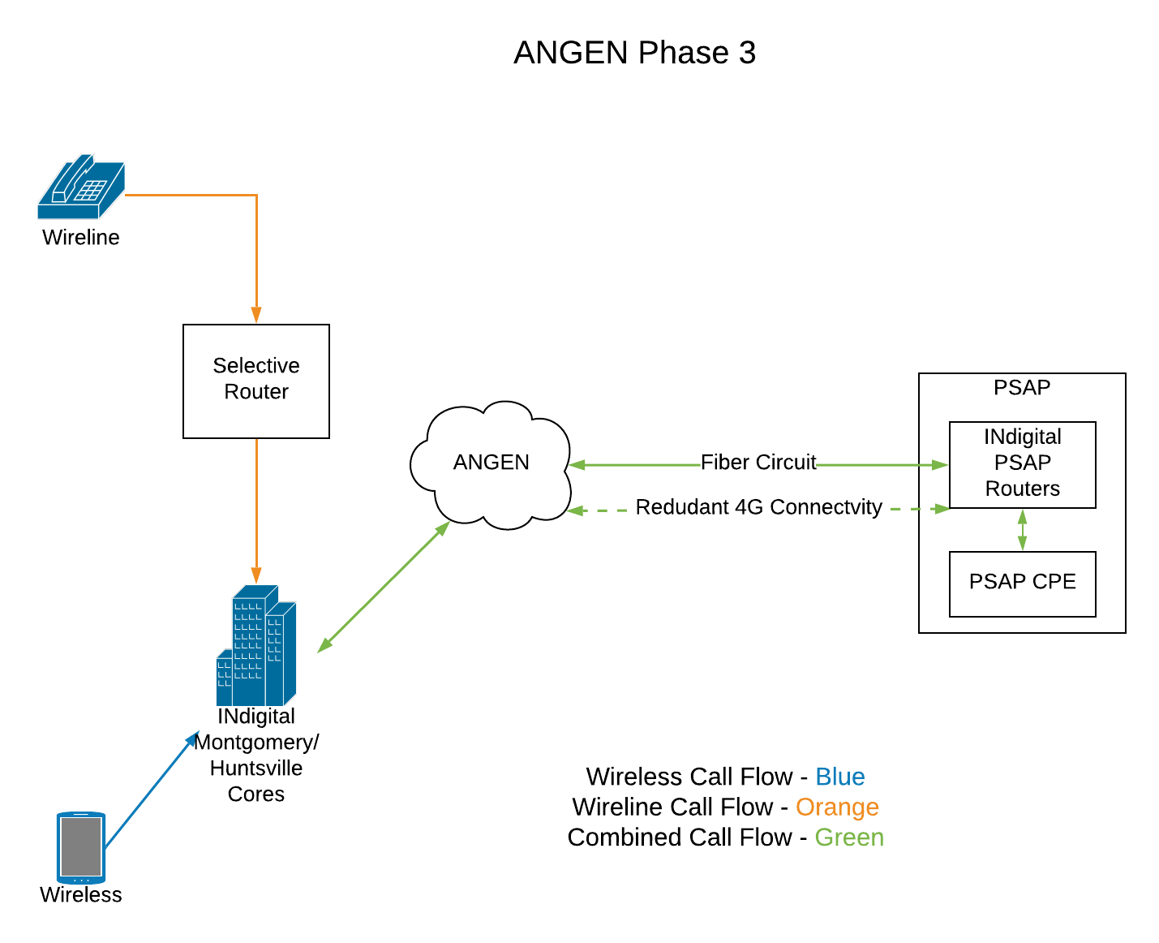
Notes:
The change you see here is that all call types, most obviously including your wireline calls, are being delivered directly to the PSAP.

Slide 10
ANGEN 2.0
Thirty-four primary PSAPs are now processing calls over ANGEN 2.0
Population served by ANGEN 2.0 is 1,327,897
Percentage of the total population served by ANGEN 2.0 is 28%
Barbour, Chilton, Montgomery City and County, and Pike up in next
Notes:
Blue counties ready for conversion to ANGEN, green counties are on ANGEN, yellow counties have equipment partially installed, white counties are awaiting circuit and equipment installation.

Slide 11
ANGEN 2.0
PSAP Cutovers
Engage your vendors and coordinate
Press release for ANGEN cutover
Reimbursement opportunity for ANGEN cutover reimbursement (≤ $3,000 per ECD)

Slide 12
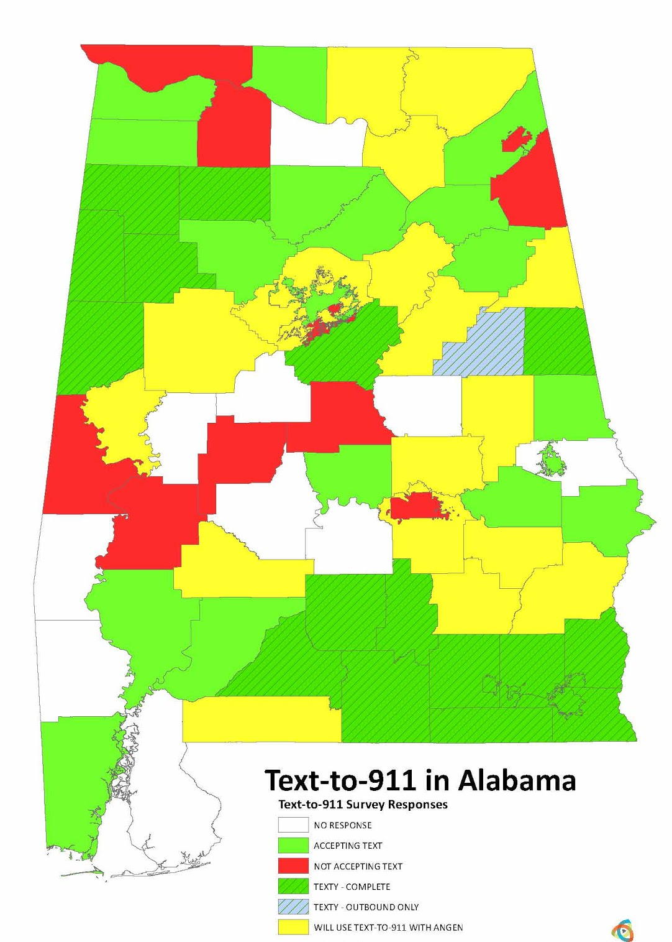
ANGEN 2.0
Texty Deployment
Version 17.3 will be released in Alabama by the end of the summer (includes RapidSOS location enhancement integration)
Twenty-one PSAPs utilizing Texty
Outbound texts exceed inbound texts three to one (669 outbound:285 inbound)

Slide 13
ANGEN 2.0
Upcoming Activities
Federal Grant aimed at “filling the gaps of NG9-1-1 implementation”
Release Hosted CPE RFP
Drafting Statewide GIS Project RFP
More training!
AL911.net User Training

Slide 14
ANGEN 2.0
AL911.net User Training
Designed to be a train-the-trainer session on using the AL911.net dashboard
Agenda:
10:00a MEVO
11:15a Texty
12:15p Lunch provided by INdigital
1:15p Toolkits/MSAG
2:30p Logix
Training Officers, Line-level and Center Supervisors, Operations Managers, & Database Administrators
Course materials and lunch are provided by INdigital in partnership with the Alabama 9-1-1 Board
How can we enhance this training?

Slide 15
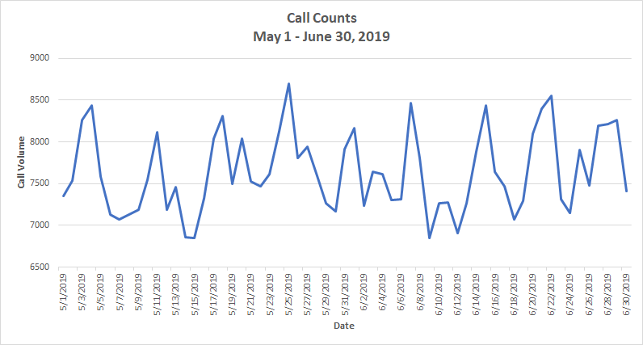
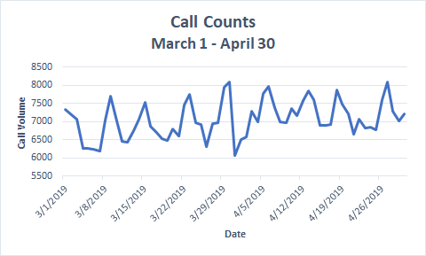
Section C: ESInet Trends and Stats
Busiest day during the period was May 25th - 8,694 calls were processed. The second busiest day was June 22th - 8,549 calls were processed. Both the first and second busiest days in the reporting period are the fourth Saturday in the month.
Average call volume per day was 7,638. Up from 7,059 in the previous reporting period. Total calls since the last report was 465,945.

Slide 16
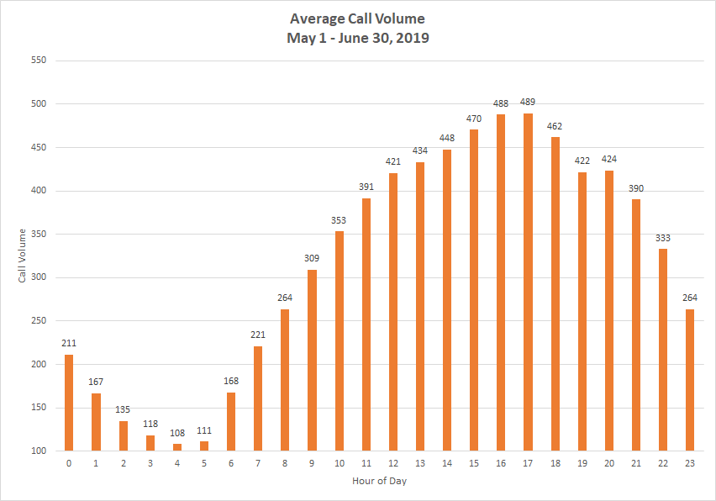
Average Calls by Time of Day
4:00 am has the lowest call volume - 108 call average across the network
5:00 pm has the peak call volume - 589 call average across the network

Slide 17
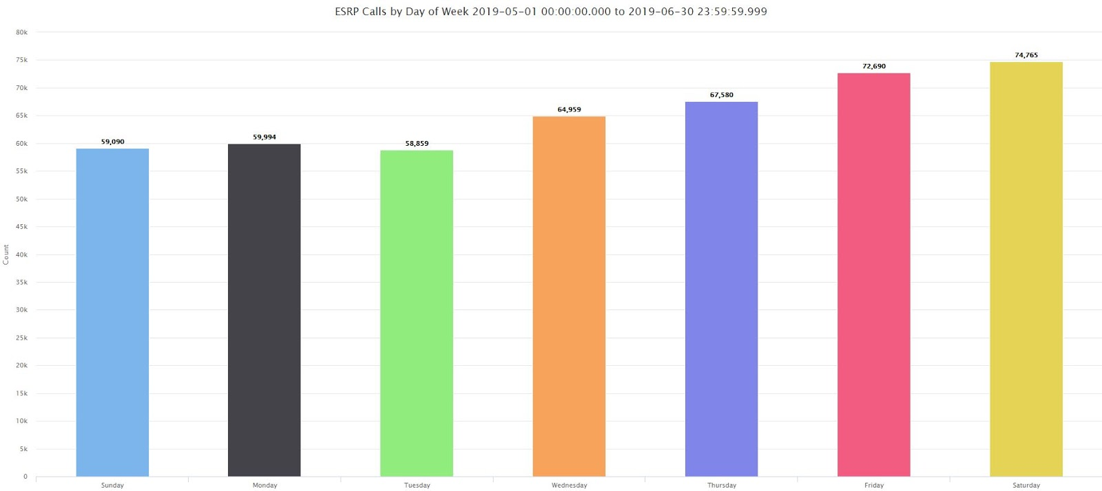
Calls by Day of Week
Saturday was the busiest day of the week for this report; Friday was the busiest day for the last reporting period.

Slide 18
Section C: ESInet Trends and Stats
ANGEN 2.0 has now processed over 3.5 million calls.
Average call volume per day : 7,069
Total Call Volume Feb 12, 2018 to June 30, 2019 : 3,563,088

Slide 19
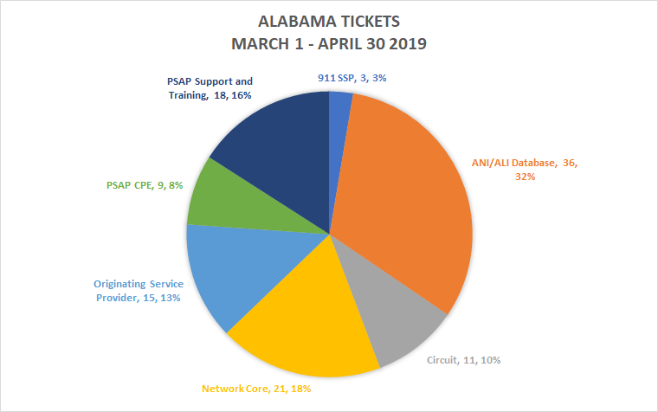
Section D: Trouble Ticket Analysis
A total 110 tickets have been created since the last report.

Slide 20
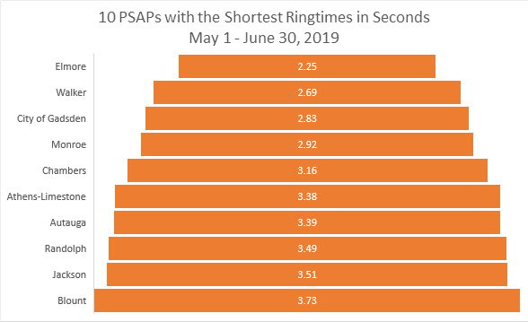
Section E: Alabama Call Service Level Metrics
The average ring time for the reporting period is 4.52 seconds.
The data is derived from twenty-five PSAPs that currently have CDR boxes deployed. PSAPs utilizing ACD or ECW have been excluded from this data set
NENA Standard: Ninety percent (90%) of all 9-1-1 calls arriving at the Public Safety Answering Point (PSAP) shall be answered within ten (10) seconds during the busy hour (the hour each day with the greatest call volume, as defined in the NENA Master
Glossary). Ninety-five (95%) of all 9-1-1 calls should be answered within twenty (20) seconds.
NENA Call Answering Standard/Model Recommendation NENA 56-005.1 June 10, 2006, Revised 8/31/2017

Slide 21
Questions
Leah Missildine
Executive Director for the Alabama 9-1-1 Board
leah@al911board.com
Office: 334-440-7911

