Slide 1

Rebuild Alabama
Implementation and Accounting
Richie Beyer, Elmore County
2019 ACCA Annual Conference

Slide 3
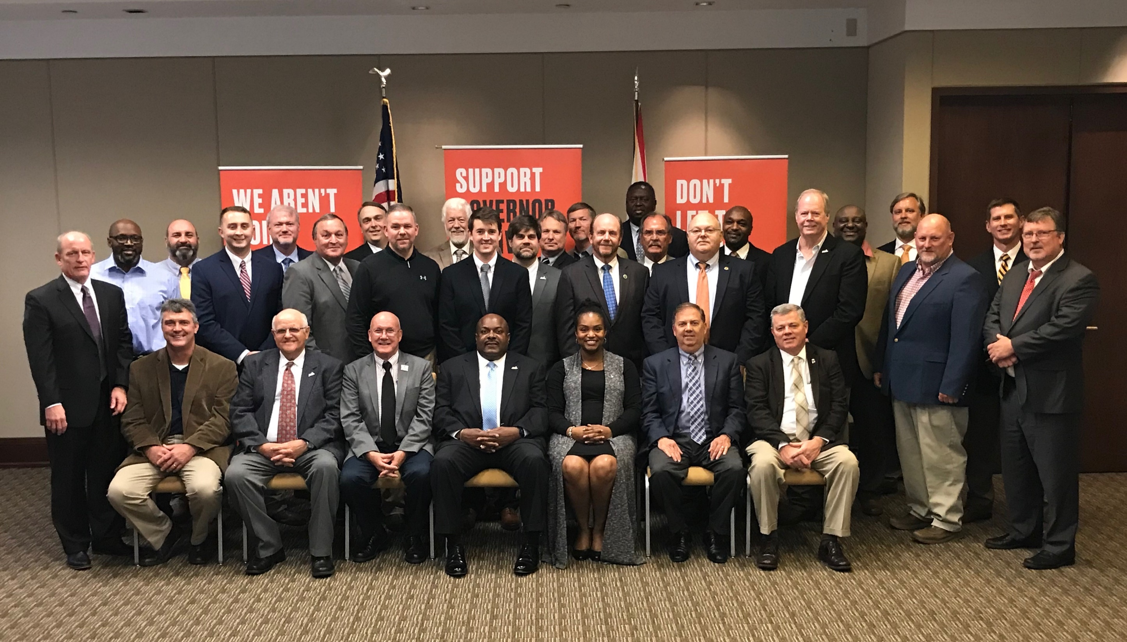

Slide 4


Rebuild Alabama Implementation Team
Technical Team
Shelby Randy Cole
Morgan Greg Bodley
Marshall Bob Pirando
Mobile Ricky Mitchell
Mobile Richard Spraggins
Elmore Luke McGinty
Chambers Josh Harvill
Policy/ Accountability Team
Crenshaw Benjie Sanders
Autauga John Mark Davis
Geneva Justin Barfield
Perry Deandre Kimbrough
Elmore Richie Beyer

Slide 5
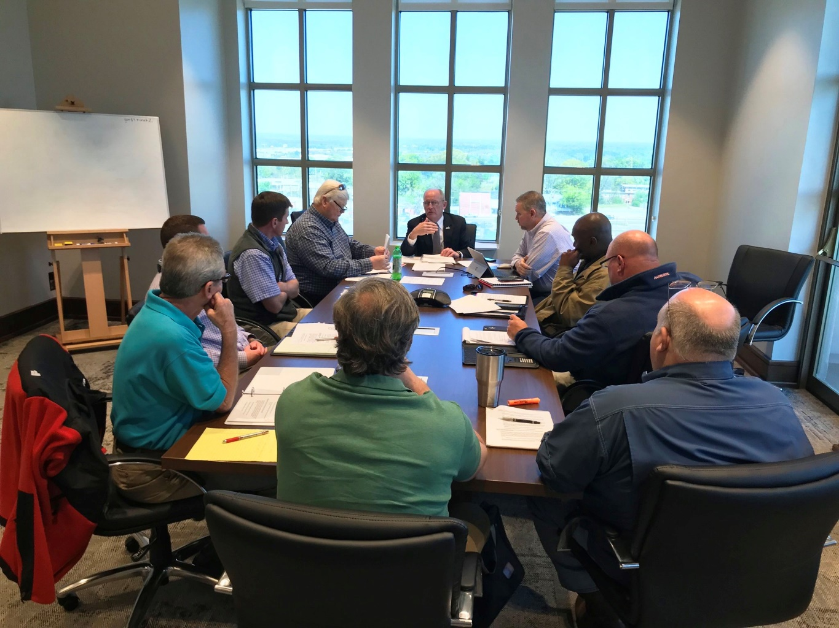
Rebuild Alabama
Implementation Team

Slide 7
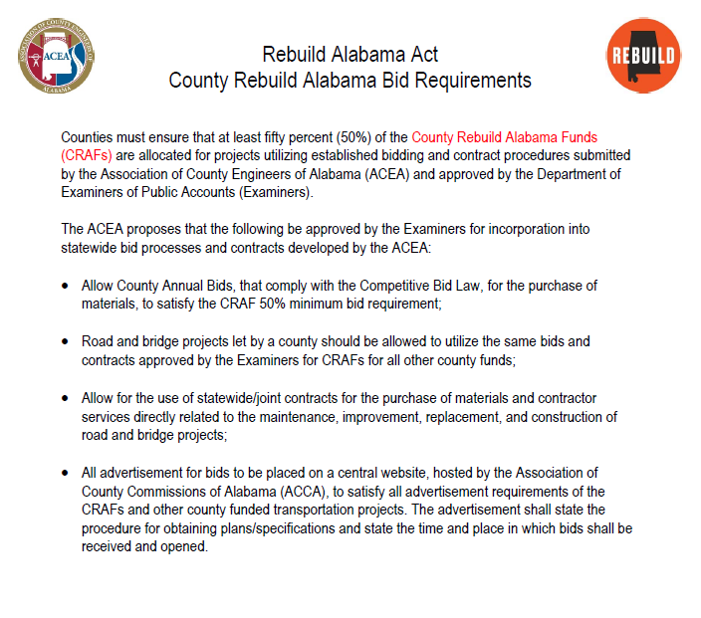
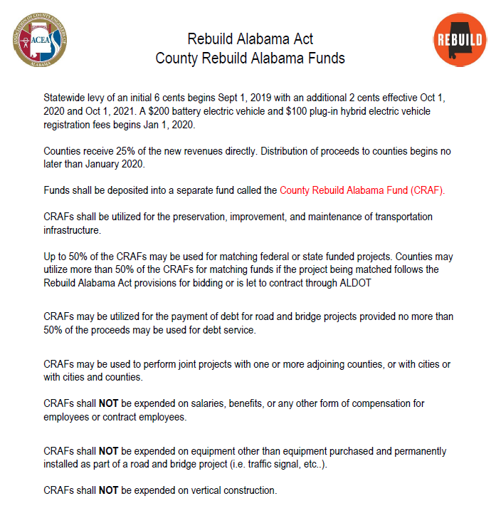

Slide 10
Federal Aid Exchange Fund (FAEF)
Beginning Oct. 1, 2019, counties will receive $400,000 in lieu of the annual federal aid funding previously allocated by ALDOT ($533,000 per county each year). The $400,000 allocation for each county is designated as Federal Aid Exchange Funds (FAEFs).
A county’s FAEFs shall be first utilized as the required match for the county’s unauthorized federal aid balance.
Counties will begin receiving their FAEFs allocation or remaining portion once their outstanding federal aid balance is authorized and the required match is satisfied.

Slide 14
Letting Schedule and Advertisement for Bids

Slide 15
County Rebuild Alabama Bid Guidance
Advertisement for Proposal
_______________ County
______________ County is taking sealed bids for labor, equipment, materials, and any incidentals required to complete the work required for the (ENTER BID DESCRIPTION HERE) of the County. This bid is intended to comply with the Rebuild Alabama Act, No. 2019-2, and Alabama Code Title 39, the Alabama Public Works Law. Bidders shall be required to comply with the provisions of the Rebuild Alabama Act, No. 2019-2 and Title 39 of the Alabama Code regardless if the requirement is explicitly detailed in the bid proposal or not.
Sealed bids will be received by the ___________ County Commission at _________________________________________________________ until _____ AM Central Time on __________________, and then publicly opened as soon thereafter as practicable. Award will be made at the next regularly scheduled meeting of the ____________ County Commission.

Slide 16
County Rebuild Alabama Bid Guidance
Alabama County Lettings are held on the third Wednesday of every month. Listed below are the tentative Letting dates through 2021. The Letting List and Advertisement for Proposals, for the current month, can be found at www.alabamacounties.org.
Advertising Dates (Suggested) Regular Monthly Lettings in 2019
Sept. 25, Oct. 2, Oct. 9, 2019 October 16, 2019
Oct. 30, Nov. 6, Nov. 13, 2019 November 20, 2019
Nov. 27, Dec. 4, Dec. 11, 2019 December 18, 2019
Advertising Dates (Suggested) Regular Monthly Lettings in 2020
Dec. 23*, 2019, Jan. 1, Jan. 8, 2020 January 15, 2020
Jan. 29, Feb. 5, Feb. 12, 2020 February 19, 2020
Feb. 26, March 4, March 11, 2020 March 18, 2020
March 25, April 1, April 8, 2020 April 15, 2020
April 29, May 6, May 13, 2020 May 20, 2020
March 27, June 3, June 10, 2020 June 17, 2020
* Backed up to Monday since Dec. 25 falls on Wednesday

Slide 17
County Rebuild Alabama Bid Guidance
2020 ACCA Joint Bid Items
Debris Services
Heavy Equipment
Metal Pipe
Herbicides
Road Signs
Portland Cement
Liquid Asphalt (CRS-2 & CRS-2P)

Slide 18
Memorandum of Understanding Between Counties and Municipalities
What if a city wants to give your county their RA money?
The purpose of this agreement is to promote and formalize cooperative relationships between the undersigned parties necessary for the utilization of funds distributed to the Municipality by Section 7 of Act 2019-2 of the Alabama Legislature.

Slide 19
Rebuild Alabama
Implementation Team
Report
Reports

Slide 22
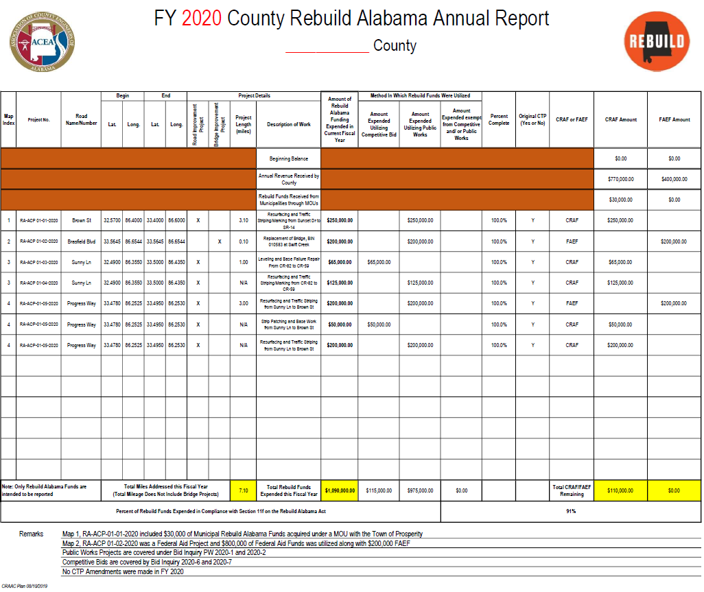
Notes:
In order to keep the reporting as simple and uniform as possible, the Implementation Team has put together this template to be utilized state wide. This report will be commonly referred to as the County Rebuild Alabama Annual Report or CRAAR.

Slide 23
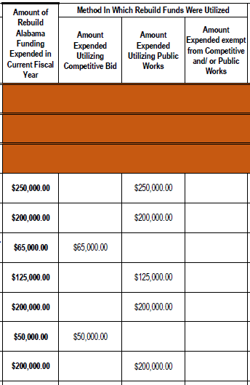
The Total Project Estimated Cost, Estimated Amounts Planned to be Utilized Under Competitive Bid and Public Works need to be updated to reflect the Actual Expended Amounts for each project. Additionally, a column has been designated for Expended Amounts regarding items that are exempt from the bidding process.
Notes:
Included in your CTP are Estimated Amounts for projects. In the CRAAR, actual expended amounts will have to be reported. The Examiner’s office asked to add a column which would capture any expenditures that would not be purchased under a Competitive Bid nor a Public Works Bid. An example of this type of expenditure would be a special type guardrail end anchor that would only be used on one project and costs less than $15,000. In this case, the end anchor would not be subject to either type bidding process.

Slide 26


County Rebuild Alabama Certificate of Compliance
To: Chair of the Joint Transportation Committee
Senate Pro Tempore
Speaker of the House
From: Perry County
DeAndrae Kimbrough, County Engineer
Re: County Rebuild Alabama Certificate of Compliance
FY 2020
This certificate of compliance is being submitted as required by the Rebuild Alabama Act to verify a minimum of 50% of the County Rebuild Alabama Funds (CRAFs) for the fiscal year 2020 were expended utilizing a contract. The counties actual expenditures under a contract were 75%.
Should you need any other information related to this project, please feel free to contact this office.

Slide 27
Rebuild Alabama
Implementation Team
Report
Documentation of Rebuild

Slide 28
Expenditure of CRAF and FAEF
Funds from the CRAF and FAEF can be expended for eligible projects in the following ways only:
1. Payments to contractors
2. Purchase of materials
3. Transfers for material purchases from other funds

Slide 29
Expenditure of CRAF and FAEF
Key Points…
All expenditures of CRAF and FAEF should be well documented so that the examiners can clearly see the what, when, and where of how the funds were expended.
Only payments to contractors and the purchase of materials to be used on CRAF and FAEF projects are allowable expenditures of these funds.
County labor and equipment costs are not eligible expenses.
Transfers for material purchases should only be made when it is not practical to purchase the material directly from the CRAF or FAEF.

Slide 30
Rebuild Alabama
Implementation Team
Report
Rebuild Alabama Implementation Team and TAC Interactions

Slide 32
Questions?

