Slide 1

Rebuild Alabama
Implementation Team
Report
ACCA Conference 2019

Slide 2
Rebuild Alabama
Implementation Team
Report
Overview and Tasks
Richie Beyer, Elmore County

Slide 4
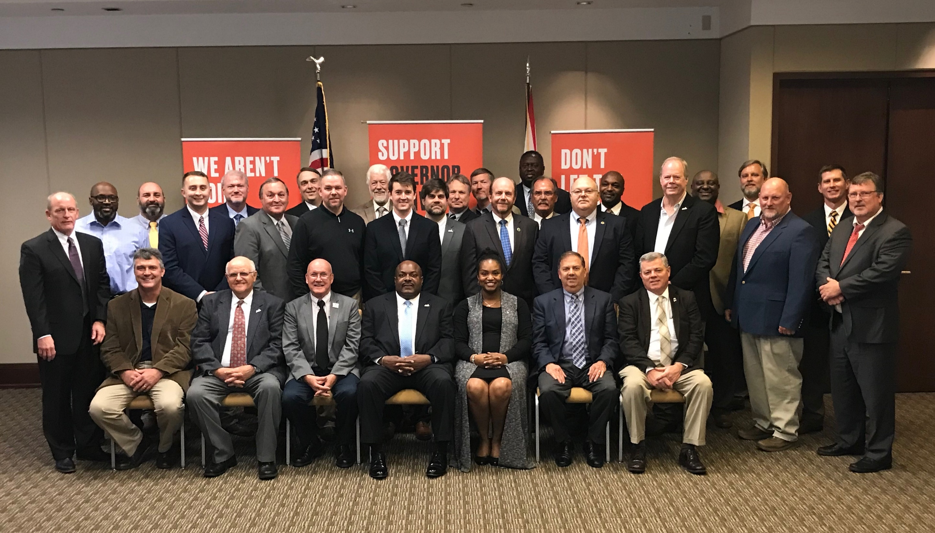

Slide 5


Rebuild Alabama Implementation Team
Technical Team
Shelby Randy Cole
Morgan Greg Bodley
Marshall Bob Pirando
Mobile Ricky Mitchell
Mobile Richard Spraggins
Elmore Luke McGinty
Chambers Josh Harvill
Policy/ Accountability Team
Crenshaw Benjie Sanders
Autauga John Mark Davis
Geneva Justin Barfield
Perry Deandre Kimbrough
Elmore Richie Beyer

Slide 6
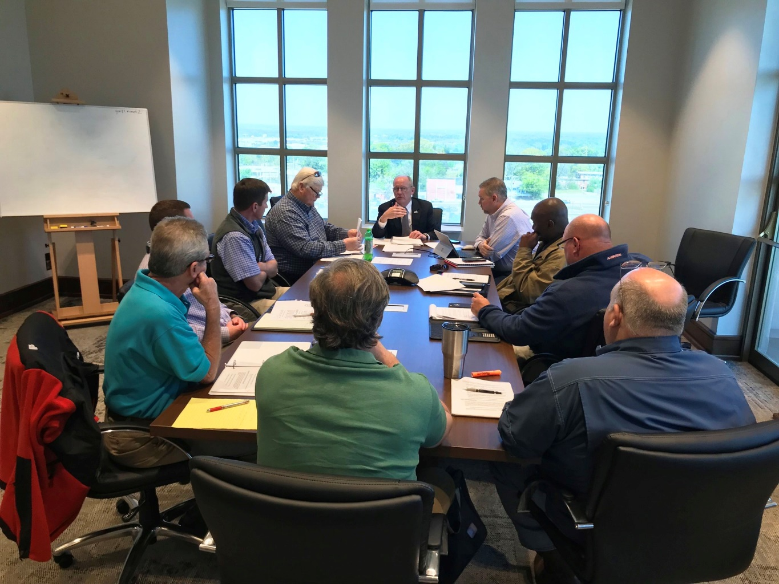
Rebuild Alabama
Implementation Team

Slide 7
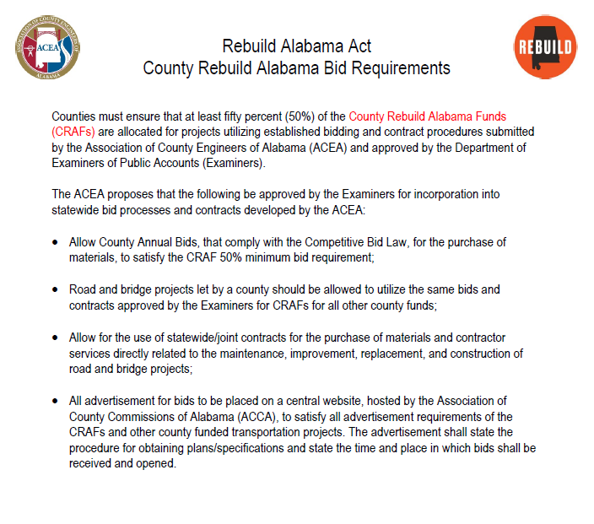
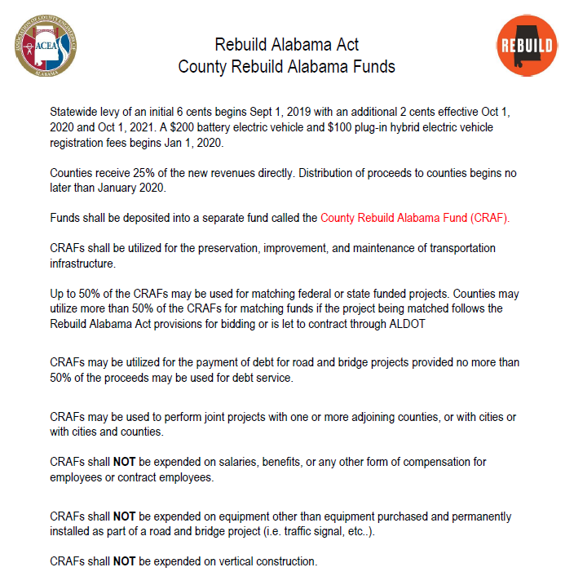

Slide 8
Federal Aid Exchange Fund (FAEF)
Beginning Oct. 1, 2019, counties will receive $400,000 in lieu of the annual federal aid funding previously allocated by ALDOT ($533,000 per county each year). The $400,000 allocation for each county is designated as Federal Aid Exchange Funds (FAEFs).
A county’s FAEFs shall be first utilized as the required match for the county’s unauthorized federal aid balance.
Counties will begin receiving their FAEFs allocation or remaining portion once their outstanding federal aid balance is authorized and the required match is satisfied.

Slide 12
Rebuild Alabama
Implementation Team
Report
County Rebuild Alabama Bid Guidance
Josh Harvill, Chambers County

Slide 13
County Rebuild Alabama Bid Guidance
Technical Team Members:
Shelby Randy Cole
Morgan Greg Bodley
Marshall Bob Pirando
Mobile Ricky Mitchell
Mobile Richard Spraggins
Elmore Luke McGinty
Chambers Josh Harvill

Slide 14
County Rebuild Alabama Bid Guidance
Counties must ensure that at least fifty percent (50%) of the County Rebuild Alabama Funds (CRAFs) are allocated for projects utilizing established bidding and contract procedures submitted by the Association of County Engineers of Alabama (ACEA) and approved by the Department of Examiners of Public Accounts (Examiners).
The ACEA proposed that the following be approved by the Examiners for incorporation into statewide bid processes and contracts developed by the ACEA:
Allow County Annual Bids, that comply with the Competitive Bid Law, for the purchase of materials, to satisfy the CRAF 50% minimum bid requirement;
Road and bridge projects let by a county should be allowed to utilize the same bids and contracts approved by the Examiners for CRAFs for all other county funds;
Allow for the use of statewide/joint contracts for the purchase of materials and contractor services directly related to the maintenance, improvement, replacement, and construction of road and bridge projects;
All advertisement for bids to be placed on a central website, hosted by the Association of County Commissions of Alabama (ACCA), to satisfy all advertisement requirements of the CRAFs and other county funded transportation projects. The advertisement shall state the procedure for obtaining plans/specifications and state the time and place in which bids shall be received and opened.

Slide 15
County Rebuild Alabama Bid Guidance
The ACCA expects the following procedures will apply to the bidding of CRAFs and FAEFs:
Except as otherwise provided in the Rebuild Alabama Act, counties must ensure that at least fifty
percent (50%) of the County Rebuild Alabama Funds (CRAFs) be allocated for projects utilizing
established bidding procedures submitted by the Association of County Engineers of Alabama
(ACEA) and approved by the Department of Examiners of Public Accounts (Examiners), the ACEA
proposes the following apply to the bidding of CRAFs and FAEFs:
Except for the advertising method and schedule enumerated below, all contracts paid for using CRAF and FAEF funds will comply with the Public Works Law (Code of Alabama 1975, Title 39) and the Competitive Bid Law (41-16-50), where applicable;
The placement of the advertisement for bids and the notice of completion on a central website, hosted by the Association of County Commissions of Alabama (ACCA), will satisfy all advertisement requirements for projects utilizing CRAF and FAEF funds otherwise provided by law. Such advertisements shall utilize the sample documents created by the ACEA. The ACCA will provide notice to ALDOT and the Alabama Roadbuilders Association of this method of advertising in an effort to inform all contractors;
All projects utilizing CRAF and FAEF funds will be bid and let to contract according to the Letting Schedule and Sample Bid Documents created by the ACEA. The ACCA will provide notice to ALDOT and the Alabama Roadbuilders Association of this method of advertising in an effort to inform all contractors;
County required reports will be on file for the Examiners to aid in the assurance on the proper expenditure of the funds. Reports will be retained in accordance with the county record disposition authority.

Slide 16
County Rebuild Alabama Bid Guidance
Richard Spraggins, Mobile County
Letting Schedule and Advertisements for Bids
Greg Bodley, Morgan County
Public Works Bids
Luke McGinty, Elmore County
Competitive Bids
Randy Cole, Shelby County
Memorandum of Understanding (MOU) with Municipalities

Slide 17
Rebuild Alabama
Implementation Team
Report
Letting Schedule and Advertisement for Bids
Richard Spraggins, Mobile County

Slide 18
County Rebuild Alabama Bid Guidance
Advertisement for Proposal
_______________ County
______________ County is taking sealed bids for labor, equipment, materials, and any incidentals required to complete the work required for the (ENTER BID DESCRIPTION HERE) of the County. This bid is intended to comply with the Rebuild Alabama Act, No. 2019-2, and Alabama Code Title 39, the Alabama Public Works Law. Bidders shall be required to comply with the provisions of the Rebuild Alabama Act, No. 2019-2 and Title 39 of the Alabama Code regardless if the requirement is explicitly detailed in the bid proposal or not.
Sealed bids will be received by the ___________ County Commission at _________________________________________________________ until _____ AM Central Time on __________________, and then publicly opened as soon thereafter as practicable. Award will be made at the next regularly scheduled meeting of the ____________ County Commission.

Slide 19
County Rebuild Alabama Bid Guidance
Only bids from contractors or material suppliers listed on the Alabama Department of Transportation (ALDOT) approved list of contractors and material suppliers will be accepted. All bids must be marked with the word “BID” on the outside of the bid package along with Bid Proposal for (ENTER BID DESCRIPTION HERE), the bid date and the Alabama General Contractor’s License Number.
The contractor shall meet all Alabama Department of Transportation (ALDOT) Bonding and Licensing requirements as well as all applicable laws, ordinances, and codes of the U. S. Government, the State of Alabama, any relevant municipality, and the COUNTY, and, specifically and without limitation, shall comply with all provisions of the Beason-Hammond Alabama Taxpayer and Citizen Protection Act, commonly referred to as the Immigration Act.

Slide 20
County Rebuild Alabama Bid Guidance
Specifications are on file and may be acquired at the _____________ County, Alabama, Engineering Department, ______________________________, _______________, Alabama.
Phone Number: ___________________________
____________ County Hours of Operation are ____ A.M. to ____ P.M. (Central Time) from _______ through ______.
County reserves the right to accept or reject all Bids or any portion thereof.

Slide 21
County Rebuild Alabama Bid Guidance
Alabama County Lettings are held on the third Wednesday of every month. Listed below are the tentative Letting dates through 2021. The Letting List and Advertisement for Proposals, for the current month, can be found at www.alabamacounties.org.
Advertising Dates (Suggested) Regular Monthly Lettings in 2019
Sept. 25, Oct. 2, Oct. 9, 2019 October 16, 2019
Oct. 30, Nov. 6, Nov. 13, 2019 November 20, 2019
Nov. 27, Dec. 4, Dec. 11, 2019 December 18, 2019
Advertising Dates (Suggested) Regular Monthly Lettings in 2020
Dec. 23*, 2019, Jan. 1, Jan. 8, 2020 January 15, 2020
Jan. 29, Feb. 5, Feb. 12, 2020 February 19, 2020
Feb. 26, March 4, March 11, 2020 March 18, 2020
March 25, April 1, April 8, 2020 April 15, 2020
April 29, May 6, May 13, 2020 May 20, 2020
March 27, June 3, June 10, 2020 June 17, 2020
* Backed up to Monday since Dec. 25 falls on Wednesday

Slide 22
County Rebuild Alabama Bid Guidance
Alabama County Lettings are held on the third Wednesday of every month. Listed below are the tentative Letting dates through 2021. The Letting List and Advertisement for Proposals, for the current month, can be found at www.alabamacounties.org.
Advertising Dates (Suggested) Regular Monthly Lettings in 2020
June 24, July 1, July 8, 2020 July 15, 2020
July 29, Aug. 5, Aug. 12, 2020 August 19, 2020
Aug. 26, Sept. 2, Sept. 9, 2020 September 16, 2020
Sept. 30, Oct. 7, Oct. 14, 2020 October 21, 2020
Oct. 28, Nov. 4, Nov. 11, 2020 November 18, 2020
Nov. 25, Dec. 2, Dec. 9, 2020 December 16, 2020
Advertising Dates (Suggested) Regular Monthly Lettings in 2021
Dec. 30, 2020, Jan. 6, Jan 13, 2021 January 20, 2021
Jan. 27, Feb. 3, Feb. 10, 2021 February 17, 2021
Feb. 24, March 3, March 10, 2021 March 17, 2021

Slide 23
County Rebuild Alabama Bid Guidance
Alabama County Lettings are held on the third Wednesday of every month. Listed below are the tentative Letting dates through 2021. The Letting List and Advertisement for Proposals, for the current month, can be found at www.alabamacounties.org.
Advertising Dates (Suggested) Regular Monthly Lettings in 2021
March 31, April 7, April 14, 2021 April 21, 2021
April 28, May 5, May 12, 2021 May 19, 2021
May 26, June 2, June 9, 2021 June 16, 2021
June 30, July 7, July 14, 2021 July 21, 2021
July 28, Aug. 4, Aug. 11, 2021 August 18, 2021
Aug. 25, Sept. 1, Sept. 8, 2021 September 15, 2021
Sept. 29, Oct. 6, Oct. 13, 2021 October 20, 2021
Oct. 27, Nov. 3, Nov. 10, 2021 November 17, 2021
Nov. 24, Dec. 1, Dec. 8, 2021 December 15, 2021

Slide 24
County Rebuild Alabama Bid Guidance
Advertisement of Project Completion
_______________ County
We, ______________________, the Contractor, hereby gives notice of completion of the Proceed Order with ______________________ County for construction of (Insert Project Description Here). This notice is to be posted on the Association of County Commissions of Alabama web site for four (4) consecutive weeks beginning on __________, 20____ and ending ____________, 20____ in accordance with the Rebuild Alabama Act, Act No. 2019-2 and Section 39-1-1(f), Code of Alabama. All claims during this period should be filed at: (Insert Contractor Contact Information Here, name address phone number).
___________________________________ _______________
(Name of Contractor Representative) (Date)
___________________________________
(Signature of Contractor Representative)

Slide 25
Rebuild Alabama
Implementation Team
Report
Public Works Bids
Greg Bodley, Morgan County

Slide 26
Rebuild Public Works Bid

Slide 27
Rebuild Alabama
Implementation Team
Report
Competitive Bids
Luke McGinty, Elmore County

Slide 28
County Rebuild Alabama Bid Guidance
Competitive Bid Law- AL Code § 41-16-50
Expenditure of funds on Labor, Equipment, Materials and Services of $15,000 or more
Purchases shall be made under contractual agreement entered into by free and open competitive bidding, on sealed bids, to the lowest responsible bidder

Slide 29
County Rebuild Alabama Bid Guidance
Counties must ensure that at least 50% of the CRAF are allocated utilizing established bidding and contract procedures. Properly executed competitive bids will satisfy this requirement.
Posted
Invitation
Specifications
Bid Bonds
Bid Awards
Contracts

Slide 30
County Rebuild Alabama Bid Guidance

Slide 31
County Rebuild Alabama Bid Guidance

Slide 32
County Rebuild Alabama Bid Guidance
2019 Elmore County Competitive Bids
Concrete
Concrete Pipe
Corrugated Metal Pipe
Granite
Crushed Base, Rip Rap
Plant mix asphalt, Cold Mix
Liquid Asphalt, CRS-2
Concrete Cloth
Mulch
Gabion Baskets/ Gabion Material

Slide 33
County Rebuild Alabama Bid Guidance
2020 ACCA Joint Bid Items
Debris Services
Heavy Equipment
Metal Pipe
Herbicides
Road Signs
Portland Cement
Liquid Asphalt (CRS-2 & CRS-2P)

Slide 34
Rebuild Alabama
Implementation Team
Report
Memorandum of Understanding (MOU) with Municipalities
Randy Cole, Shelby County

Slide 35
County Rebuild Alabama Bid Guidance
What if a city wants to give your county their RA money?
Memorandum of Understanding Between Counties and Municipalities

Slide 36
County Rebuild Alabama Bid Guidance
A. PURPOSE
The purpose of this agreement is to promote and formalize cooperative relationships between the undersigned parties necessary for the utilization of funds distributed to the Municipality by Section 7 of Act 2019-2 of the Alabama Legislature.

Slide 37
County Rebuild Alabama Bid Guidance
B. IT IS MUTUALLY UNDERSTOOD AND
AGREED BY AND BETWEEN THE PARTIES THAT:
The ____________ County Commission and the City/Town Council of ____________ have adopted resolutions (which are attached and incorporated herewith) authorizing the signatories to this agreement to bind both the COUNTY and the Municipality to the terms herein.
All Municipality funds to which the Municipality is entitled, accruing for benefit of, or being paid to the Municipality pursuant to Section 7 of Act 2019-2, shall be allocated to the COUNTY, on a monthly basis, and shall be deposited by the COUNTY into the County Rebuild Alabama Fund established by the COUNTY, and shall be used by the COUNTY for such purposes as provided for in Section 7 of the Act.

Slide 38
County Rebuild Alabama Bid Guidance
Once the funds have been deposited into the County Rebuild Alabama Fund, the COUNTY shall have the full and complete discretion and responsibility to ensure that the funds are used and expended in a manner consistent with the Act.
The parties further agree that the COUNTY will include the utilization and expenditure of funds transferred under this agreement in its annual reporting as required in Act 2019-2 and copies of such reporting will be provided to the Municipality so that it may comply with the notification and posting requirements of the act.
This agreement may be revised as necessary, by mutual consent of the parties, by issuance of a written amendment signed and dated by all parties; or may be terminated by either party upon delivery of thirty days written notice to the other party.

Slide 39
County Rebuild Alabama Bid Guidance
The termination of this agreement shall immediately relieve the COUNTY of its responsibilities to comply with the requirements for the reporting of the utilization and expenditure of the funds otherwise received by the Municipality.
If any provision of this agreement is determined to be inconsistent with existing law, regulations, or directives governing the signatories, then only that provision of the agreement affected by a finding of inconsistency shall be voided.
Each party shall perform its responsibilities and activities described herein as an independent contractor and not as an officer, agent, or employee of any other party hereto. Each party shall be solely responsible for the acts and omissions of its officers, agents, employees, volunteers, contractors, and subcontractors, if any.

Slide 40
County Rebuild Alabama Bid Guidance
The receipt and utilization of Rebuild Alabama Funds by the COUNTY as provided in this agreement shall not be interpreted to require the COUNTY to assume responsibility or liability for any street, road, bridge or structure under the control and responsibility of the Municipality on or after the date of this agreement.
This agreement is executed at the date of the last signature and shall continue until amended or terminated as provided herein.

Slide 41
County Rebuild Alabama Bid Guidance
IN WITNESS THEREOF, the parties herein set below their signatures:
____________________________, Mayor, City/Town of _______________
Signature:____________________________ Date:_______________
ATTEST:___________________________
_____________________________, Chairman, _____________County Commission
Signature:______________________________ Date:________________
ATTEST: ____________________________

Slide 42
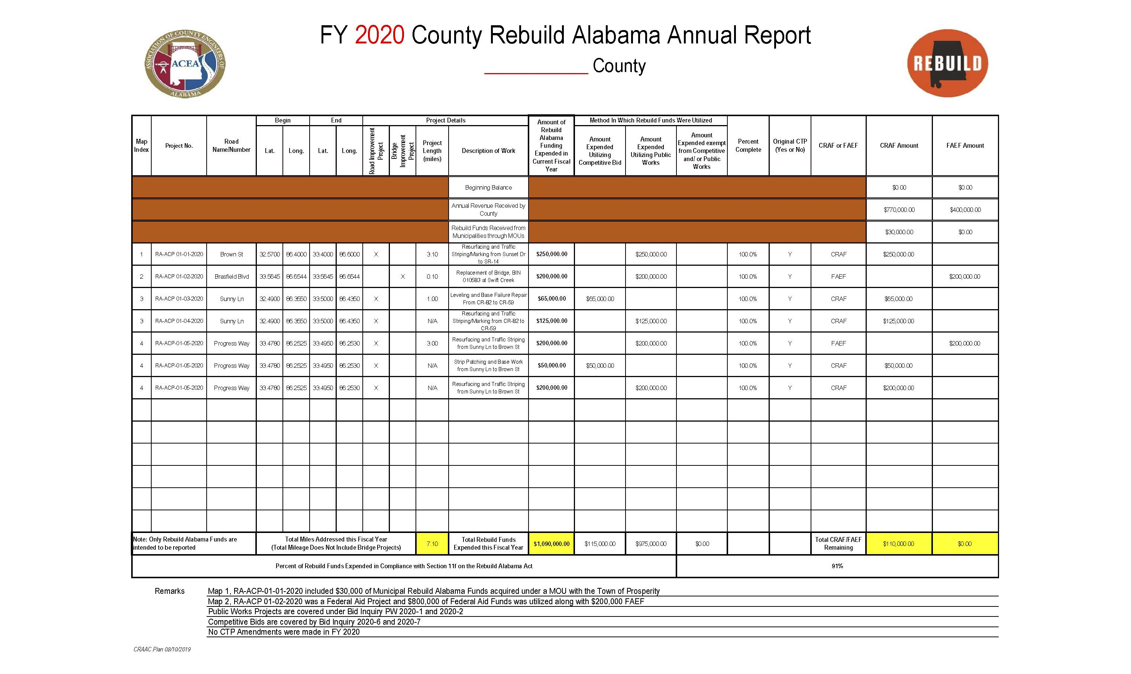
County Rebuild Alabama Bid Guidance

Slide 43
County Rebuild Alabama Bid Guidance

Slide 44
Questions?

Slide 45
Rebuild Alabama
Implementation Team
Report
CRAAR
John Mark Davis, Autauga County

Slide 46


County Rebuild Alabama Annual Report (CRAAR)
Important Facts
At the first meeting in January of each year (starting 2021), all county engineers shall present to the County Commission an annual written report detailing expenditures made from the CRAF and FAEF during the previous fiscal year.
This report shall include the status of each project that was included in the CTP.
It should also address any Memorandums Of Understanding (MOUs) that were implemented between County and Municipality.
The report shall be entered into the minutes of the County Commission and shall be available to the public for inspection, including posting on the County’s website (if available).
Notes:
As part of the Rebuild Alabama Act, all County Engineers are required to present an annual report to the County Commission at the first meeting in January beginning in 2021. This report will detail all the expenditures made on the projects that were listed on the previous year’s CTP. This will include revenue from both the CRAF and FAEF.
It will also include any revenue from any Memorandums of Understanding that were implemented between the County and any Municipality.
This report will have to be entered into the minutes of the meeting and posted for inspection by the public, which will include posting it on the County’s website, if available.

Slide 47
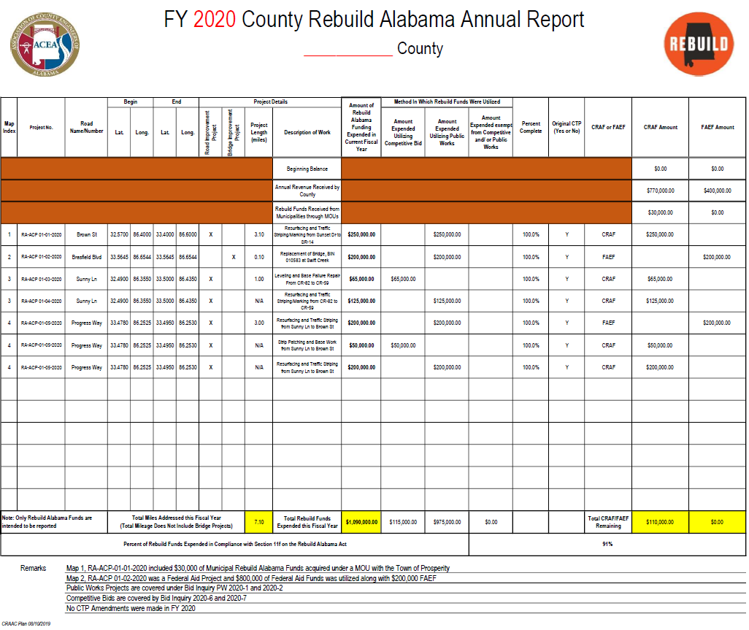
Notes:
In order to keep the reporting as simple and uniform as possible, the Implementation Team has put together this template to be utilized state wide. This report will be commonly referred to as the County Rebuild Alabama Annual Report or CRAAR.

Slide 48
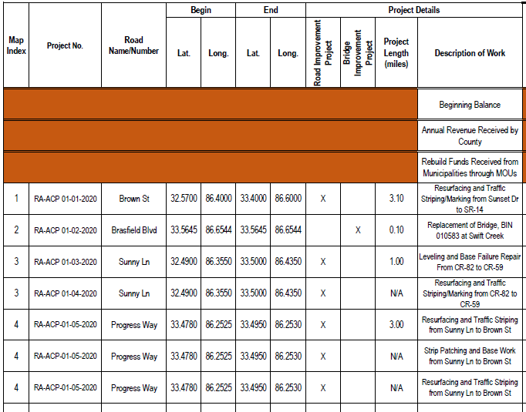
The CRAAR will look very similar to the CTP, especially this section. This data does not change unless you amend the CTP after the original Approval. Note Revenue from MOUs that consist of Rebuild Alabama Funds will need to be reported as well.
Notes:
As you may recognize, the data in this section should be exactly the same as your county’s CTP. This data would only change if there has been an amendment to the county’s original CTP. Another data field was added after the original CTP template was released. The Examiner’s office wanted the team to add a row for revenues received by way of Memorandums of Understanding between Counties and Cities. These revenues will have to be reported as well.

Slide 49
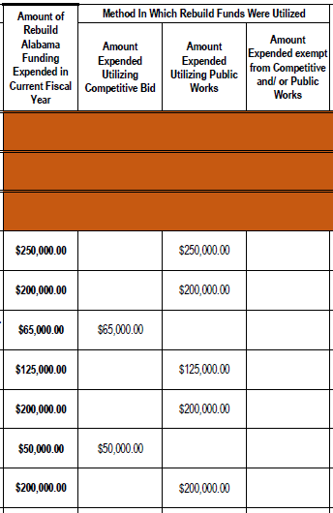
The Total Project Estimated Cost, Estimated Amounts Planned to be Utilized Under Competitive Bid and Public Works need to be updated to reflect the Actual Expended Amounts for each project. Additionally, a column has been designated for Expended Amounts regarding items that are exempt from the bidding process.
Notes:
Included in your CTP are Estimated Amounts for projects. In the CRAAR, actual expended amounts will have to be reported. The Examiner’s office asked to add a column which would capture any expenditures that would not be purchased under a Competitive Bid nor a Public Works Bid. An example of this type of expenditure would be a special type guardrail end anchor that would only be used on one project and costs less than $15,000. In this case, the end anchor would not be subject to either type bidding process.

Slide 50
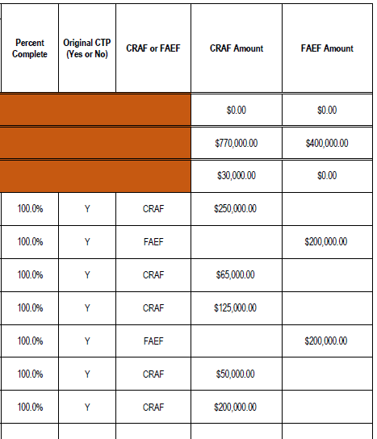
Two new columns were added that were not included in the CTP :
Percent Complete & Original CTP (Yes/No)
– Was the project on the Original CTP? If not, there should be a note at the bottom explaining why and when the CTP was amended to include the change.
Notes:
Section 11 (e) of the Rebuild Alabama Act not only requires an annual report, but that the report include the status of the projects, therefore one column was added to allow the County to post the Percent Complete. And another column was added to signify that the projects were included in the original CTP. Projects that were not included on the original CTP should be added and a note placed at the bottom to clarify when the plan was amended.

Slide 51
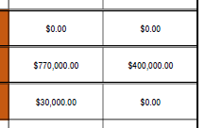

Total Available Rebuild Alabama Funds
Begin Balance
Annual Revenue
MOU Funds
Total Comp. Bid & Public Works Expended
The Percent of Rebuild Alabama Funds that Utilized Contracts must be calculated as per Section 11f of the Rebuild Alabama Act and shown on the report. This Percentage is calculated by dividing the Total Amount Performed Under Contract by the Total Available RA Funds (Including MOU Funds). This should match the Compliance Certification.
Notes:
Section 11 (f) requires the County Engineer to submit a Certification of Compliance verifying that at least 50% of the funding was let to contract. The Examiner’s office wanted the percentage to be documented on the CRAAR, so we added it just below the project totals. This percentage is calculated by dividing the Total amount performed under Contract, which will include both the Competitive Bid and Public Works Amounts, by the Total Available Rebuild Alabama Funds including any Revenue from a MOU.

Slide 52
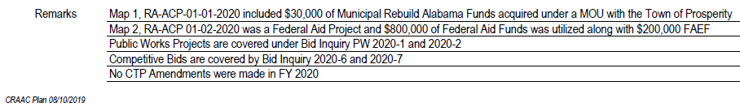
Remarks shall be placed at the bottom to explain MOU’s, Revenue Sources other than Rebuild Alabama, and Public Works/Competitive Bid Inquiry Number to denote which Bid Documents verify compliance.
Notes:
Don’t forget to add your remarks at the bottom of the sheet. These remarks will include any additional funding that was utilized on a project, such as Federal Aid or Local Funds. Also, Public Works and Competitive Bid Inquiry Numbers need to be listed so that the Examiner’s Office can easily associate these projects with your bidding process. Lastly, denote any changes to the Original CTP.
Any Questions?

Slide 53
Rebuild Alabama
Implementation Team
Report
CRACR and Certificate of Compliance
Deandre Kimbrough, Perry County

Slide 54
County Rebuild Alabama Reporting Contract Report
County projects let to contract shall utilize suppliers listed on the Alabama Department of Transportation (ALDOT) list of approved contractors and suppliers, including ALDOT’s Certified Disadvantaged Business Enterprise (CDBE) list.
Beginning October 1, 2020 and every October 1st thereafter, counties shall provide a list of all contractors awarded projects funded with County Rebuild Alabama Funds to the Senate President Pro Tempore, Speaker of the House and the Chair of Joint Transportation Committee. This listing shall be called the County Rebuild Alabama Contractor Report (CRACR).
No bidding is required by the county for asphalt or other local road construction or repair materials in the county has an annual contract for providing such materials.

Slide 57
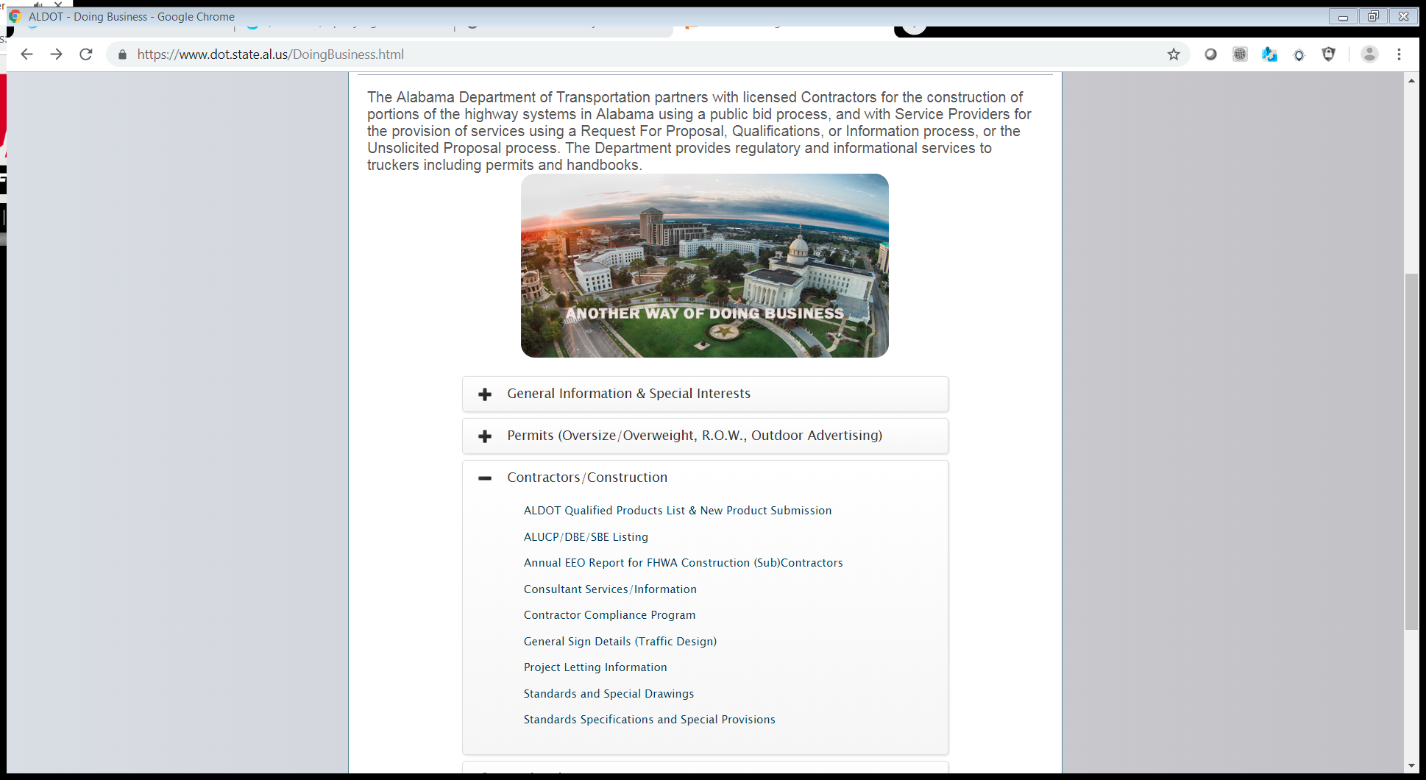
https://www.dot.state.al.us/DoingBusiness.html

Slide 58
Certificate of Compliance
By January 15 of each year, the county engineer will submit a certificate of compliance verifying that at least fifty percent (50%) of funding for the last fiscal year was let to contract, and shall file such certificate with the Chair of the Joint Transportation Committee, the Alabama Senate Pro Tempore, and the Speaker of the Alabama House of Representatives.

Slide 59
County Rebuild Alabama Certificate of Compliance
To: Chair of the Joint Transportation Committee
Senate Pro Tempore
Speaker of the House
From: Perry County
DeAndrae Kimbrough, County Engineer
Re: County Rebuild Alabama Certificate of Compliance
FY 2020
This certificate of compliance is being submitted as required by the Rebuild Alabama Act to verify a minimum of 50% of the County Rebuild Alabama Funds (CRAFs) for the fiscal year 2020 were expended utilizing a contract. The counties actual expenditures under a contract were 75%.
Should you need any other information related to this project, please feel free to contact this office.

Slide 60
Rebuild Alabama
Implementation Team
Report
Documentation of Rebuild
Benjie Sanders, Crenshaw County

Slide 61
Expenditure of CRAF and FAEF
Each County must establish two separate funds to deposit funds in:
County Rebuild Alabama Fund (CRAF)
Federal Aid Exchange Fund (FAEF)
Funds from the CRAF and FAEF can be expended for eligible projects in the following ways only:
1. Payments to contractors
2. Purchase of materials
3. Transfers for material purchases from other funds

Slide 62
Expenditure of CRAF and FAEF
1. Payments to Contractors
Payments to Contractors performing eligible work on a CRAF or FAEF project should be issued directly from the appropriate account.
If the project is utilizing both CRAF and FAEF, a payment from each fund should be issued at the same percentage that the total project amount was based on from each fund.
OR
The total payment can be issued from either the CRAF or FAEF and a transfer be made from the other fund at the same percentage that the total project amount was based on from each fund.
Note: It is imperative that transfers are clearly documented so that it is clear to the examiners how the funds were expended.

Slide 63
Expenditure of CRAF and FAEF
2. Purchase of Materials
The purchase of materials for use on CRAF and FAEF eligible projects can be made directly from either account by issuing Purchase Orders in the same manner as with any other County account.
The project number and Road name/number on which the material will be used should be noted on the Purchase Order.

Slide 64
Expenditure of CRAF and FAEF
3. Transfers for materials purchased from other funds
For auditing purposes, it is recommended that all materials used on CRAF and FAEF projects be purchased directly from the appropriate fund as previously discussed.
However, this may not be practical in all cases because of bulk purchases made that will be used on multiple projects. (Examples: Pipe, liquid asphalt, Portland cement)
Transfers should be well documented including the date, project number, road name/number, and quantity of each material used. Invoices for each material showing the unit price and total quantity purchased should be attached to the transfer as well.

Slide 65
Expenditure of CRAF and FAEF
Key Points…
All expenditures of CRAF and FAEF should be well documented so that the examiners can clearly see the what, when, and where of how the funds were expended.
Only payments to contractors and the purchase of materials to be used on CRAF and FAEF projects are allowable expenditures of these funds.
County labor and equipment costs are not eligible expenses.
Transfers for material purchases should only be made when it is not practical to purchase the material directly from the CRAF or FAEF.

Slide 66
Questions?

Slide 67
Rebuild Alabama
Implementation Team
Report
Rebuild Alabama Implementation Team and TAC Interactions
Justin Barfield, Geneva County

Slide 76
Questions?

