Slide 1
Complete
Count
Committee Training

Slide 2
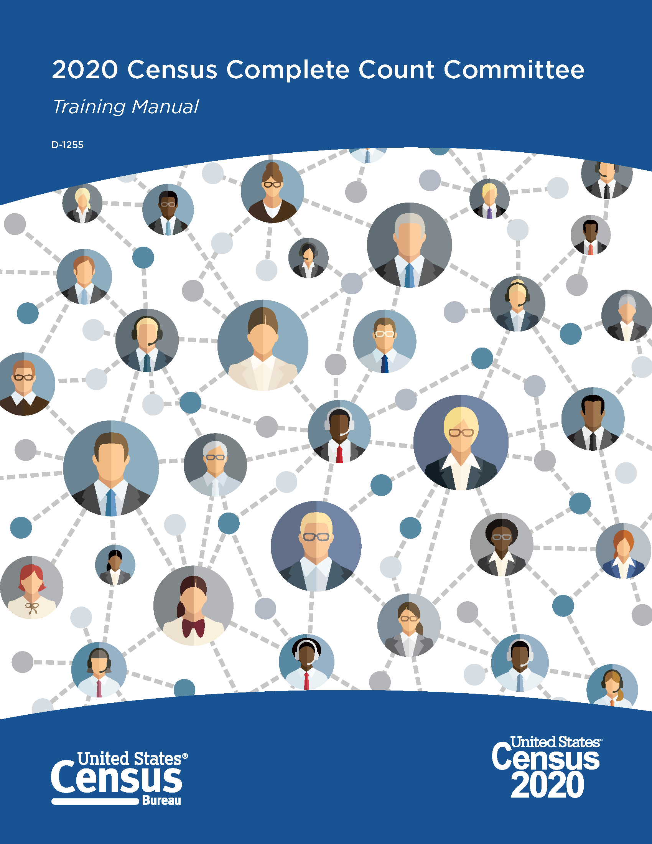
Introduction
Complete Count Committee (CCC) Training Manual
Provides information to educate CCC leaders and members about the census and their roles
Equip CCC leaders with information needed to train their members about ways they can promote participation in the census

Slide 3
2020 Census Highlights
Mandated by Article 1, Section 2 of the U.S. Constitution, the Census determines congressional representation and is used for state and local redistricting.
Census Day is April 1, 2020.
The Census is the nation’s largest peacetime mobilization.
Respondent information is strictly confidential by law.
Will include a number of key innovations: online response; telephone response; in addition to traditional paper response.
Helps to direct more than $675 billion annually in Federal funding.
Census data used by businesses, governments and civic organizations to inform decision-making.

Slide 4
Overview of CCCs
CCCs are one of the core strategic elements of the Partnership program for the Census
Census Bureau works with tribal, state and local governments, and community organizations to form CCCs
CCCs exist to plan and implement locally-based outreach campaigns that raise awareness of the census and ultimately drive participation
Notes:
Introduction (1/2)
Page 1

Slide 5

Background and Structure of CCCs
Tribal, state and local governments work together with partners in their communities to form CCCs to promote the 2020 Census to their constituents. Community-based organizations also establish CCCs that reach out to their constituents.
Committee members are experts in the following areas:
  Government
  Media
  Workforce development
  Business
  Education
  Community organizations
  Faith-based community
  Other, based on needs
Notes:
Introduction (2/2)
Page 2

Slide 6
Alabama State Complete Count Commission
On August 20, 2018, Governor Kay Ivy signed Executive Order 715 establishing the Alabama State Complete Count Committee under the direction of Alabama Dept. of Economic and Community Affairs (ADECA).
The AL SCCC includes an executive committee and 8 subcommittees representing leaders in government, education, faith-based, community based, economic and industry, health care, rural and outreach organizations to encourage increase participation in 2020 Census.
The AL SCCC has developed an outreach plan tailored to the unique characteristics of state’s population.
The focus is to encourage individuals in the state to self respond online, by phone or by mail.
Notes:
Ultimately, the success of the 2020 Census depends on everyone’s participation. One way to ensure success is by forming a Complete Count Committee. Complete Count Committees encourage participation in their communities. They develop an outreach plan tailored to the unique characteristics of their community. Then they work together to implement the plan.

Slide 7
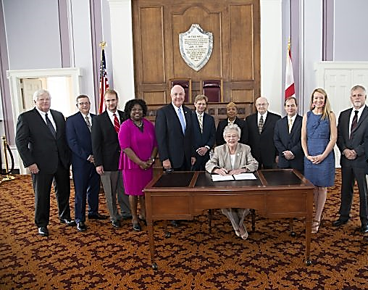
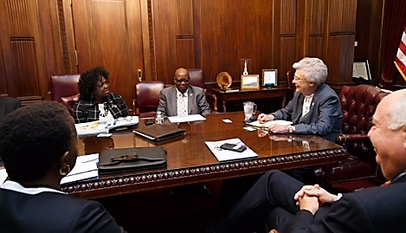
Alabama State Complete Count Commission
Notes:
Ultimately, the success of the 2020 Census depends on everyone’s participation. One way to ensure success is by forming a Complete Count Committee. Complete Count Committees encourage participation in their communities. They develop an outreach plan tailored to the unique characteristics of their community. Then they work together to implement the plan.

Slide 8
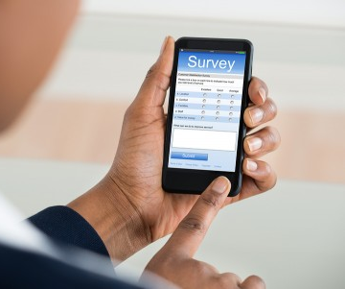
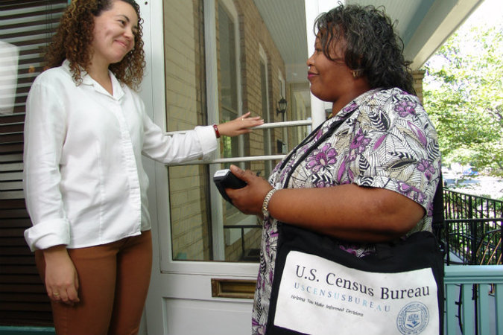
2020 Census vs 2010 Census
In 2020, we will introduce new technology to make it easier than ever for people to respond to the census.
For the 1st time, you will be able to respond online, by phone, or by mail. We will use data that the public has already provided to cut down on household visits.
We are building a more accurate address list and automating our field operations—all while keeping your information confidential and safe.
The Census Bureau is eliminating paper and incorporating the use of handheld data collection devices.
1
Notes:
Chapter 1: Decennial Census Overview

Slide 9
How are census data used?
Assisting tribal, federal, state and local governments in planning, and implementing programs and services in:
  Education and Healthcare
  Transportation and Social services
  Emergency response and Other Areas
Distribution of more than $675 billion annually in federal funds
Redistricting of state legislative districts
Forecasting of future transportation needs
Determining areas eligible for housing assistance and rehabilitation loans
2
Notes:
Chapter 1: Decennial Census Overview (Page 3) The many uses of Census Data

Slide 10
The Census is Confidential, and that confidentiality is required by Law
The Census Bureau is required by law to keep information confidential. All responses provided on the 2020 Census questionnaire or to a Census Bureau employee are confidential and protected under Title 13 of the U.S. Code
We will never share a respondents personal information with other government agencies
Results from the census are reported in statistical summary format only
Records are confidential for 72 years by law (Title 44, U.S. Code)
All Census Bureau employees swear a lifetime oath to protect respondent information.
Penalty for wrongful disclosure is up to 5 years imprisonment and/or a fine of $250,000
3
Notes:
Decennial Census Overview(page 3)
The Census is Confidential, and that confidentiality is required by law. (Update title)

Slide 11
What are Complete Count Committees?
CCC is a committee established by tribal, state and local governments, and community leaders or organizations to increase awareness and motivate residents to respond to the 2020 Census
CCCs are “census ambassadors” that play a key role in the 2020 Census
4
Notes:
Chapter 2: CCCs Overview (page 5)
What is a CCC?

Slide 12
Tribal or Local Government CCCs
Local government CCCs are formed by the highest elected official in a local government, regardless of size. This includes:
  Local governments in cities, counties, towns and villages
Charged with developing and implementing a census awareness campaign that motivates EVERY household to respond to the 2020 Census in a timely manner
10
Notes:
Chapter 3: Forming CCCs (page 7)
Tribal or Local Government CCCs

Slide 13

Community CCCs
Formed in probable low response areas
Formed to fill a gap in areas where there is no government-sponsored CCC
Includes representation from the following suggested areas of the community:
  Business leaders
  Educators
  Media representatives
  Organization leaders
  Community-based organization leaders
  Faith-based organizations
10
Notes:
Chapter 3: Forming CCCs (page 7)
Community CCCs

Slide 14

What is the subcommittee structure of CCC?
State Government CCCs can be a SCCC or a CCC. The structure should consist of influential members. Below are suggested membership for this sub team:
Government
Workforce development
Faith-based community
Education
Media and Technology
Community organizations
Business
10
Notes:
Chapter 3: Forming CCCs (page 7)
CCC Structure

Slide 15
Recommended Subcommittee Structure
CCCs should be all-inclusive, addressing the various racial, ethnic, cultural and geographic considerations of the community
Census Bureau staff serve as liaisons and information resources for CCC
CCC operations are governed by elected officials or community leaders
The Census Bureau recommends the following subcommittees structure:
Recruitment
Government
Education
Faith-based community
Media
Community-based organizations
Business
11
Notes:
Chapter 3: Forming CCCs (page 8)
Recommended Subcommittee Structure

Slide 16
Recruitment Subcommittee
Government Subcommittee
Focus
Distributes recruiting materials received from Partnership Specialists and assists them in securing donations for space to train employees
Publicizes Census Bureau job openings using all available resources, including local festivals and job fairs
Composition
Staff from local job training
agencies or organizations
Focus
Represents tribal, state and local government in all programs between the Census Bureau and the local government, such as new construction programs
Ensures that elected officials are aware of and are included in all committee activities
Composition
Elected officials, city planners, demographers, cartographers and municipal employees
11
Notes:
Chapter 3: Forming CCCs (page 8)
Recruitment and Government

Slide 17
Education Subcommittee
Faith-based Subcommittee
Focus
Creates, facilitates, and coordinates census awareness activities among various educational levels
Ensures the wide distribution and awareness of the Statistics in Schools program and materials
Works with area colleges and universities to raise awareness of the census among students housed on and off campus
Raises awareness through adult education and English Language Learner programs
Composition
Educational leaders, superintendents, principals, school district administrators, charter school administrators, teachers, students, and university housing coordinators
Focus
Facilitates and coordinates census awareness activities between faith-based institutions and organizations, ministerial alliances and forums, and ecumenical councils across racial, cultural and ethnic divisions
Composition
Faith-based leaders from denominations representing the community, ministerial alliances, ecumenical councils and seminary administrators
11
Notes:
Chapter 3: Forming CCCs (page8-9)
Education and Faith-based

Slide 18
Media Subcommittee
Community-based Subcommittee
Focus
Assist the CCC in communicating census message to ALL households
Facilitates communication of CCC messages through multiple channels, such as ethnic media, local newsletters, electronic bulletin boards, bloggers, local websites, bloggers, and any social media platforms.
Composition
Local media representatives, communication directors, publishers and editors of neighborhood newspapers, and ethnic media representatives
Focus
Coordinates the building of coalitions with community organizations that serve the needs of various racial, ethnic, cultural, civic, fraternal and advocacy groups, immigrants, and people with disabilities.
Composition
Executive directors from community organizations, leaders of fraternities and sororities, membership and non- membership organizations and advocacy groups, and disability organizations.
11
Notes:
Chapter 3: Forming CCCs (page 9)
Media Subcommittee and Community-based

Slide 19

Business Subcommittee
Focus
Coordinates and generates census awareness activities that involve businesses of all types and sizes
Composition
Chambers of Commerce, business alliances, neighborhood business associations, franchise owners and operators, financial institution officers, owners of small community and ethnic businesses, and utility company managers
11
Notes:
Chapter 3: Forming CCCs
Business (page 9)

Slide 20
Summary
CCC Training Manual has been created to provide leaders and members information to form strong effective CCCs
CCC can develop strategies and activities that are focused and make the best use of available resources
13
Notes:
Chapter 8: Summary and Closing (page 21)

Slide 21
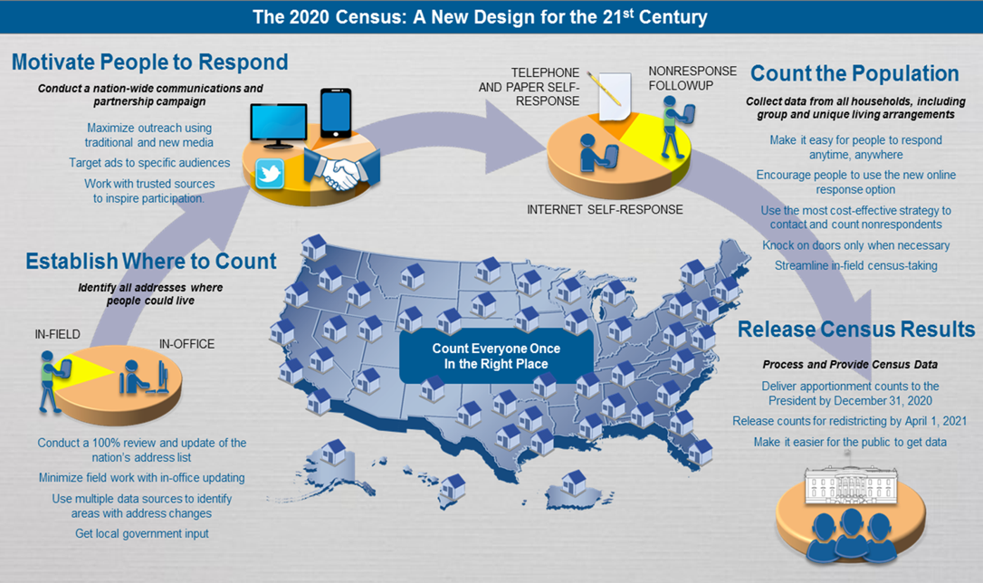

Slide 22
Key dates of the 2020 Census
Operational Timeline
Early Area Census Offices (ACO) open
January 2019
Address Canvassing Starts
August 2019
Area Census Offices open
July 2019
CENSUS DAY
April 1, 2020
NRFU
May 2020
Census Bureau delivers apportionment counts
to the President
December 31, 2020
Redistricting counts are delivered to states
April 2021
Notes:
Chapter 6: 2020 Census Integrated Communications Campaign (page 16)

Slide 23
The 2020 Census Phases
Education
Awareness
Motivation
Reminder
Thank You
Local governments and community leaders throughout the nation participate in activities highlighting the message that the 2020 Census is imminent and that it is easy, important and safe to participate.
Education Phase – 2018 - 2019
Awareness Phase – January – February 2020
Motivation Phase – March – May 2020
Reminder Phase – May – July 2020
Thank You Phase – Starts July 2020
Notes:
Chapter 4: Timeline Key Communications Phases (page 11)

Slide 24
Education Phase
Education
Awareness
Motivation
Reminder
Thank You
Action Steps for now thru December 2019
Conduct CCC training for members
Develop a work plan for promoting the census and motivating participation in your community
Hold regular meetings to report on tasks, other activities, including subcommittee reports
Proceed with census awareness-building activities generated by the committee or subcommittees
Evaluate the effectiveness of CCC activities
Conduct at least one census awareness-building activity each month
Notes:
Chapter 4: Timeline Key Communications Actions (page12)

Slide 25
Awareness Phase
Education
Awareness
Motivation
Reminder
Thank You
Action steps starting January 2020
Hold regular CCC and subcommittee meetings
Finalize plans for activities surrounding responding to the census
Review task lists and subcommittee plans
Proceed with 2020 Census activities
Finalize plans for activities to encourage households to complete and respond to the census
Develop and finalize plans for motivating residents who do not participate to cooperate with census takers during nonresponse follow-up
Notes:
Chapter 4: Timeline Key Communications Actions (page 12)

Slide 26
Motivation Phases
Education
Awareness
Motivation
Reminder
Thank You
Action steps for March 2020 – April 2020
Hold weekly CCC and subcommittee meetings
Review and modify plans to promote responding to the census activities
Send a news release highlighting the 2020 Census activity schedule
Encourage households to respond accurately and expediently
Prepare to implement activities for residents who do not return their questionnaire
Census Bureau plans to provide response rate numbers starting in April. Response rates may be used to determine where more outreach is needed
Notes:
Chapter 4: Timeline Key Communications Actions (page 12)

Slide 27
Reminder & Thank You Phase
Education
Awareness
Motivation
Reminder
Thank You
Action steps for May 2020 – July 2020
Encourage every household that did not respond that they still can respond or wait for the census taker to knock on their door.
Continue to meet and review the CCC plans. Please plan to use the 2020 daily response rates that will become available to the public in April to implement your plans to encourage cooperation.
Prepare a summary report of committee activities and member feedback
Share this report with your Partnership Specialist
Celebrate the success of the 2020 Census and recognize the efforts of the CCC members
Thank your community for their support and response
Notes:
Chapter 4: Timeline Key Communications Phases (page 12)

Slide 28

The Decennial Census
The 2020 Census Environment
Constrained fiscal environment
A mobile population
Rapidly changing use of technology
The 2020 Census is being conducted in a rapidly changing environment, requiring a flexible design that takes advantages of new technologies and data sources while minimizing risk to ensure a high quality population count.
Informal, complex living arrange- ments
2020
Census
Information explosion
Increasingly diverse population
Distrust in government
Declining response rates

Slide 29

ACTIVITY
Create a Work Plan
Notes:
Chapter 5: Planning Your Work & Working Your Plan

Slide 30
Components of a CCC Work Plan
Overview
Summary of the goals and objectives of the CCC and description of the community
Committee Structure
Identify the name of the CCC
Describe the structure of the committee
Develop strategies for reaching
their objectives
Timeline
Develop broad timetable of events and activities with dates
Reporting
Include a report of subcommittee activities to the committee
Modify future activities as needed based on feedback
Thank you
Include strategies for thanking committee members, the community and others who provide support
Final Report
Prepare a final evaluation of your activities and successes to help the Census Bureau guide future committees
Notes:
Chapter 5: Planning Your Work & Working Your Plan (page 13)

Slide 31
On the Road to 2020
Identifying Hard-to-Count Areas and Populations
Your CCC work plan should utilize the local knowledge of members and data of the makeup of the community
Data tools such as Response Outreach Area Mapper (ROAM) can provide assistance to the committee to identify predicted areas of low response at the community level
Overview – Integrated Communication Campaign features:
Advertising, events, public relations and partnership activities
Objective
To surround every household in the country with credible and memorable messages
Notes:
Chapter 6: 2020 Census Integrated Communications Campaign (page 15)

Slide 32

Effective committee activities used in 2010
Public Service Announcement (PSAs)
Advertising campaign
Banner, posters, billboards, advertising on benches
Print materials
Faith-based activities
Translation of materials
Local media coverage (including social media)
Notes:
Chapter 5: Planning Your Work & Working Your Plan (page 14)
DRAFT 4.12.18

Slide 33
Engaging Generations
Generation | Silent Generation | Baby Boomer | Gen X (Baby Busters) | Millennials | Millennials (Gen Y) | iGen (Genz Z, Wii)
Birth Years | 1925-1942 | 1943-1964 | 1965-1979 | 1980-2000 | 1994-2001 | 1995-2012
Current Age | 72-93 | 54-72 | 39-53 | 18-38 | 17-24 | 6-23
Modes of Communication | In Person, (Postal) Mail | In Person, Postal, Email | Email, Text | Text, Email | Text | Text, Social Media
https://www.npr.org/2014/10/06/349316543/don-t-label-me-origins-of-generational-names-and-why-we-use-them
Notes:
Sources: https://www.npr.org/2014/10/06/349316543/don-t-label-me-origins-of-generational-names-and-why-we-use-them
“Silent Generation”: Too young to see action in World War II but too old to take part in the Summer of Love; First appeared in November 1961 Time article.
“Baby Boomers”” describes the economic boom after World War II, and later, the rise in fertility rates.
“Generation X”: First appeared in a Robert Capa photo essay on young adults coming of age after World War II. Author Douglas Coupland, 1991 book, Generation X: Tales for an Accelerated Culture, explained the letter “X” signifies his generation’s desire not to be defined.
“Millennial Generation”: Coined by historian Neil Howe and co-author William Strauss in the 1991 book Generations.
Generations are cultures.

Slide 34
ACTIVITY: What Do You Know About Your Community?
ACTIVITY: 15 Minutes. Assign a scribe/presenter to write responses.
Question 1: What are the demographics of your community? (Demographics include, education, income, age, gender, etc.)
Question 2: How do these demographics present a challenge to a successful census?
Question 3: What type of areas/populations are in your community that may be a challenge to get them to participate in the census? (some of these areas are pockets of new immigrants, low income, etc.)
Question 4: How can the CCC assist the Census Bureau in getting a complete and accurate count in hard-to-count areas?
Notes:
You can use Census Fact finder or one person’s common knowledge of their community? Try to work with other people from your community on this activity. After some presenters have shared, explain that these are the kinds of questions a Complete Count Committee would ask to start planning and strategizing on how best to get a complete and accurate count in their communities.

Slide 35
ROAM
www.census.gov/roam

Slide 36
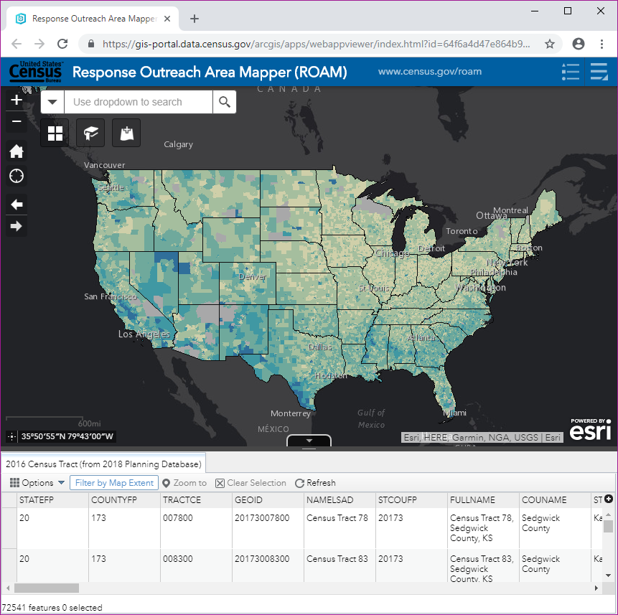
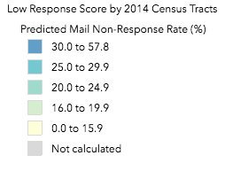
Response Outreach
Area Mapper (ROAM)
https://www.census.gov/roam
Public mapping application that displays characteristics of hard-to-count areas from the PDB
ACS 5-year estimates data
Census tract level
Notes:
Chapter 6: 2020 Census Integrated Communications Campaign (page 17)

Slide 37
Low Response Score (LRS)
Overview
LRS = predicted level of census nonresponse at the tract level
Values from 0-100
For example: If LRS= 25, we are estimating that 25% of households in that tract will not self-respond to the census
LRS Limitations/Cautions
Uses 2010 mail self-response and current ACS data – 2020 Census will offer internet, phone and mail options to self-respond
LRS are not calculated for all census tracts (-1)
How do I access the LRS?
Census Planning Database (PDB)
Response Outreach Area Mapper (ROAM) Web Application
Notes:
Chapter 6: 2020 Census Integrated Communications Campaign

Slide 38
Census Tract 0000
Name of County
Low Response Score (%): 24.0
2012-2016 ACS 5-year estimates
Total Population: 7,373
Median Household Income ($): 48,409
Population Under 5 (%): 8.91
Population 18-24 (%): 10.55
Population 65 and Over (%): 9.03
Below Poverty Level (%): 30.90
Not High School Graduate (%): 9.38
Non-Hispanic, Black (%): 30.44
Non-Hispanic, White (%): 60.94
Hispanic (%): 5.62
American Indian or Alaska Native (%): 0.00
Asian (%): 1.04
Native Hawaiian or Other Pacific Islander (%): 0.00
Some Other Race (%): 0.42
Foreign Born (%): 5.51

Slide 39
2000 vs 2010 Mail Response Rate
AL Cities/Counties | 2000 Mail Response Rate | 2010 Mail Response Rate
Alabama | 68% | 72%

Slide 40
Partnership Specialists
Role of the Partnership Specialists
Primary contact between the
U.S. Census Bureau and the CCC
Serve as advisers and information resources to CCCs
Help identify census awareness building activities that are more effective in their community
Steps Partnership Specialists will follow:
Meet with local governments in the area to encourage
the formation of CCCs
Distribute materials
Provide orientation/training for CCC leaders or Chairpersons
Provide advisory support to CCC Chairpersons
Assist CCCs in developing a strategy and work plan
When possible, attend CCC meetings, provide guidance, recommend outreach and promotional activities, and distribute promotional materials and items
Encourage the development of innovative activities geared to specific groups within the community
Maintain an open line of communication with CCCs
Notes:
Chapter 7: What to Expect From Your U.S.
Census Bureau Partnership Specialist (page 19)

Slide 41
Direct Interested Applicants for 2020 Census Positions to:
www.usajobs.gov
or
2020census.gov/jobs
for hourly jobs (paid weekly)
Toll Free Job Line
1-855-JOB-2020
(1-855-562-2020)
https://www.npr.org/2014/10/06/349316543/don-t-label-me-origins-of-generational-names-and-why-we-use-them
Notes:
Sources: https://www.npr.org/2014/10/06/349316543/don-t-label-me-origins-of-generational-names-and-why-we-use-them
“Silent Generation”: Too young to see action in World War II but too old to take part in the Summer of Love; First appeared in November 1961 Time article.
“Baby Boomers”” describes the economic boom after World War II, and later, the rise in fertility rates.
“Generation X”: First appeared in a Robert Capa photo essay on young adults coming of age after World War II. Author Douglas Coupland, 1991 book, Generation X: Tales for an Accelerated Culture, explained the letter “X” signifies his generation’s desire not to be defined.
“Millennial Generation”: Coined by historian Neil Howe and co-author William Strauss in the 1991 book Generations.
Generations are cultures.

Slide 42
  William Scott
  Partnership Specialist
  Atlanta Regional Census Center
  U. S. Census Bureau
  Contact Number: (251) 751-6533‬‬
  Email: william.c.scott@2020census.gov
  Connect with us on Social Media
  For more information visit: www.census.gov
Question and Answer Session

