Slide 1
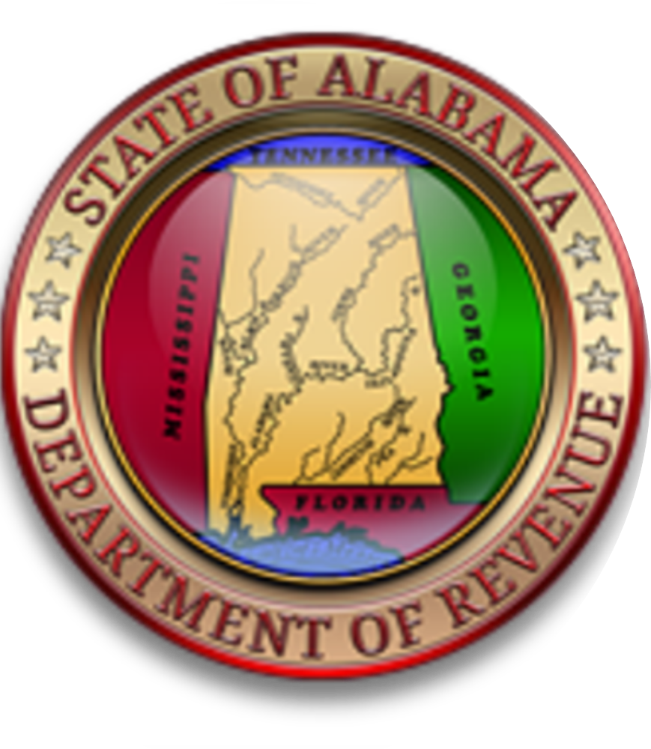
Alabama Department of revenue
Wholesale to Retail Accountability Program
August 2019

Slide 2
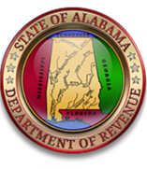
WRAP Law
Act 2017-294, codified Code of Alabama 1975, §40-23-260, established the wholesale retail accountability program, requires new information be provided to the Alabama Department of Revenue in five areas:
1099k Information – requires payment settlement entities to report credit card transactions to the ADOR
This information is reported to the IRS annually
Beer And Wine Distributors – report sales
Tobacco Distributors – report sales
Municipal Business Privilege License - report each application completed
Due October 1, 2019
Counties are currently reporting this data
Make WRAP data available to local governments

Slide 3
WRAP Program
ADOR has implemented a two-prong approach:
WRAP Inquiry Letters –
When the analysis of the WRAP Data shows that reported sales are less than purchases for a specific period, an inquiry letter is sent to the taxpayer. The inquiry letter provides the total purchases for the period, reported sales and calculates the amount of sales tax potentially underpaid. A standard computed markup is applied to the total purchases and then compared to the sales reported on the sales tax return. The inquiry letter allows the taxpayer 30 days to contact the Department to correct any discrepancies.
WRAP Audit Leads –
The most egregious taxpayers from the analysis of the WRAP Data will be distributed to District Offices all over the State of Alabama for audit.
The goal is to change the behavior of non-compliant taxpayers.

Slide 4
Before WRAP
Sales tax returns were filed showing:
Before the WRAP program, verification required an audit of each taxpayer
There are 59,285 active sales tax accounts
There are 103 Sales tax auditors
86 instate auditors, located throughout Alabama in the 9 Taxpayer Service Centers
Auburn/Opelika, Shoals, Montgomery, Mobile, Dothan, Gadsden, Huntsville, Tuscaloosa, and Jefferson/Shelby
17 Foreign Auditors, located in Alabama (7), Georgia (4), Tennessee (2), New York, North Carolina, Mississippi, and Florida.
Gross Sales
(less)Deductions
= Taxable Measure

Slide 5
After WRAP -
With the implementation of WRAP,
ADOR can now conduct an analysis of the tobacco, beer, and wine purchases from WRAP along with the liquor purchases from ABC.
These purchases are compared to the sales reported on the sales tax returns. ADOR can then identify taxpayers who are grossly underreporting sales and sales taxes based on these purchases.

Slide 6
How Alabama Prepared for the WRAP Law:
The MyAlabamaTaxes (MAT) filing system has been upgraded
includes the separate monthly returns for tobacco and beer and wine data
WRAP training has been conducted for all revenue examiner’s (field auditors)
ABC licenses and Alabama sales tax account numbers have been cross referenced
Corrections have been made and emailed to distributors
A special WRAP unit has been created
Consisting of a manager, an administrative assistant, five revenue examiners and three accounting technicians

Slide 7
What WRAP means to Alabama
More effective administration of the Sales Tax Laws
The WRAP program is a two pronged approach
For the most egregious a referral to the Field Section, both Sales and Tobacco Tax, is made
For the others, a WRAP inquiry letter is mailed

Slide 8
WRAP Inquiry Process
Lead established using the Discovery
Based on three full months of returns for each quarter (no letters mailed to taxpayers that only file two of the required three returns for the respective quarter)
Inquiry letter – taxpayer given 30 days to respond
Billing letter – taxpayer given 30 days to respond
Preliminary Collections – Collection Services Division given 30 days to make a courtesy contact with the taxpayer
Prints and hand delivers a copy of the WRAP Billing Letter
Most of these taxpayers have a preexisting relationship with the Collection Services Division agent
Preliminary Assessment entered – taxpayer given 30 days to respond
Final Assessment entered – taxpayer given 30 days to respond
File forwarded to the Collection Services Division for normal collection processes
Including, garnishment, refund interception, liens, etc

Slide 9
Problem Areas – Distributors
Wrong account numbers
FEIN in lieu of Alabama Sales Tax Account Number
Same ABC license for multiple locations
Invalid account numbers
Incorrect addresses and zip code
Using descriptive locations not the actual location address
Distributors not reporting all of the wholesale transactions

Slide 10
Problem Areas – Taxpayers/Retailers
Using prior owners account and license information when making purchases
Renewing ABC license under prior owners name
During the transfer of an existing ABC license, there should be a signed agreement between the parties
Per the ABC board, the original license holder is responsible for all of the alcohol purchased during this time frame (normally 60 days)
Retailers without a valid sales tax account number

Slide 11
Additional tidbits
Currently, we have vendors/distributors that voluntarily report all of their sales (including groceries and non alcoholic purchases)
These sales are used by the Field Audit Section as an audit tool
The Alabama Beverage Control Board requires licensed retailers to maintain on premise 12 months of purchase invoices. The retailer should also have available three years worth of purchase information upon request.

Slide 12
Stories of success
To date there has been over 298 field audits conducted with an assessed total of over $22,000,000.00
With $1,505,651.50 in audits collected
These audits were based on purchases of beer, wine and tobacco exceeding the reported sales
In addition, there has been over 1,268 inquiry letters mailed
Of those letters mailed, 376 have made remittance of $882,903.06
The ultimate goal is to correct taxpayer behavior
It’s easier to collect a small amount verses a larger audit amount

Slide 13
How can I get more information on wrap?
Additional information can be found by following the link below:
(please note this information will be updated periodically)
Https://revenue.Alabama.Gov/sales-use/wrap/

Slide 14
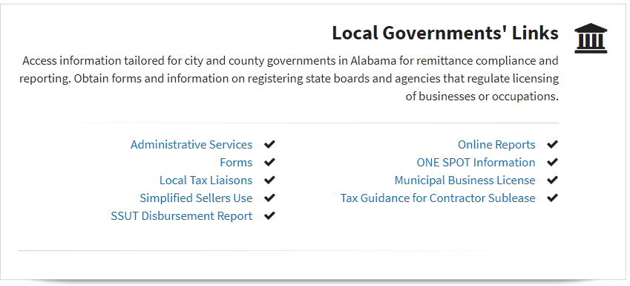
As a local official, how can I access wholesaler data?
Using The Local Governments’ Link On The ADOR’s Website:
Log In
Click On “Online Reports”
Click On “WRAP Reports”
WRAP Beer And Wine Sales Resale Report
WRAP Tobacco Sales For Resale Report

Slide 15
Municipal Business Privilege Licenses
Beginning October 1, 2019, information on municipal business privilege license applications is to be submitted to the Department of Revenue electronically
Two separate formats available for use
Comma separated value - .Csv
Fixed length record - .Txt
If these formats are not usable, a template can be used to manually create the file
A updated notice was mailed on June 14, 2019 detailing the information above
https://revenue.alabama.gov/sales-use/local-government-forms/#munlicrpt

Slide 16
WRAP Unit contact information
WRAP Contact #: | 334-353-0440
WRAP Email: | wrap@revenue.alabama.gov
WRAP Personnel:
Shirley Aiken, Examiner
Bill Crownover, Examiner
Tina Miller, Examiner
Leslie Rollins, Examiner
Tommie Johnson, State Intern
Brenda Champlin, Accounting Technician
Amy Jordan, Accounting Technician
Kayla Montgomery, Administrative Assistant
Lori Price, Manager
WRAP Unit
334-353-7868
lori.price@revenue.alabama.gov
Lee Ann Rouse, Manager
Special Projects Unit
334-353-8411
Leeann.Rouse@revenue.Alabama.Gov

